Slide 1
Cleaning and Sanitizing for Homebrewers
Vern Tegger
Silicon Valley Sudzers
April 5, 2013

Slide 4
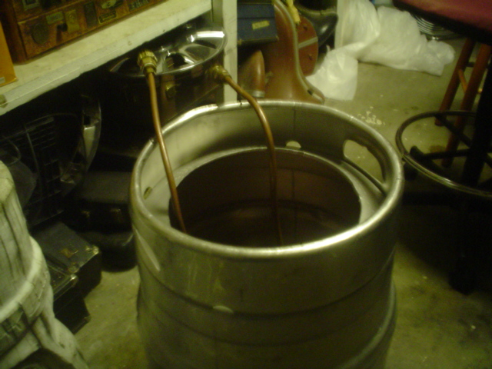

Slide 5
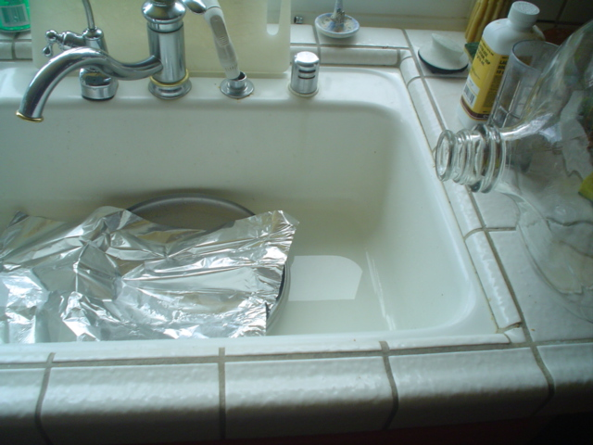

Slide 6
