Slide 1
Intermediate Homebrewing
Palo Alto City Library, June 19, 2014
Andrew Carroll, Doug Weitz, and Derek Wolfgram
(with special thanks to Mike Conant and Justin Vincent)

Slide 2
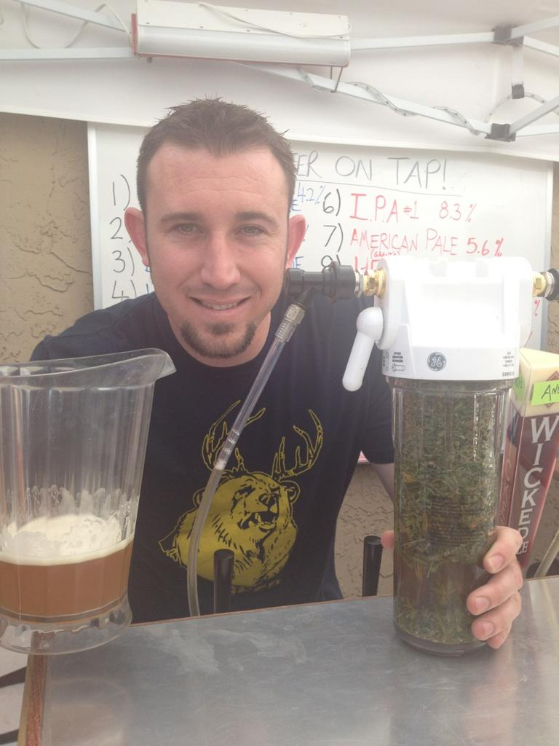
Andrew Carroll
has been homebrewing for close to five years now, and in that time has managed to brew almost 100 batches. Mild-mannered construction worker by day and beer enthusiast by night, Andy is continually trying to spread the good word of brewing and drinking better beer. He is currently President of The Headquarters homebrew club in Campbell, CA established January, 2012.

Slide 3
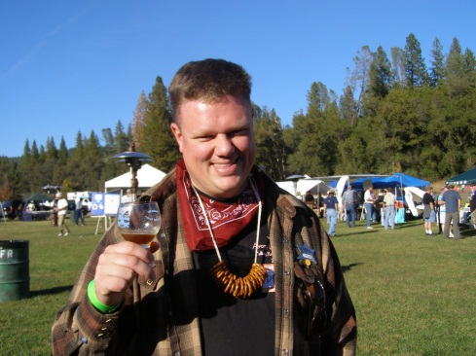
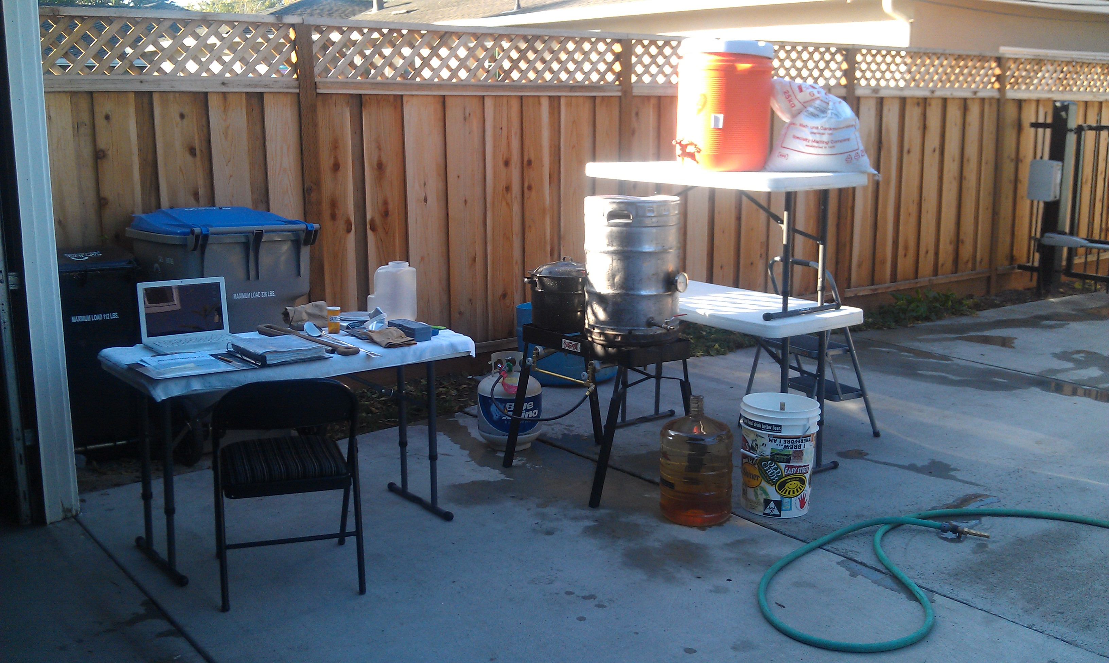
Derek Wolfgram
Derek Wolfgram has been a librarian since 1996, and a homebrewer since 2001. This program is his opportunity to bring those two passions together. Library-wise, Derek is Deputy County Librarian of the Santa Clara County Library District. Homebrew-wise, he is Past President and Secretary of the Silicon Valley Sudzers homebrew club and was the 2010 club Brewer of the Year, primarily for making plenty of coconut porter.

Slide 4
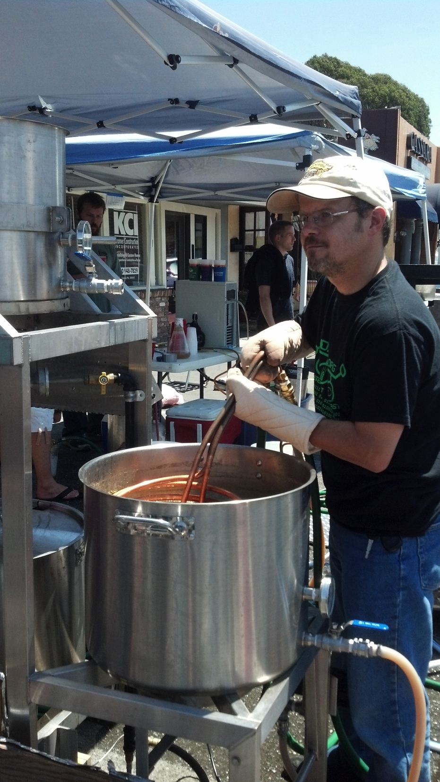
Doug Weitz
With a degree in chemistry and over 20 years as a software consultant, Doug brings his passion for elegance and process development from the software world into the beer world, carefully crafting excellent Belgian brews (among others). Doug is a past president of the Silicon Valley Sudzers.

Slide 5
Primary Components of Beer
Water
Malted Barley
Hops
Yeast

Slide 6
Water
Is the main ingredient in beer
Contains a variety of chemicals that vary by water source - precipitation, surface water, groundwater
Impacts beer process and flavor
Can make the difference between good beer and great beer

Slide 7
Key Topics - Water
Removing chlorine and chloramines
Managing water profiles
Water profiles for beer styles
Important ions for brewing
Brewing adjuncts to adjust ion concentrations
Water calculators
pH, alkalinity, and hardness

Slide 8
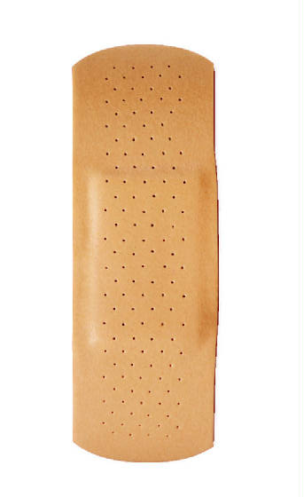
Removing Chlorine and Chloramine
Used to disinfect tap water for public health
Can react with phenols to produce chlorophenols → “band aid beer”
Chlorine can be removed through carbon filtering, UV light photolysis, boiling, or letting water sit
Chloramine needs to be broken down chemically with campden tablets (which also remove chlorine)

Slide 9
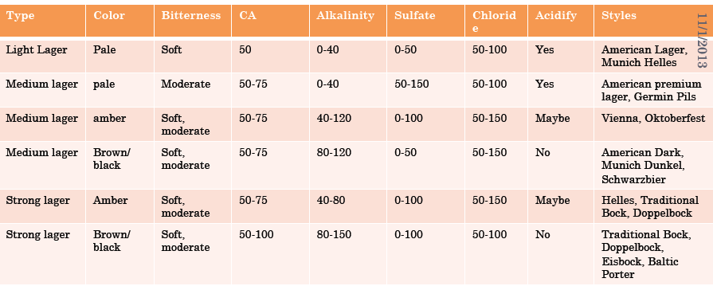
Water Profiles for Lager Styles
Source: Water: A Comprehensive Guide for Brewers by John Palmer and Colin Kaminski.©2013 Brewers Publications, pp. 156-157.

Slide 10
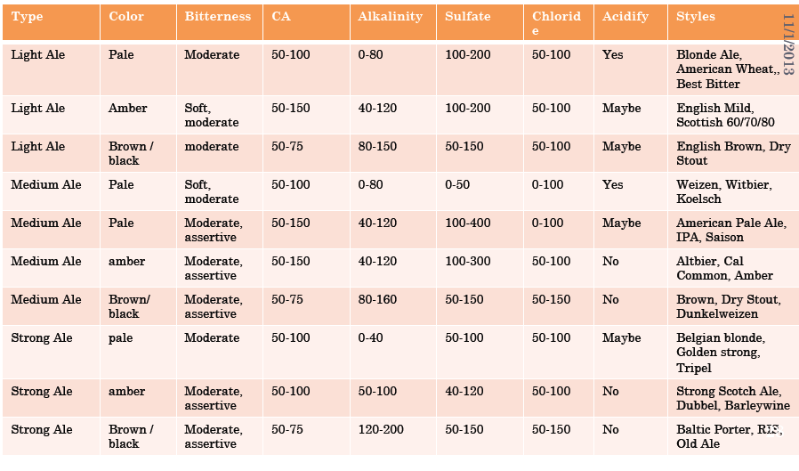
Water Profiles for Ale Styles
Source: Water: A Comprehensive Guide for Brewers by John Palmer and Colin Kaminski.©2013 Brewers Publications, pp. 158-159.

Slide 11
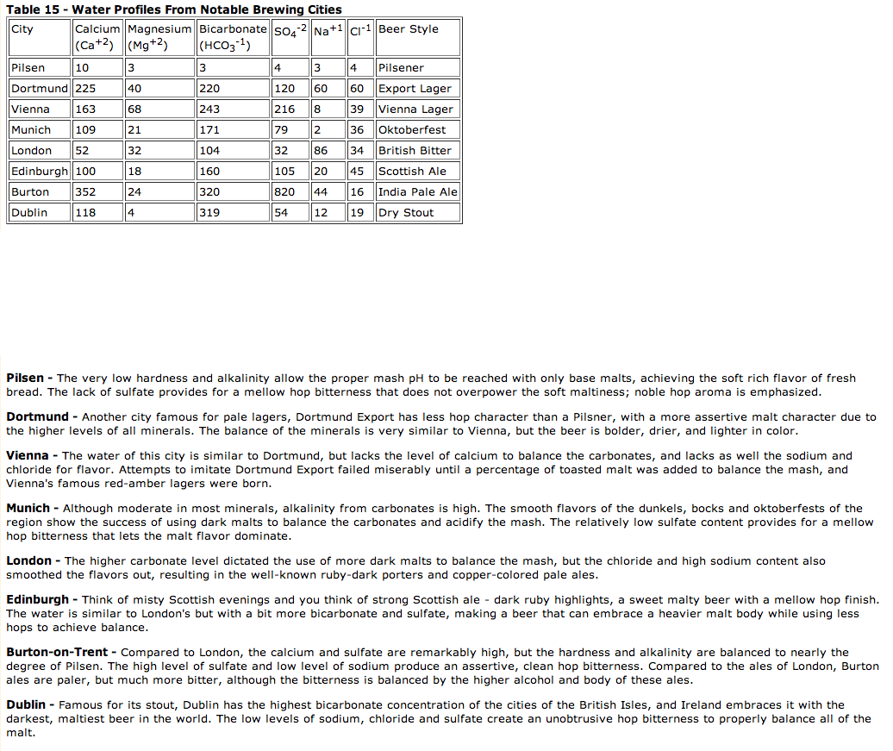
Source:
http://howtobrew.com/section3/chapter15-2.html
Palo Alto 13 5 60 17 12 10

Slide 12
Palo Alto Water
Comes from San Francisco Public Utilities Commission
85% Hetch Hetchy, 15% groundwater from San Mateo and Alameda counties
Other alternatives: distilled water, RO water, filtering, blending

Slide 13
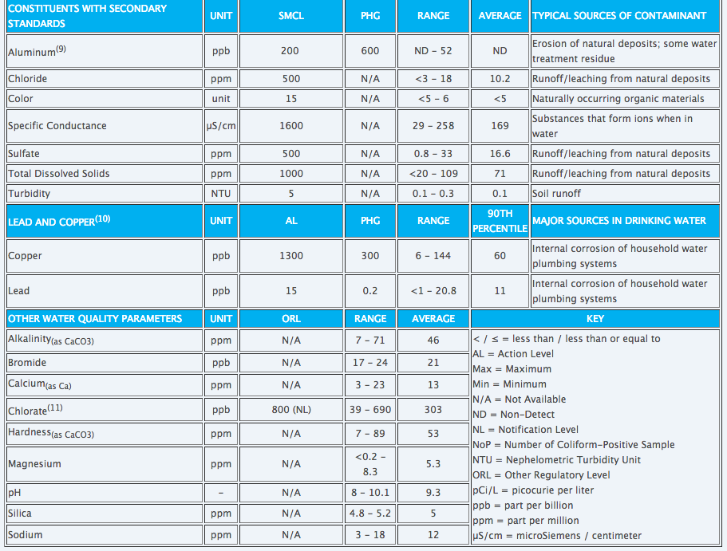
Palo Alto Water
Source: http://sfwater.org/index.aspx?page=634

Slide 14
Important Ions for Brewing
Calcium
Magnesium
Sodium
Sulfate
Chloride (different from Chlorine!)
Concentrations can be increased by adding salts, or decreased by adding distilled or RO water

Slide 15
Calcium (CA⁺⁺)
Protects enzymes from thermal degradation, extends activity in mash
Improves trub formation during boil
Decreases pH during mashing and boil
40 ppm minimum
Sources: calcium chloride, gypsum, chalk

Slide 16
Magnesium (Mg⁺⁺)
Magnesium salts are much more soluble than those of calcium.
Less effect on wort pH
Only add if desired to enhance bitterness
30 ppm maximum
Source: epsom salt

Slide 17
Sodium (Na⁺)
At low concentrations (<100 ppm), sodium gives a slightly sweet flavor to beer.
But > 100 ppm, sodium gives a salty flavor.
100 ppm maximum
50 ppm maximum for dry, crisp beers
Sources: table salt, baking soda

Slide 18
Sulfate (SO₄²⁻) & Chloride (Cl⁻)
Chloride increases palate fullness and gives a mellow flavor to beer.
Sulfate results in drier, more bitter flavors in beer.
Sulfate can be a source of SO₂ and H₂S formed during fermentation that may give the beer a sulfury note (especially in “Burton” beers).
Sulfate to Chloride ratio is generally used to target beer flavor profiles. A high ratio accentuates bitterness; a low ratio, sweetness
2:1 Sulfate to Chloride => great for Pale Ales, IPAs
1:1 Sulfate to Chloride => Balanced beers
1:2 Sulfate to Chloride => Malty beers
Maximum concentrations
Chloride below 100 ppm
Sulfate below 150 ppm generally, higher can work (up to 350 ppm) in highly hopped beers
Sources:
Sulfate: gypsum, epsom salt
Chloride: table salt, calcium chloride

Slide 19
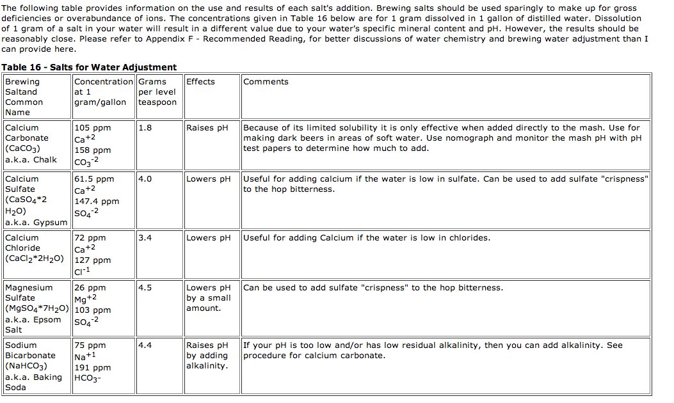
Brewing Salts
Source: http://www.howtobrew.com/section3/chapter15-4.html

Slide 20
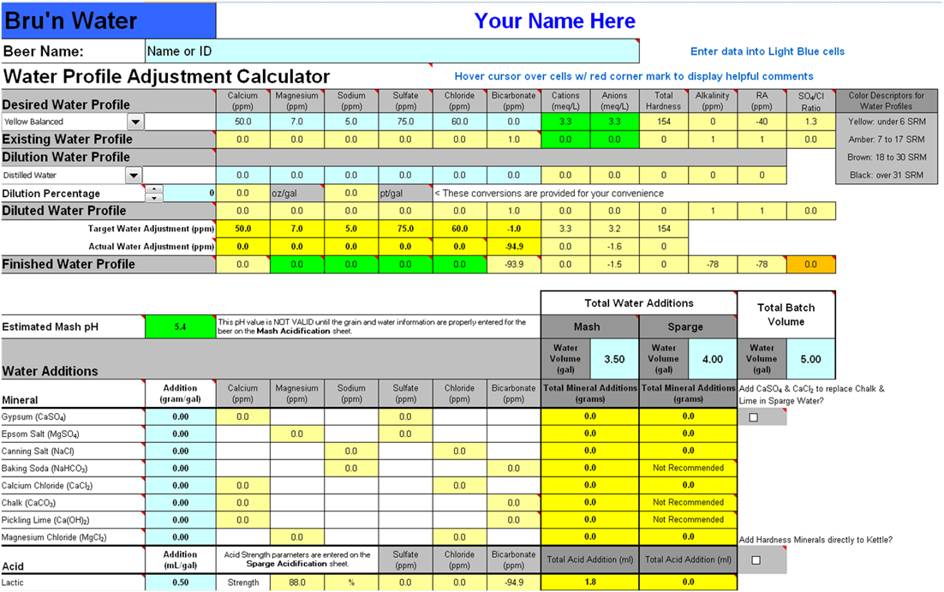
Water Calculators
Highly recommend Bru’N Water: https://sites.google.com/site/brunwater/

Slide 21
pH and Brewing
pH measures the acidity or basic nature of a solution (1=acidic, 14=basic)
RO/Distilled water pH is 7.0
Municipal water pH is 6.5-9
Target pH for mashing is between 5.2 (light beers) and 5.6 (dark beers) – this is the range where enzymatic activity takes places to convert starches to sugars
In addition to water and brewing salt additives, grains also contribute acidity to the mash
Sparge water pH should be <6.0 to prevent tannin extraction

Slide 22
Water Hardness
Concentration of calcium and magnesium in water
Permanent hardness: Calcium or Magnesium paired with Sulfates or Chlorides - cannot be boiled off
Temporary Hardness: Calcium or Magnesium paired with Carbonate/Bicarbonate - can be boiled off (bi/carbonate leaves as CO2, calcium stays behind). Temporary hardness contributes to alkalinity, and buffers pH changes from salts or acids.

Slide 23
Alkalinity
Alkalinity (typically from carbonate and bicarbonate) impacts mash pH: buffering capacity of solution determines degree to which bases can be neutralized
Reduce alkalinity by boiling, adding dark grains, using acidulated malt, or adding acids
Raise alkalinity with sodium bicarbonate or pickling lime
Residual alkalinity (RA) = remaining alkalinity after acid from malts reacts with water hardness in mash. While RA can help predict pH, using a water calculator and pH meter is far more reliable.

Slide 24
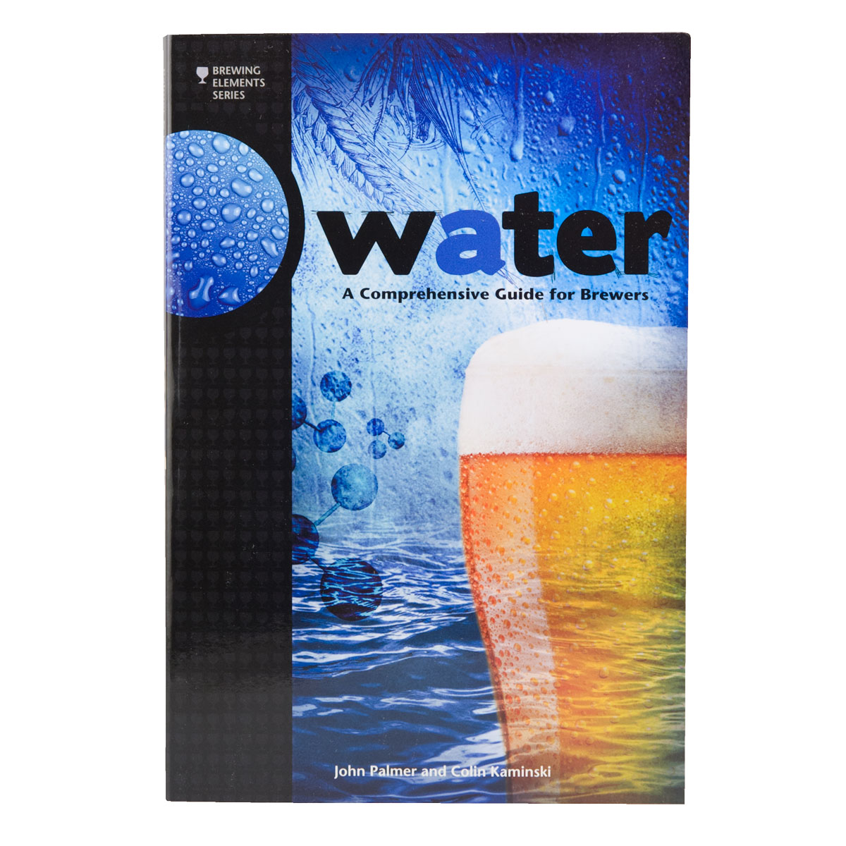
For More Information

Slide 25
The Mash

Slide 26
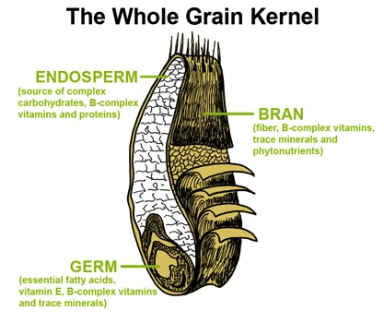
What’s in a kernel of grain?
Protein
Starch
Vitamins
Trace Minerals
Other Compounds

Slide 27
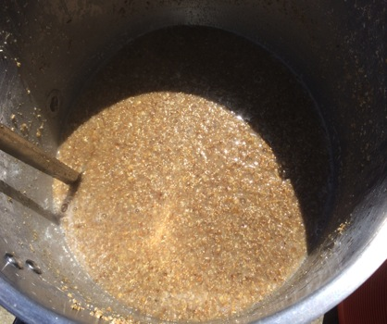
What is Mashing?
Hot water steeping process
Hydrates the barley
Activates the malt enzymes
Converts grain starches into fermentable sugars

Slide 28
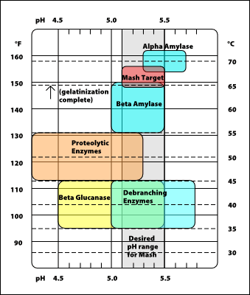
How Does It Work?
http://www.howtobrew.com/section3/chapter14-1.html

Slide 29
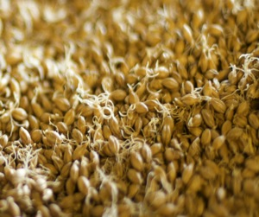
What Does Highly Modified Mean?
Modification is a result of the malting process
(Nothing to do with GMO)
A simple measure is the length of the developing acrospire before kilning

Slide 30
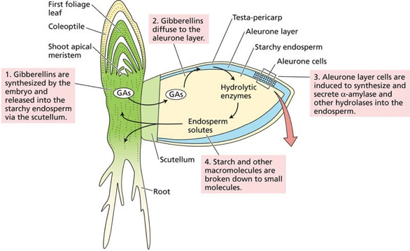
What Does Highly Modified Mean?
Modification is a result of the malting process
(Nothing to do with GMO)
A simple measure is the length of the developing acrospire before kilning
“The germinated grains, which show a well-developed root and have a shoot (termed an “acrospire”), which is approximately 75% of the length of the grain, are then kilned.”
http://5e.plantphys.net/article.php?id=372

Slide 31
What Does Highly Modified Mean?
“One indicator of the degree of modification of a grain is that grain's Nitrogen ratio; that is, the amount of soluble Nitrogen (or protein) in a grain vs. the total amount of Nitrogen(or protein).
This number is also referred to as the "Kolbach Index" and a malt with a Kolbach index between 36% and 42% is considered a malt that is highly modified and suitable for single infusion mashing.
Maltsters use the length of the acrospire vs. the length of the grain to determine when the appropriate degree of modification has been reached before drying or kilning.”

Slide 32
The Big Show!!!!
Starch Conversion

Slide 33
The Big Show!!!!
Starch Conversion
The major starch components of malted barley are Amylose and Amylopectin
http://homebrewmanual.com/mash-temperatures/

Slide 34
B-Amylase
http://homebrewmanual.com/mash-temperatures/
B-Amylase works at the lower end of the saccharification range (usually favored in single infusion mashes from 145-150˚F).
It produces maltose, a simple 2-glucose chain, that is highly fermentable.

Slide 35
A-Amylase
http://homebrewmanual.com/mash-temperatures/
A-Amylase works at the higher end of the saccharification range (usually favored in single infusion mashes from 154-160˚F).
It produces many sugars of varying composition, including maltose.

Slide 36
References
Palmer, J., How To Brew, Defenestrative Publishing, Monrovia, CA, 2002 http://www.howtobrew.com
Noonan, G., New Brewing Lager Beer, Brewers Publications, Boulder, CO, 1996.
http://www.brewwiki.com
http://www.homebrewmanual.com/mash-temperatures/

Slide 37
Hops!

Slide 38
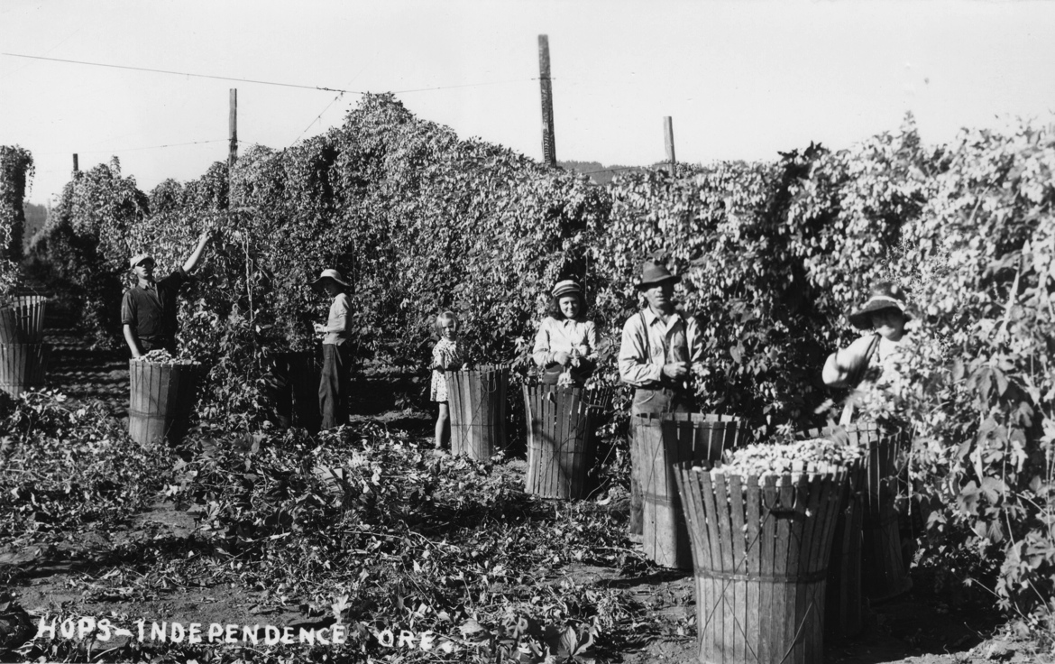
History of Hops

Slide 39
Hop Varieties & Growing Regions
VARIETY | ACID RANGE (ALPHA %) | FLAVOR PERCEPTION | COMMERCIAL EXAMPLE
Amarillo® | 8-10% | A flowery, citrus-like aroma with medium bittering value that is gaining acceptance as a substitute for Cascade due to its hardy nature. | Ales, IPAs
Cascade | 4-7% | Flowers, citrus & spice with grapefruit the noticeable fragrance quite often. This medium aroma balances the low bittering value. Very popular hop among craft brewers. | Pale Ales, IPAs, Porters
Centennial | 8-11% | Flowers & citrus most evident. A medium aroma with mid to high bittering value makes it a dual purpose choice. | Ales, IPAs
Chinook | 11-13% | A pine forest washed with exotic spice and infused with grapefruit. This alluring aroma and a high bittering value has gained this hop full respect from craft & major brewers. | Most beer styles from Pale Ales to Lagers
Columbus | 14-17% | High on the bittering scale yet also valued for its oil content creates a hop that is an interesting dichotomy of sharp and herbal. | American IPAs & Pale Ales, Stout, Lager
Crystal | 3-5% | Genteel, continental lady meets American belle with a delicate blend of spices and flowers. Low bittering value adds to the charm. Craft brewers love her style. | German-style Pilsner, Lager, Kölsch, ESB, Belgian Ales
Fuggle | 4.0-5.5% | Classic English aroma hop with moderate bittering value. Pleasant wood and fruit tones will have you heading off to the hunt. | English-style beers (particularly Stout), American Ales
Hallertau | 5-6% | Named for its origins in the Hallertauer region of Germany, this is a noble aroma hop with ever-so-subtle flower and spice fragrances defining its “über alles” superiority. Very low bittering value. | Pilsner, Bock, Lager, Wheat
Kent Golding | 3-5% | The refined older English gentleman with his flowery tones that have produced some of England’s best bitters. | All English-style beers (Ales, ESB, Bitter), Belgian-style Ales
Liberty | 2-6% | American cousin to Hallertau with very similar flower and spice characteristics. Best used as a finishing hop in German-style lagers. | Lager, Pilsner, Bock, Kölsch
Magnum | 12-17% | A German thoroughbred with limited Pacific Northwest plantings. Prized for its high bittering value, the aromatic nature is one of spice and citrus. | Pale Ales, IPAs, German-style Lager
Mt. Hood | 4-5% | Hybrid of Hallertau with similar mild flower/spice aroma characteristics with a hint more of the forest. “Clean” commonly describes it. | Lager, Pilsner, Bock, Wheat

Slide 40
Hop Varieties (continued)
VARIETY | ACID RANGE (ALPHA %) | FLAVOR PERCEPTION | COMMERCIAL EXAMPLE
Northern Brewer | 7-11% | A plucky American filly found herself an affable English suitor and the happy union was this well-adapted hop with its neutral, clean aroma and slightly higher-than-average bittering value. Dual purpose. | English-style Ales, ESB, Bitter, Porter
Nugget | 11-16% | Strong herbal/slight spice aroma and high bittering value (along with desirable growing traits) has brought this hop variety to the forefront of the industry. | All Ales, Stout
Perle | 7-8% | A palate-pleaser with its moderate, clean bittering qualities and refreshing, spicy aroma. | A wide range from Pale Ale to Lager to Stout
Saaz | 3-5% | The Old World steadfast standby made famous by Pilsner Urquell possesses the aromatic blend of earth and spice notable in European nobles. Low bittering value. | Pilsner, Lager, Wheat, Belgian-style Ales
Simcoe® | 12-14% | A hop variety less than 10 years old that is quickly finding its way into the hearts of bitter-loving craft brewers. Intense pine aroma adds to the fresh, youthful vigor. Dual purpose but generally considered a bittering hop. | American Ales, IPAs, Double IPAs
Sorachi Ace | 13-16% | A Japanese winner by all counts with its powerful lemon aroma, high bittering value and flavorful personality. | American Ales, Pale Ales, Wheat
Sterling | 6-9% | Herbs and spices dominate, flowers and citrus around the fringes. Moderate bittering values with a mix of Saaz and Mt. Hood properties. | Ale, Pilsner, Lager
Summit (Dwarf) | 17.5–19.5% | Quite new on the scene (2003) but the consensus is very positive with its “peak” bittering value coupled with robust citrus notes of orange, tangerine and grapefruit. Receiving accolades as an ideal hop for the ultimate Pale Ale. | Drifter Pale Ale, Widmer Brothers
Warrior | 14.5- 17.0% | Its high bittering value and very mild aroma offers new dimensions to IPA & Double IPA brewers. | Three Floyd’s Dogfish Head IPA
Willamette | 4-6% | The king of aroma hops in the U.S. with its modest bittering value and the joyous harmony of flowers, fruit, earth and spice. | American Pale and Brown Ales, English-style Ales
Adapted from http://www.freshops.com/hops/variety_descriptions

Slide 41
Show and Smell
https://www.flickr.com/photos/hotelcoffee/4933976304/

Slide 42
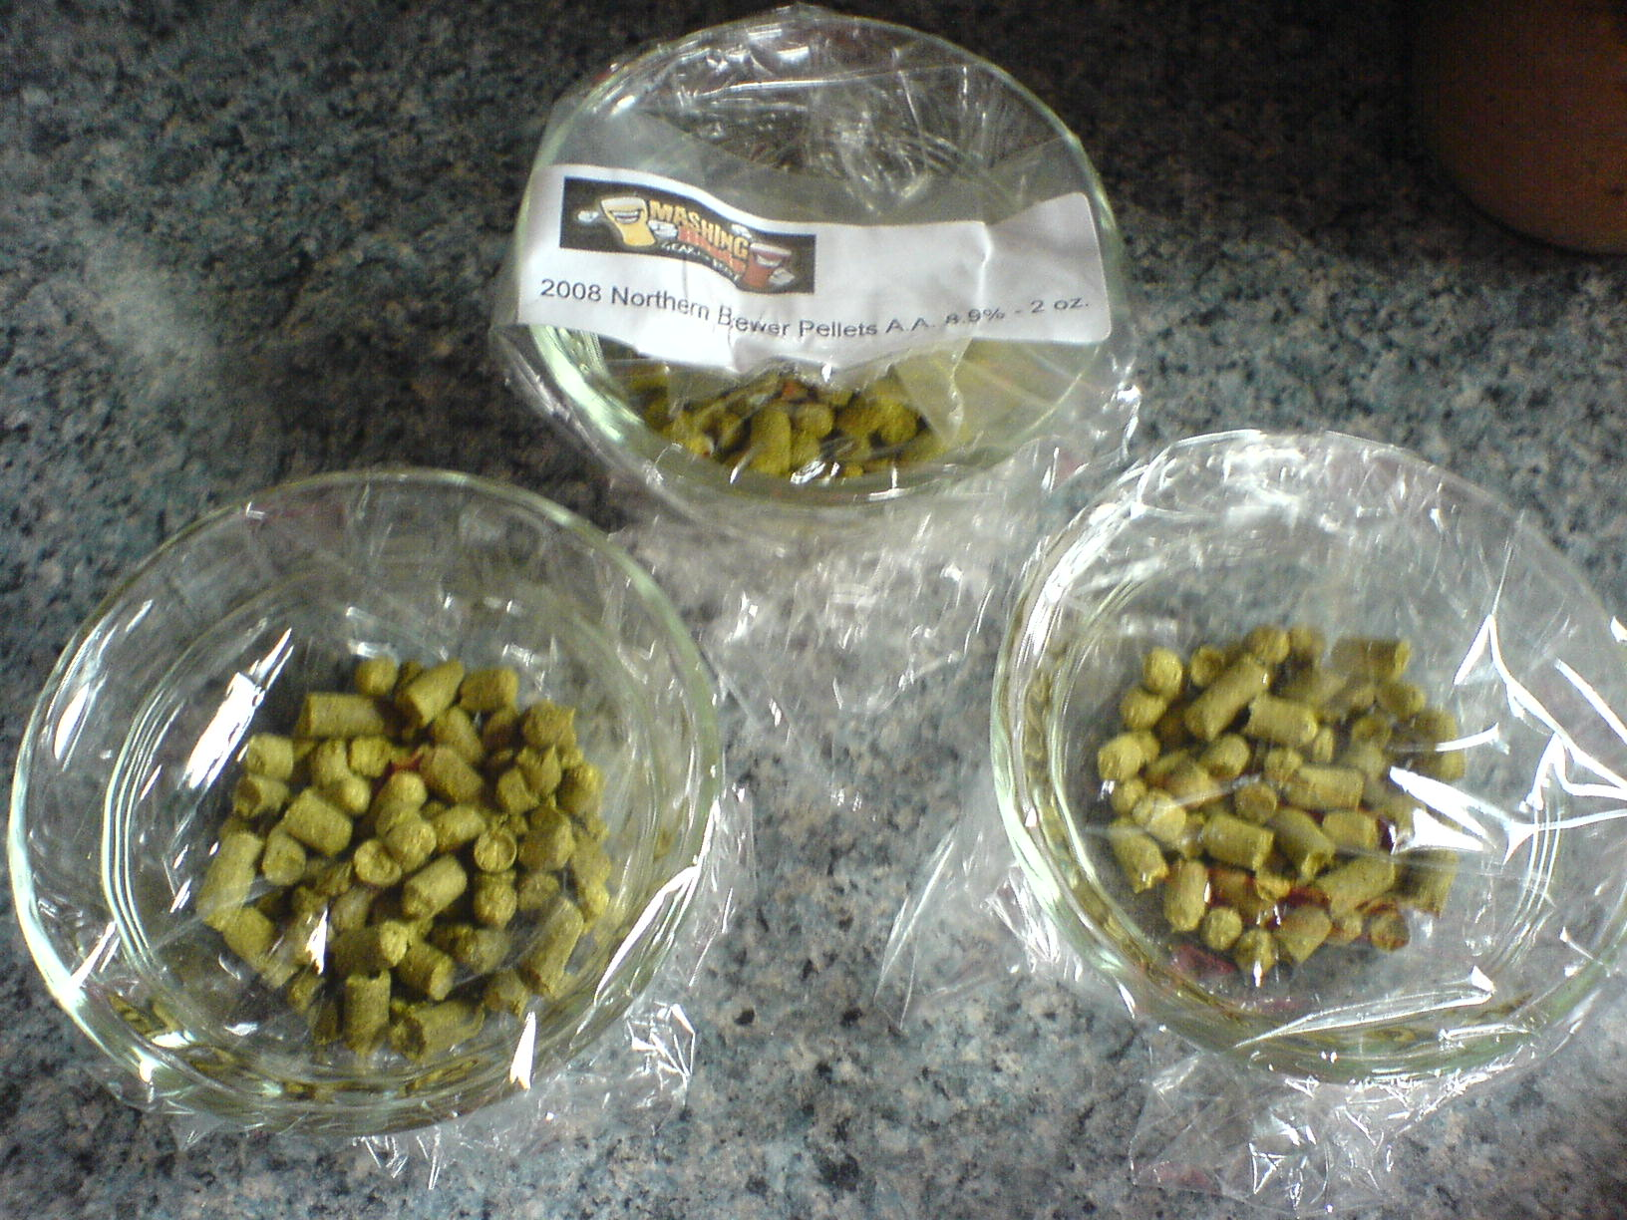
Forms of Hops
https://www.flickr.com/photos/zanateh/3855420197/

Slide 43
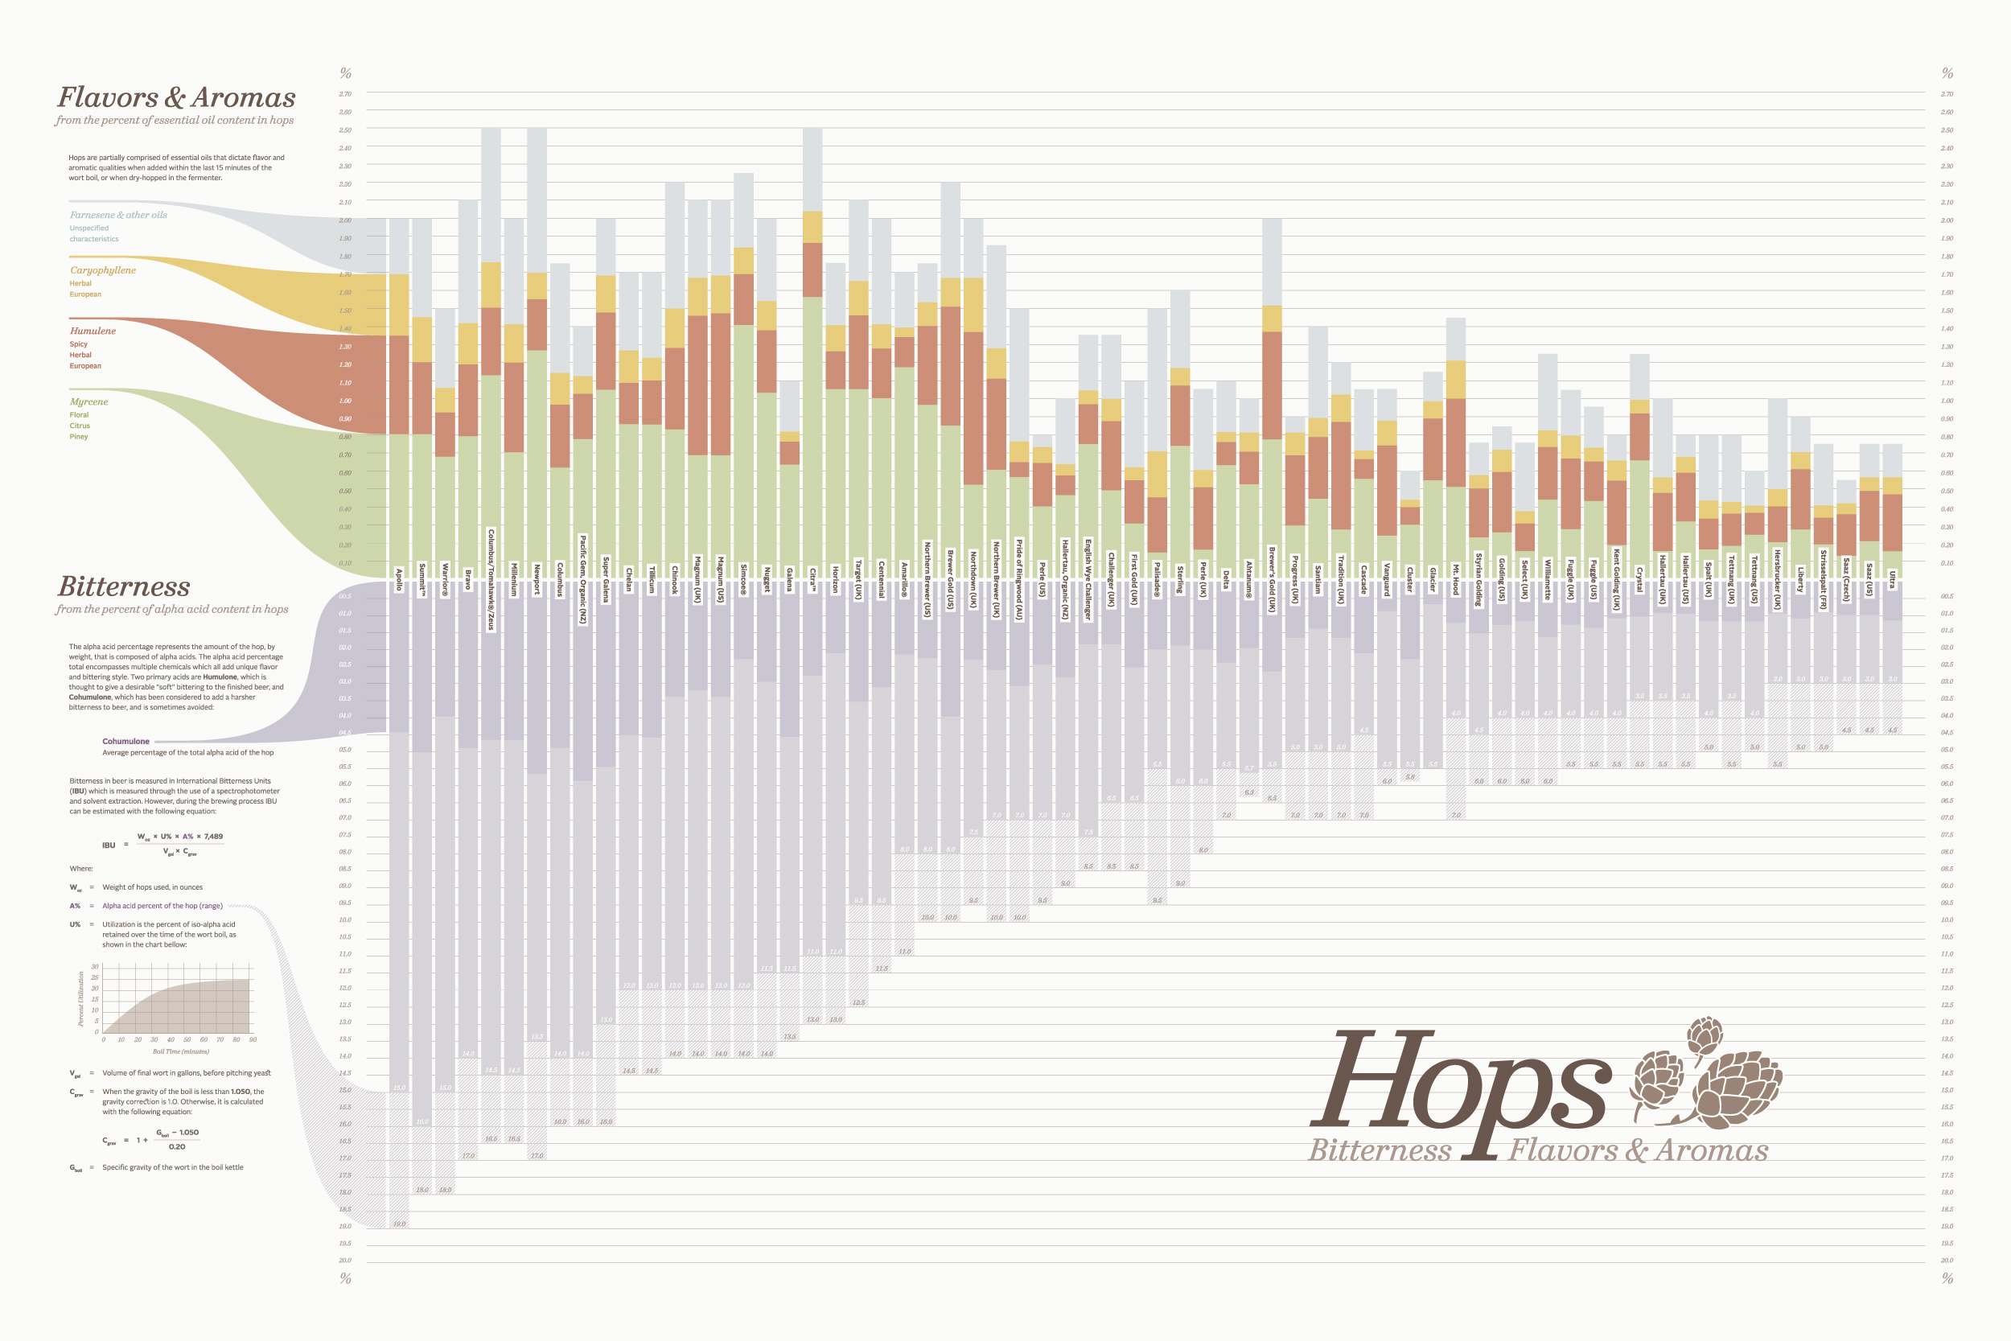
What Brewers Are Interested In
http://hopschart.com/images/hopschart_render.jpg

Slide 44
Hop Flavor Combinations
Homebrew recipe ingredients list for Pliny the Elder
Ingredients for 6.0 gallons (22.7 L) [Net: 5 gallons (18.9 L) after hop loss]
13.25 lb (6.01 kg) Two-Row pale malt
0.6 lb (272 g) Crystal 45 malt
0.6 lb (272 g) Carapils (Dextrin) Malt
0.75 lb (340 g) Dextrose (corn) sugar
3.50 oz (99 g) Columbus* 13.90% A.A. 90 min.
0.75 oz (21 g) Columbus* 13.90% A.A. 45 min.
1.00 oz (28 g) Simcoe 12.30% A.A. 30 min.
1.00 oz (28 g) Centennial 8.00% A.A. 0 min.
2.50 oz (71 g) Simcoe 12.30% A.A. 0 min.
1.00 oz (28 g) Columbus* 13.90% A.A. Dry Hop (12 to 14 days total)
1.00 oz (28 g) Centennial 9.10% A.A. Dry Hop (12 to 14 days total)
1.00 oz (28 g) Simcoe 12.30% A.A. Dry Hop (12 to 14 days total)
0.25 oz (7 g) Columbus* 13.90% A.A. Dry Hop (5 days to go in dry hop)
0.25 oz (7 g) Centennial 9.10% A.A. Dry Hop (5 days to go in dry hop)
0.25 oz (7 g) Simcoe 12.30% A.A. Dry Hop (5 days to go in dry hop)
White Labs WLP001 California Ale Yeast or Wyeast 1056 American Ale Yeast
Recipe by Vinnie Cilurzo, Russian River Brewing. From Zymurgy, July/August 2009 issue, page 25

Slide 45
Evolution of Brewing with Hops

Slide 46
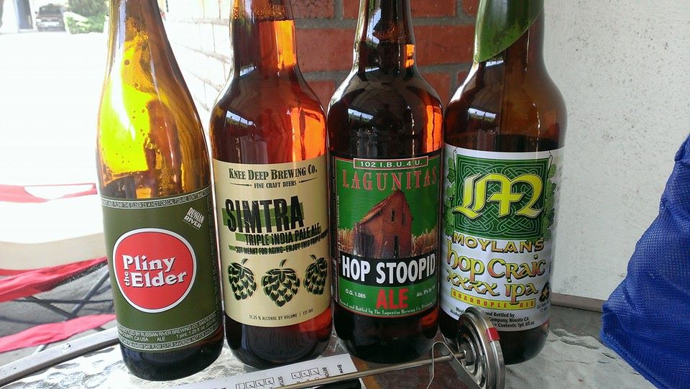
IPA... The West Coast Way

Slide 47
YEAST MANAGEMENT
Characteristics
Starters
Ranching

Slide 48
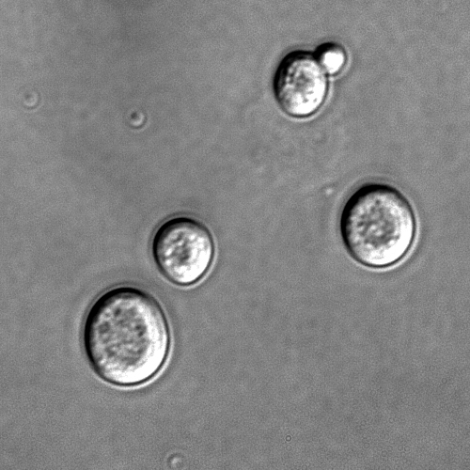
What is Yeast?
Unicellular fungi
Discovered mid 1800’s
~ 10 µm (10⁻⁶) in size
Sugar => Alcohol
Arguably the single most important “ingredient” of the beer-making process

Slide 49
Classification
genus Saccharomyces
Species | Type
S. cerevisiae | Ale
S. carlsbergenis | Lager

Slide 50
Terminology
Attenuation
Flocculation
Temperature
By-products

Slide 51
Attenuation
The extent to which yeast ferments the sugars in the wort
Category | Apparent Attenuation | Comments
Strong | 75% - 78% | All fermentable sugars are metabolized. Most lager yeasts fall into this category
Medium | 71% - 74 % | Minor fermentable sugars are not metabolized. Most ale strains fall into this category
Low | < 70% | Minor sugars and some trisaccharides are not metabolized.

Slide 52
Flocculation
How fast or how well a yeast clumps together and settles to the bottom of the fermentor after fermentation is complete
Category | Comments
Strongly sedimenting | Can sometimes settle out before fermentation is finished. Usually produce a nice clear product.
Non-flocculating | Remain in suspension for the duration of fermentation

Slide 53
Temperature
Each yeast strain performs best within a certain temperature range
What happens if the ferment temperature is higher than the recommended range?
High ester and sulfur levels
Flavor of the beer may become rough
What happens if the ferment temperature is lower than the recommended range?
Ferment will be sluggish
Yeast may become dormant, stop fermenting

Slide 54
By-Products
Ethanol
Carbon Dioxide
Esters
Diacetyl
Phenols

Slide 55
Yeast Starters
What is a starter?
A small volume of wort that yeast use as an initial step to become healthy, multiply and prepare themselves to ferment a batch of beer
What is its purpose?
To create enough clean, healthy yeast to ferment your beer under optimum conditions
Primary focus should always be yeast health first, increased cell growth second

Slide 56
How To Make A Starter
Materials
Clean, sanitized container able to hold starter (plus headspace)
Aluminum foil
Dry malt extract (DME)
Yeast nutrients
Water

Slide 57
How To Make A Starter
Process
Keep starting gravity between 1.030 and 1.040 (7 – 10ºP)
6 oz (by weight) of DME to 2 quarts of water
Mix DME and water, add nutrients (optional) and boil gently for 15 minutes
Cool
Pitch yeast
Stir plate or shake/swirl as often as possible

Slide 58
Factors That Affect Yeast Growth & Health
Nutrients (oxygen, zinc, amino acids, nitrogen)
Temperature
Sugars (maltose)
pH

Slide 59
How Big of a Starter?
(0.75 million cells/mL) * (mL of wort) * (ºP of wort)
~ 20,000 mL in 5.25 gallons
1ºP ~ 1.004 SG
1.060 SG wort
(750,000 cells/mL) * (20,000 mL of wort) * (60/4)
225,000,000 cells (double for lager)
On average, a White Labs Pitchable Yeast vial and Wyeast Activator 125XL Smack Pack contain 100,000,000 cells
In general, a two liter starter doubles the amount of yeast in a single vial or pack

Slide 60
Yeast Ranching
Cultivation
Process
Storage
How to use

Slide 61
Thank you! Cheers!
We’re happy to answer any questions
Visit www.sudzers.org/?p=1444 to download
or print a copy of this presentation
We hope to see you shortly at Steins Beer Garden, 895 Villa Street in Mountain View, for more discussion of beer and brewing

