Slide 1
Water basics
Silicon Valley Sudzers

Slide 2
What this talk is about
Why do we care about water?
Basics about flavor ions
Equipment for building water
Overview of brew day prep and process

Slide 3
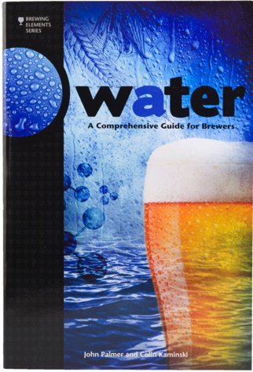
What this talk isn’t about
Mash chemistry
Reading water reports
Building from tap water
If you want to learn these topics and more, read:
Water by John Palmer and Colin Kaminski

Slide 4
Why?
Mash pH
Targeting 5.2 to 5.6
Control sparge pH
Ensure pH doesn’t go too high (astringency)
Consistency
Full control of exactly what’s in your beer
Tap water profiles change
Flavor
One of the main ingredients of beer
Minerals in water can enhance, and detract from, your beer’s flavor

Slide 5
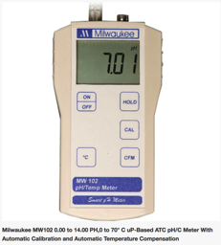
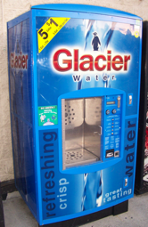
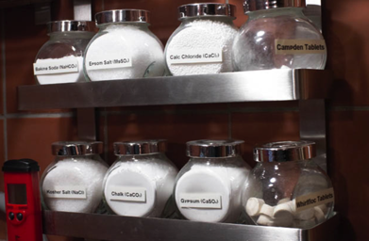
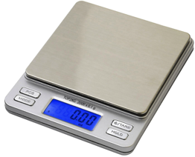
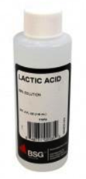
pH meter: no strips; temp correction
Water: distilled; RO, etc
Salts: (following slides) MoreBeer; Amazon, etc.
Acid: phosphoric or lactic; acidify sparge water; MoreBeer
Digital scale: 1/10 gram accuracy

Slide 6
Flavor ions
Ion | Notes
Calcium | Helps drop mash pH; Mostly flavorless (minerally at high concentrations); Promotes enzyme activity & clarity; …
Magnesium | Necessary yeast nutrient; Barley wort typically has enough; Sour/bitter at high concentrations
Sulfate | Make hop character more assertive; Defining character for Burton-upon-Trent water; Can increase “linger time” of bitterness
Chloride | Provides rounder, fuller, sweeter malt character
Sodium | Can sweeten malt character at low concentrations; Will be “salty” at high concentrations
Bicarbonate | Determines mash acidity; Low levels may result in too acidic mash (especially with high dark-malt beers); High levels may reduce efficiency
Sulfate-to-Chloride ratio: influences the hoppy-to-malty and dryness-to-fullness balance; 9 to 0.5; Sulfate 50-500ppm; Chloride 50-200ppm

Slide 7
Salts provide the ions we need
Salt & Common name | Chemical Formula | Effects | Notes
Calcium Carbonate (Chalk) | CaCO₃ | Raises pH | Limited solubility; Used typically in dark beers
Calcium Sulfate (Gypsum) | CaSO₄ | Lowers pH | Add crispness to hop bitterness
Calcium Chloride | CaCl₂ | Lowers pH | Round out malt sweetness
Magnesium Sulfate (Epsom salt) | MgSO₄ | Lowers pH by a small amount | Add crispness to hop bitterness
Sodium Bicarbonate (Baking Soda) | NaHCO₃ | Raises pH | Raises alkalinity

Slide 8
My brew day prep (day before)
Buy ingredients for recipe
Amount of grain determines amount of strike water
Typically 1.5 quarts of water per pound of grain
Get 10gal RO water from Glacier machine
Determine what water profile I want
E.g., dark balanced, yellow dry, etc.
Use Bru’n water spreadsheet to calculate amount of salts in mash and sparge
Note, we want low alkalinity in sparge water
And possibly acid (e.g., lactic) in sparge water for very light beers

Slide 9
Brew day process
Pre-mash
Heat strike water; mill grains
Weigh out salts for mash in separate beakers
Try to dissolve in water (tough with chalk)
Mash
Combine strike water, grains, and salts
Measure temp, pH at 0, 30, 60, … minutes
Heat sparge water
Measure out salts for sparge in separate beakers
Mix sparge water, salts, (optional lactic acid) in cooler
Sparge
Normal, but measure pH and Specific Gravity every 20 minutes or so (doing a slow mash)
Stop if pH gets above 5.8 or SG goes below 1.008
Top off with RO water in boil kettle if necessary

Slide 10
Sources
http://www.brewerspublications.com/books/water-a-comprehensive-guide-for-brewers/
http://howtobrew.com/book/section-3/understanding-the-mash-ph/using-salts-for-brewing-water-adjustment
https://sites.google.com/site/brunwater/
http://www.brewersfriend.com/water-chemistry/

