Slide 1
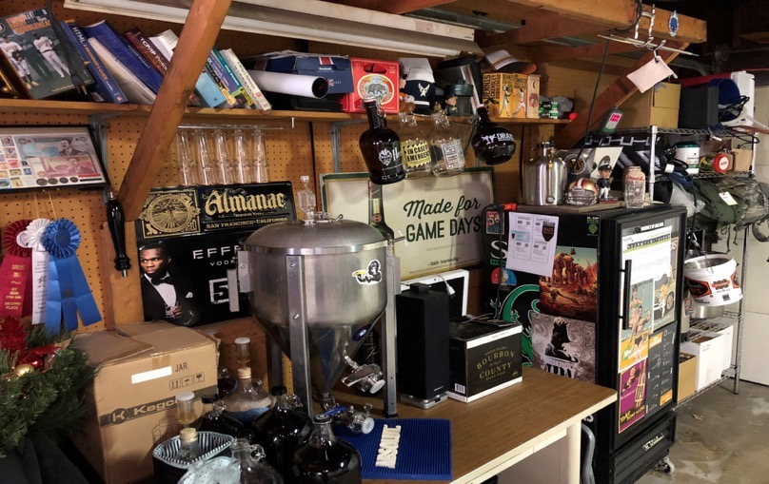
Danny’s Brew House

Slide 2
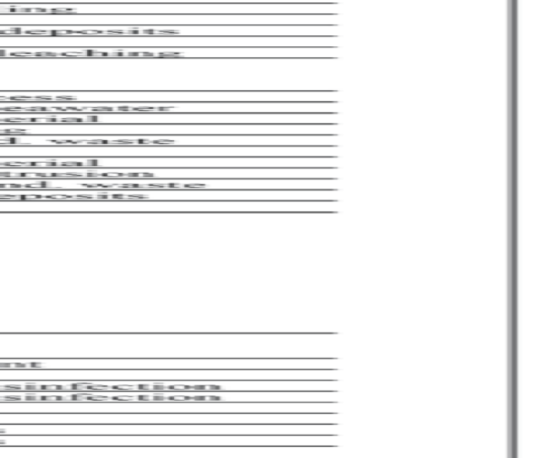
City Water
The City operates 26 wells that tap the underground aquifers and make up about 62% of the City's potable water supply.
The remaining water is supplied by water imported from the two wholesale water agencies. Sources available to the City include an extensive local underground aquifer and imported water supplies delivered by two wholesale water agencies: the Santa Clara Valley Water District (SCVWD) and the San Francisco Hetch Hetchy system.
http://santaclaraca.gov/government/departments/water-sewer-utilities/water-utility/water-quality

Slide 3
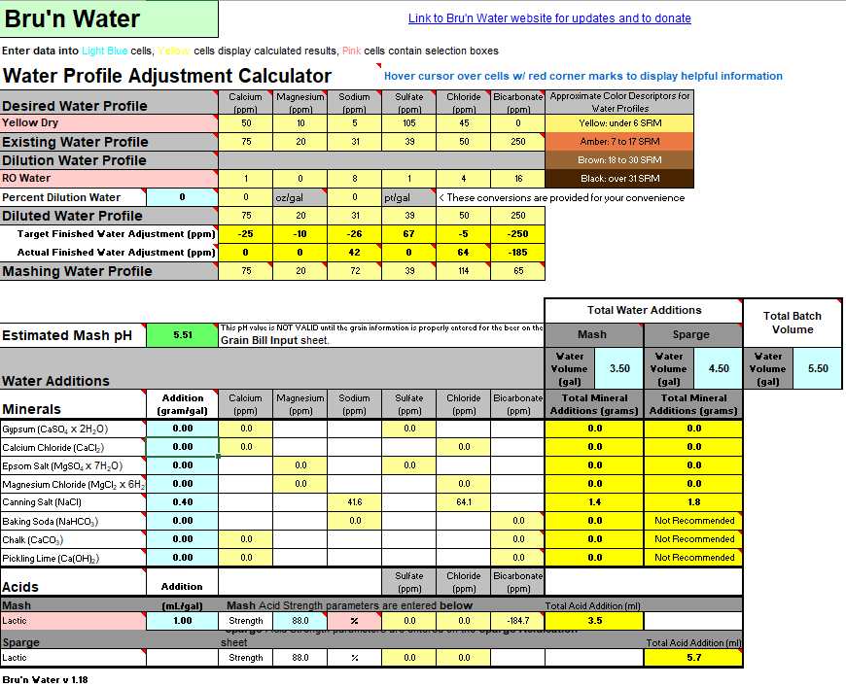
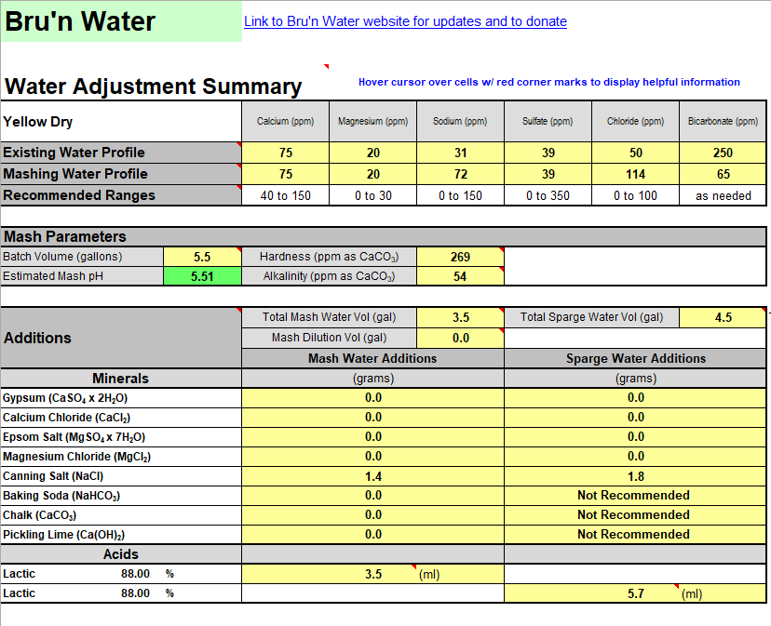
Bru’n Water
https://sites.google.com/site/brunwater/

Slide 4
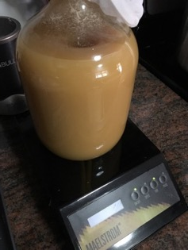
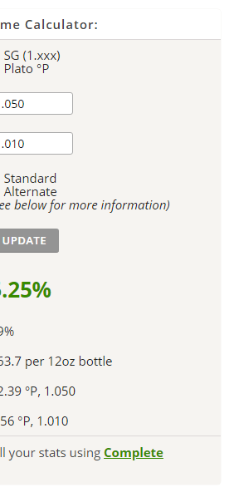
https://www.brewersfriend.com/

Slide 5
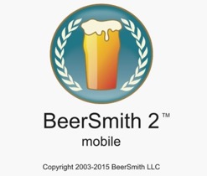
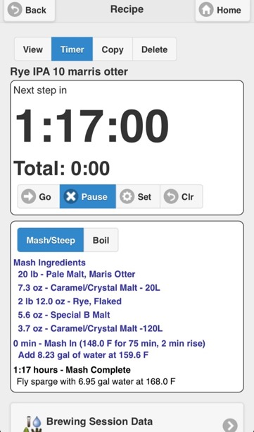
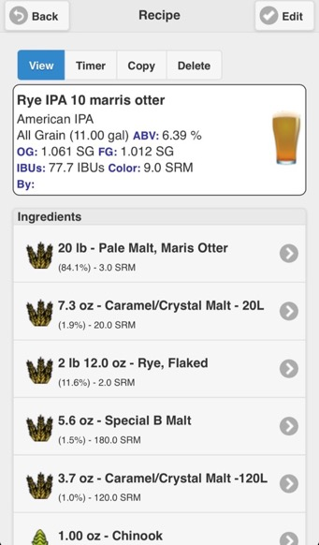

Slide 6
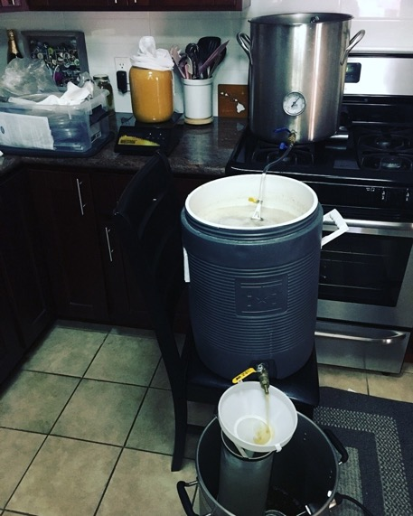
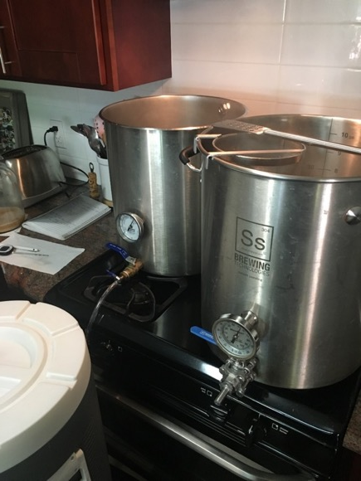
All grain tier system

Slide 7
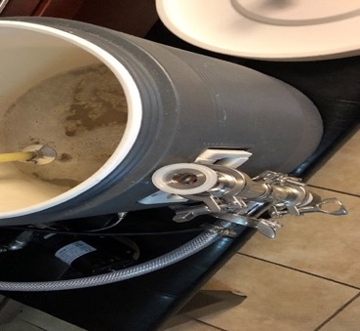
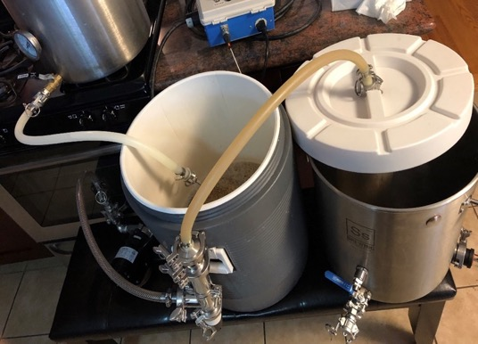
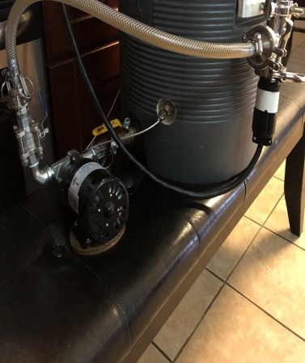
New RIMS stuff
Mash in
Mash out
Recirculate

Slide 8
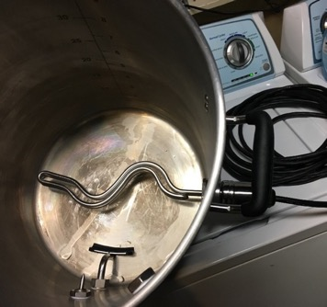
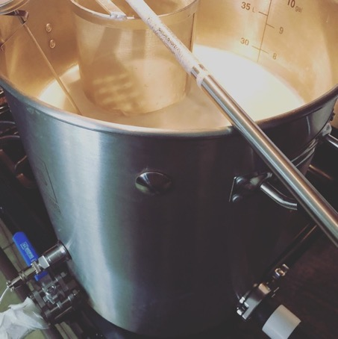
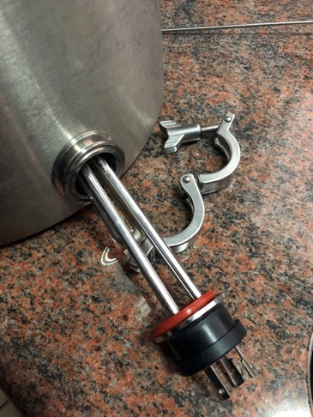
The boil

Slide 9
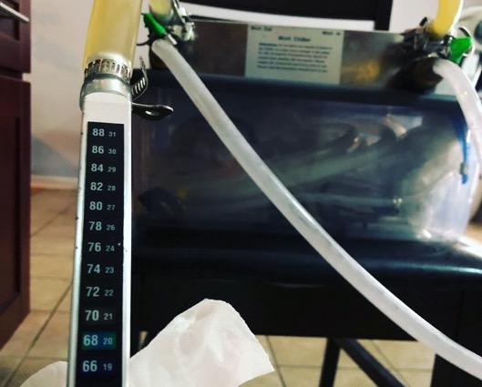
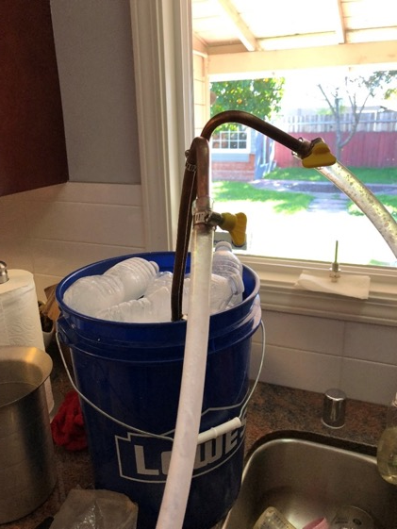
Chilling

Slide 10
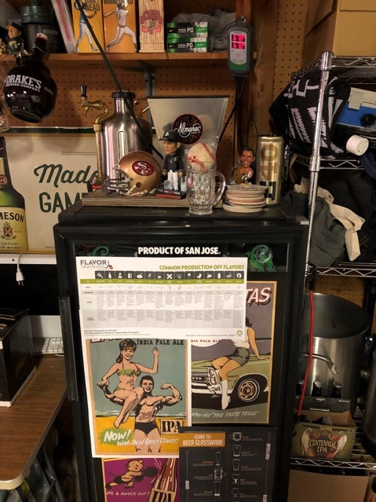
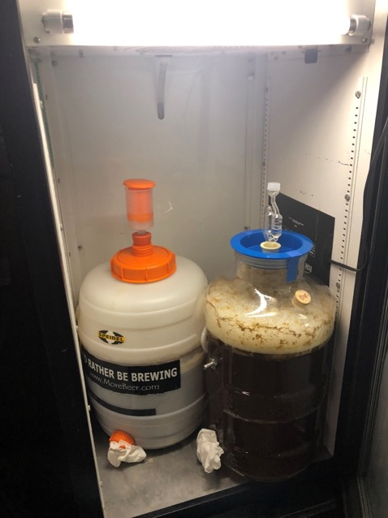
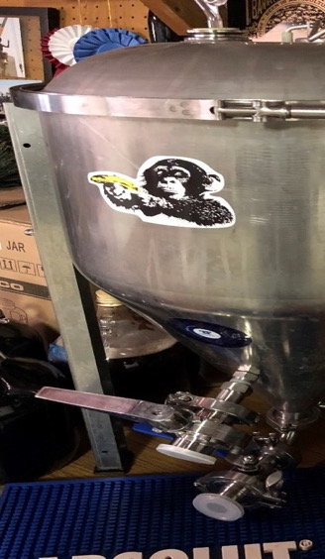
Fermentation

Slide 11
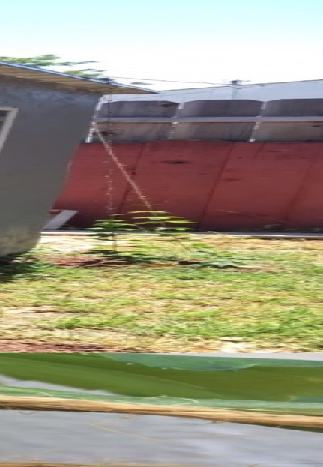
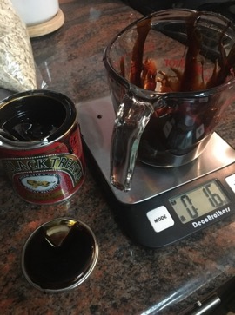
Mill scales hop plants

Slide 12
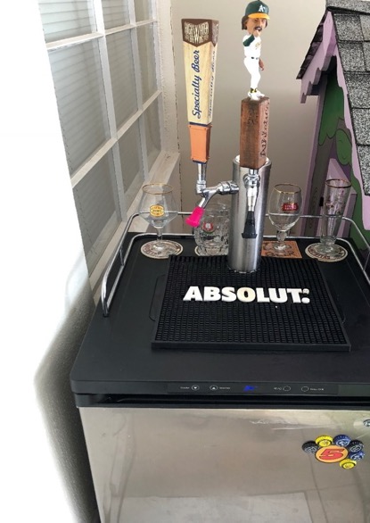
Kegerator
Used kegs $56.59
+free shipping

Slide 13
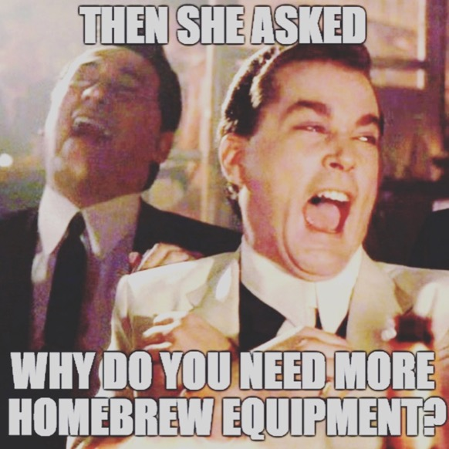
Questions?

