Slide 1
Dark matter 2017
bottling day recap

Slide 2
Schedule
11:00AM Arrival of bottling helpers
11:01AM Start of Dark Matter tasting
11:30AM Blend decided, setup and start of keg transfers
12:00PM Bottling starts, keg transfer in parallel
2:00pm Keg transfer done, start of 2nd bottling line
3:30pm Bottling finished. Group picture and cleaning
4:00PM ½ price burger at St-John’s

Slide 3
Statistics
Dark Matter brewers | 6
Dark Matter variants | 8
Lost dogs | 1
Found dogs | 1
Broken glasses | 1
Broken bottles | 1
Blend A bottles | 88
Blend B1 bottles | 44
Blend B2 bottles | 22
Blend B3 bottles | 20
Total number of bottles | 174 + 1 special keg for NCHF

Slide 4
Tasting pictures

Slide 5
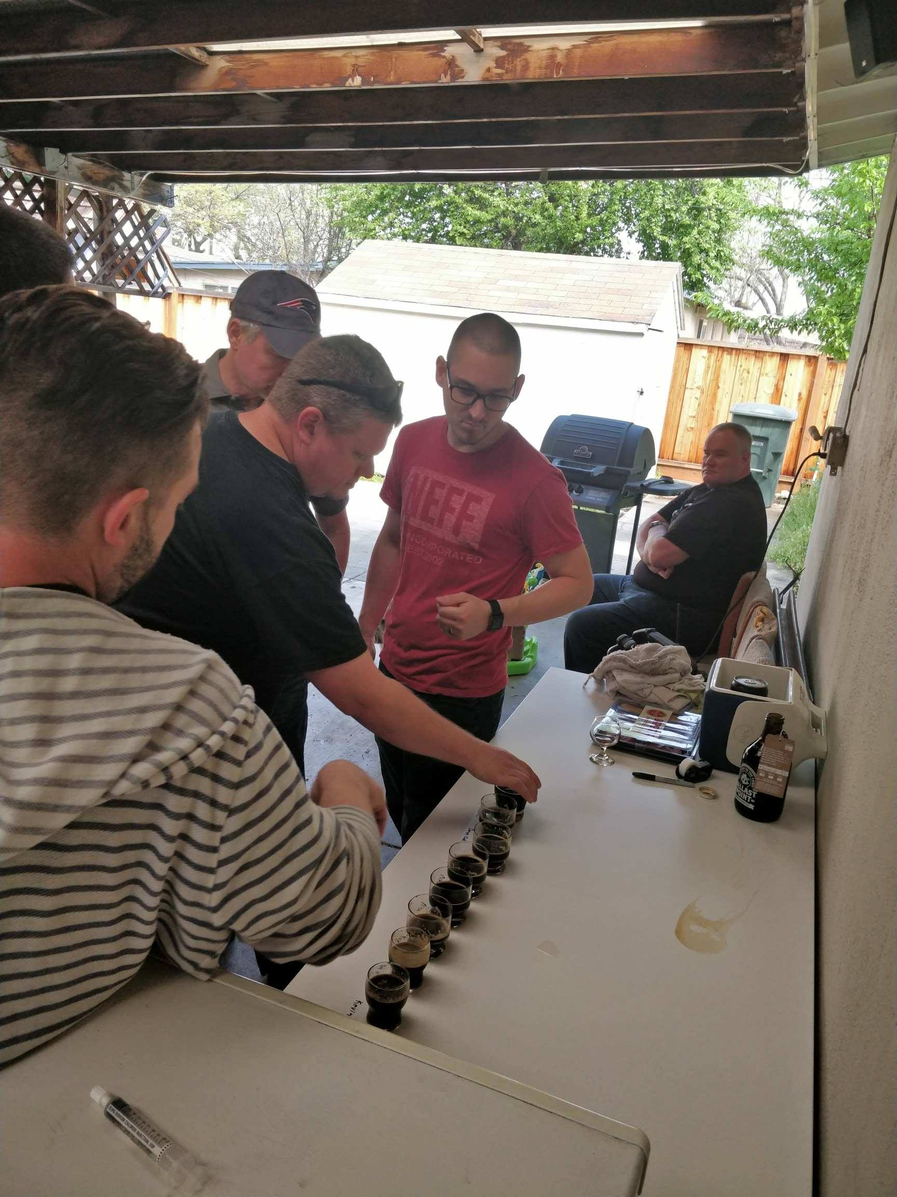
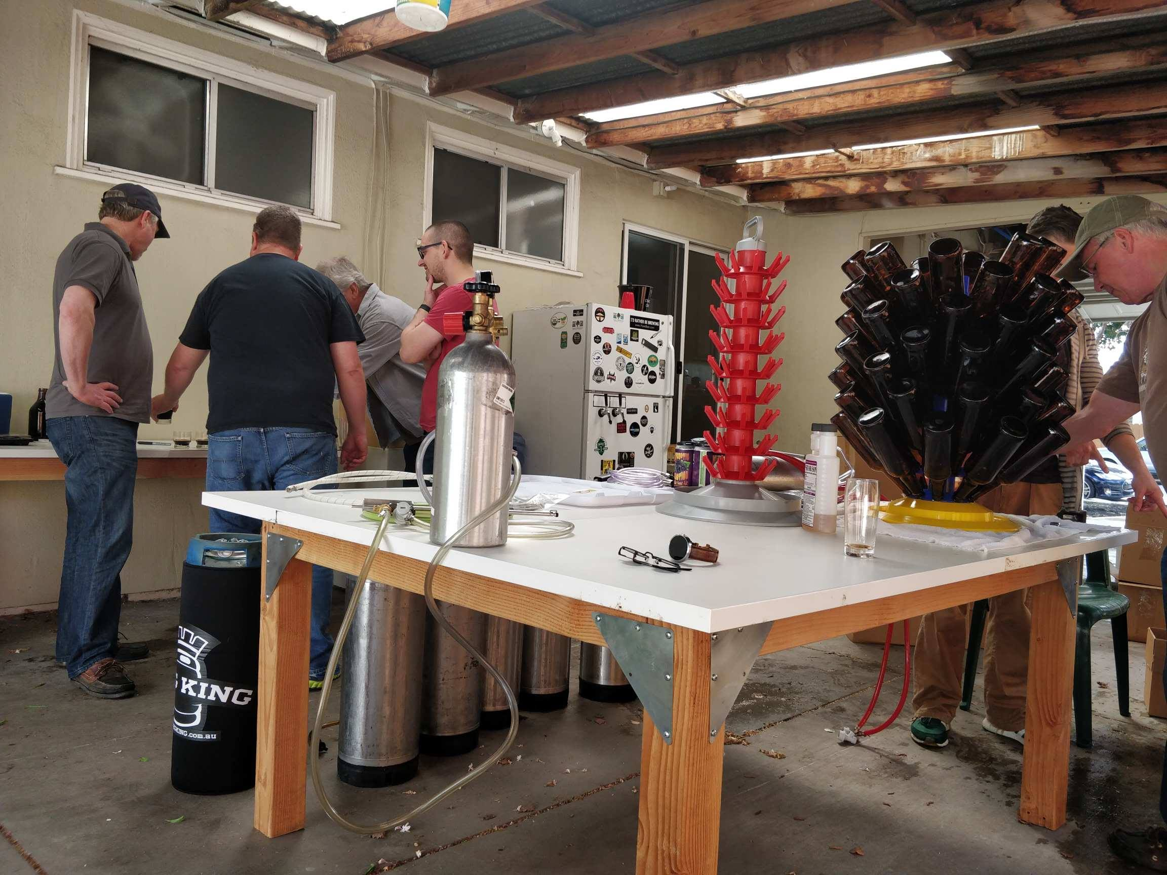

Slide 6
blending pictures

Slide 7
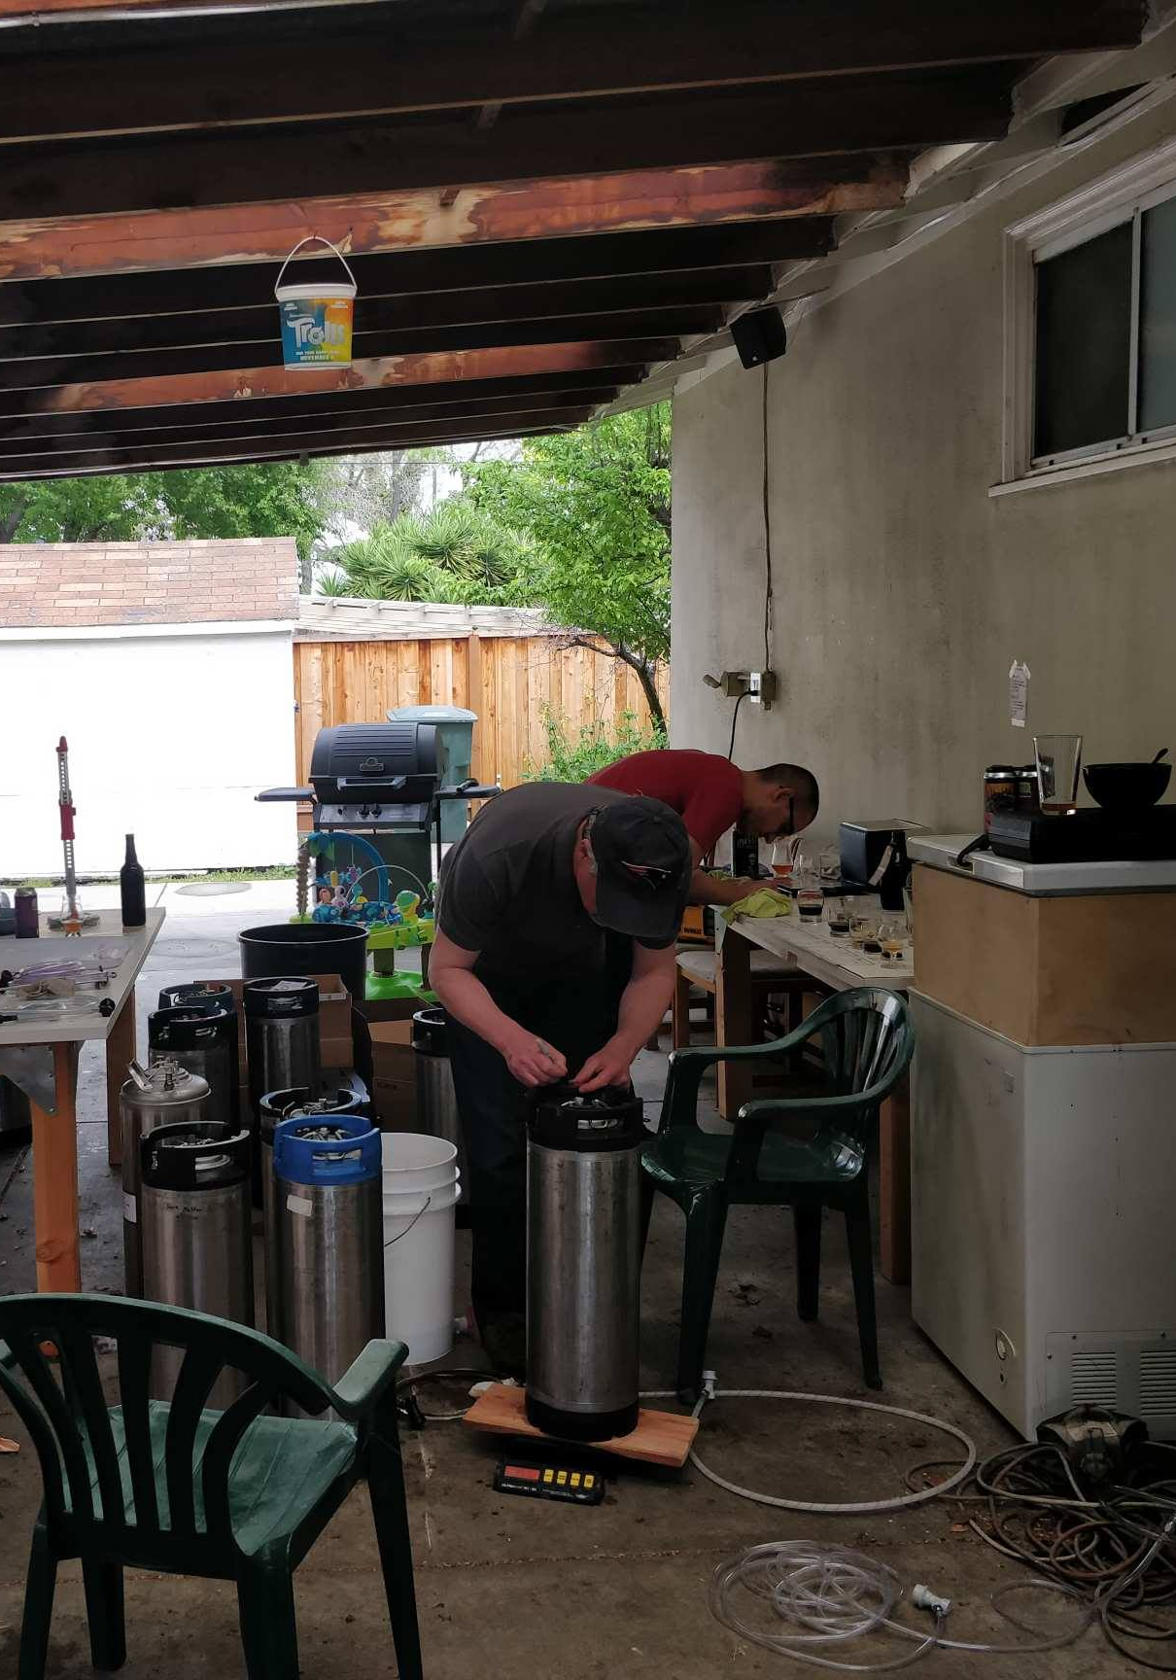
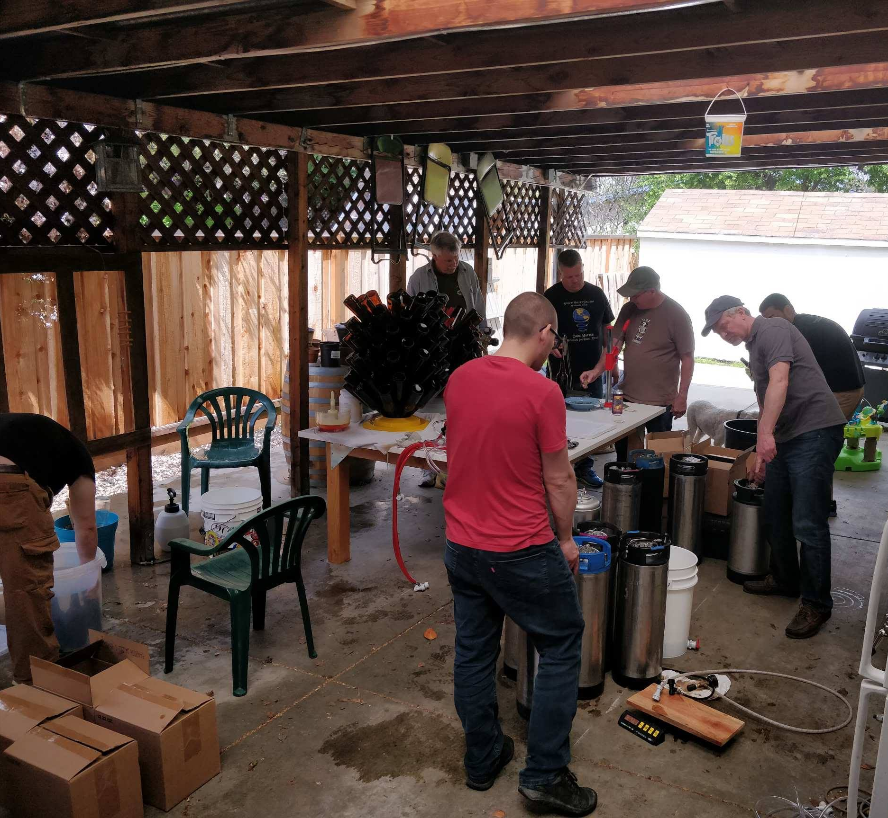

Slide 8
Bottling pictures

Slide 9
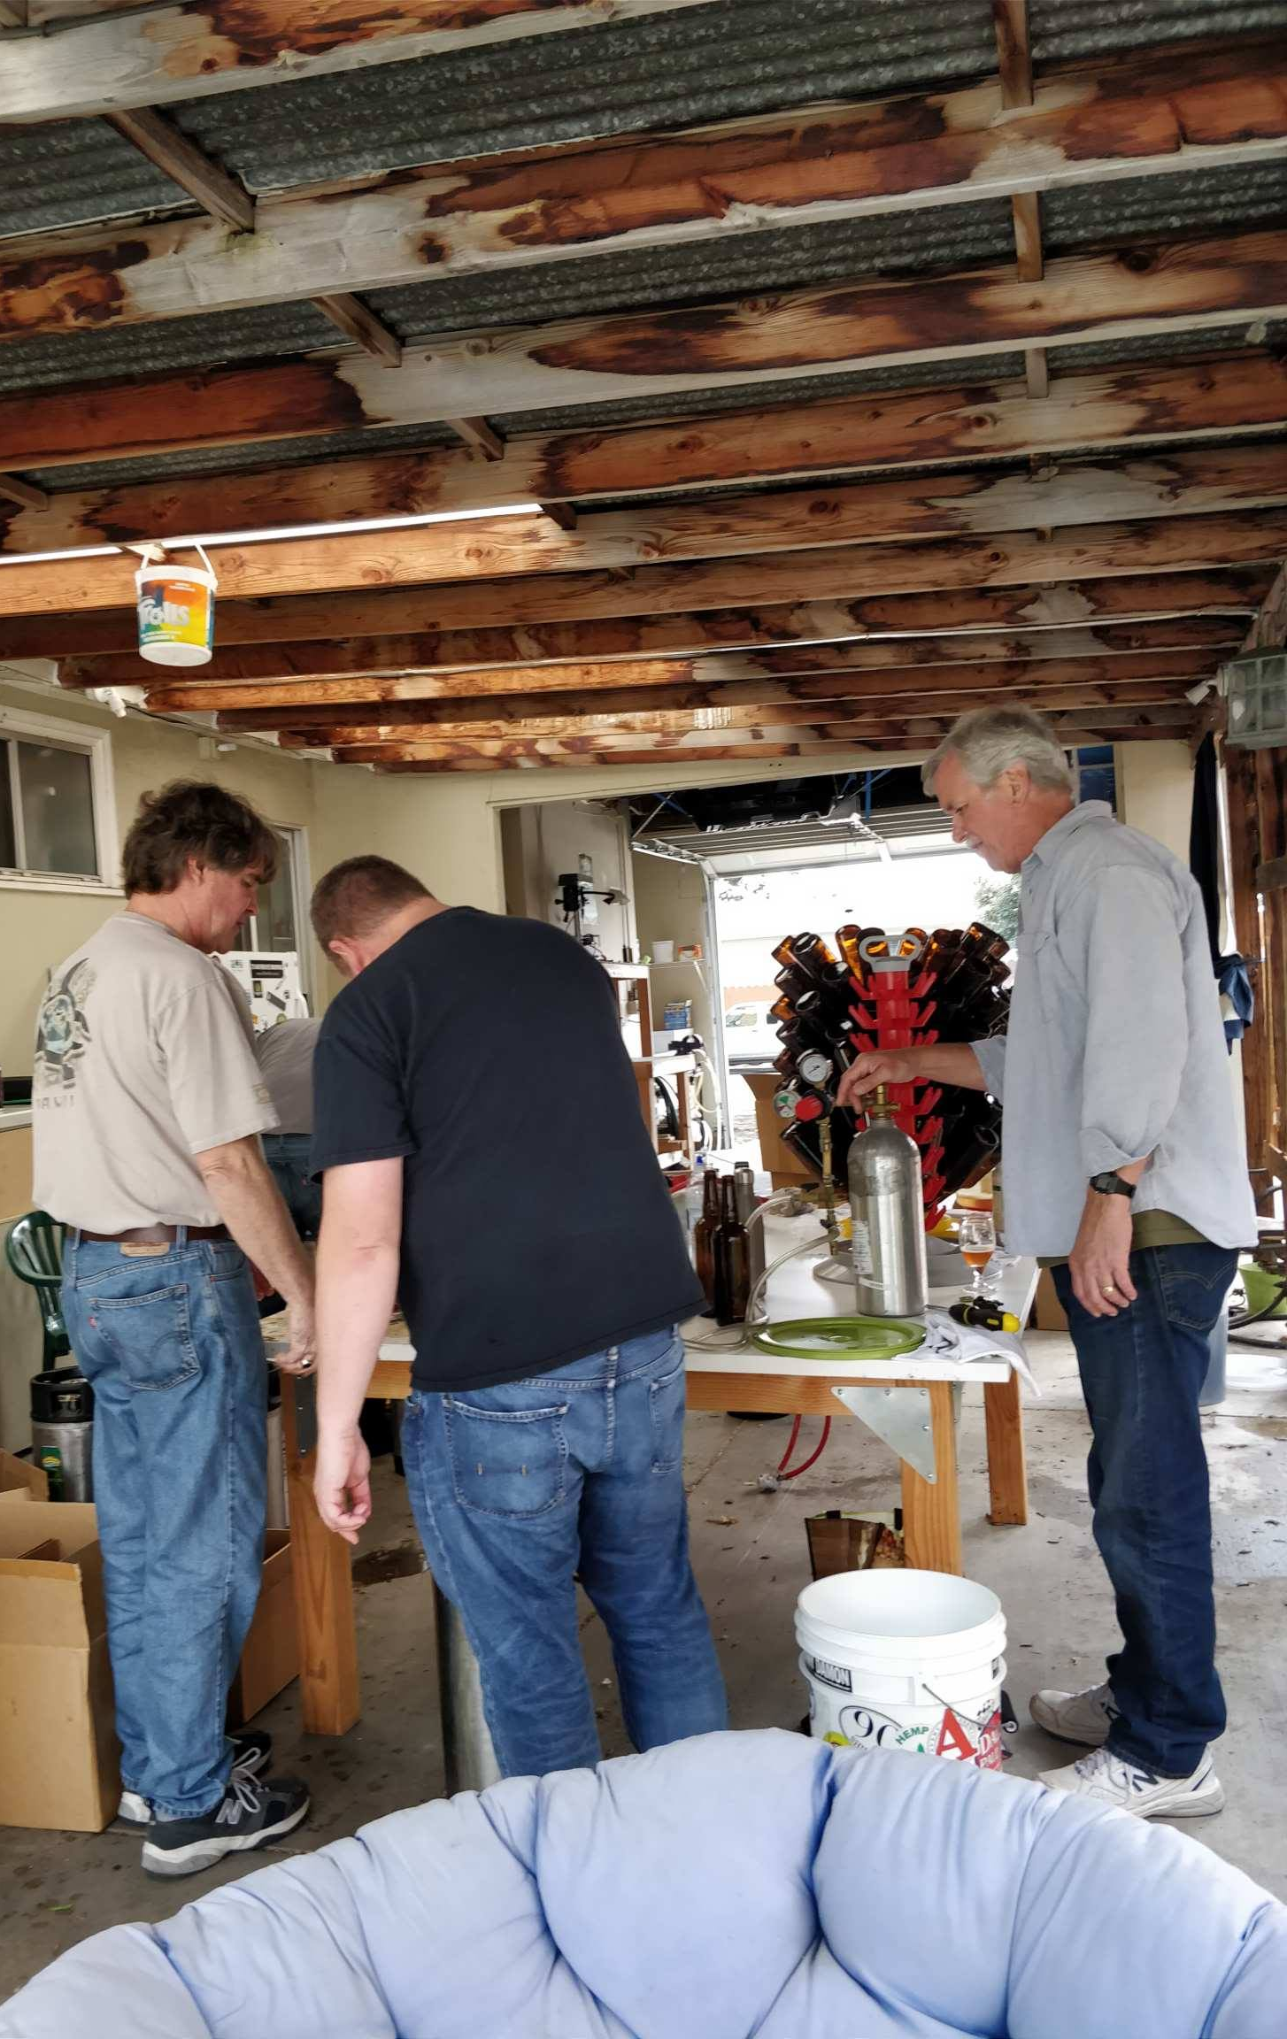
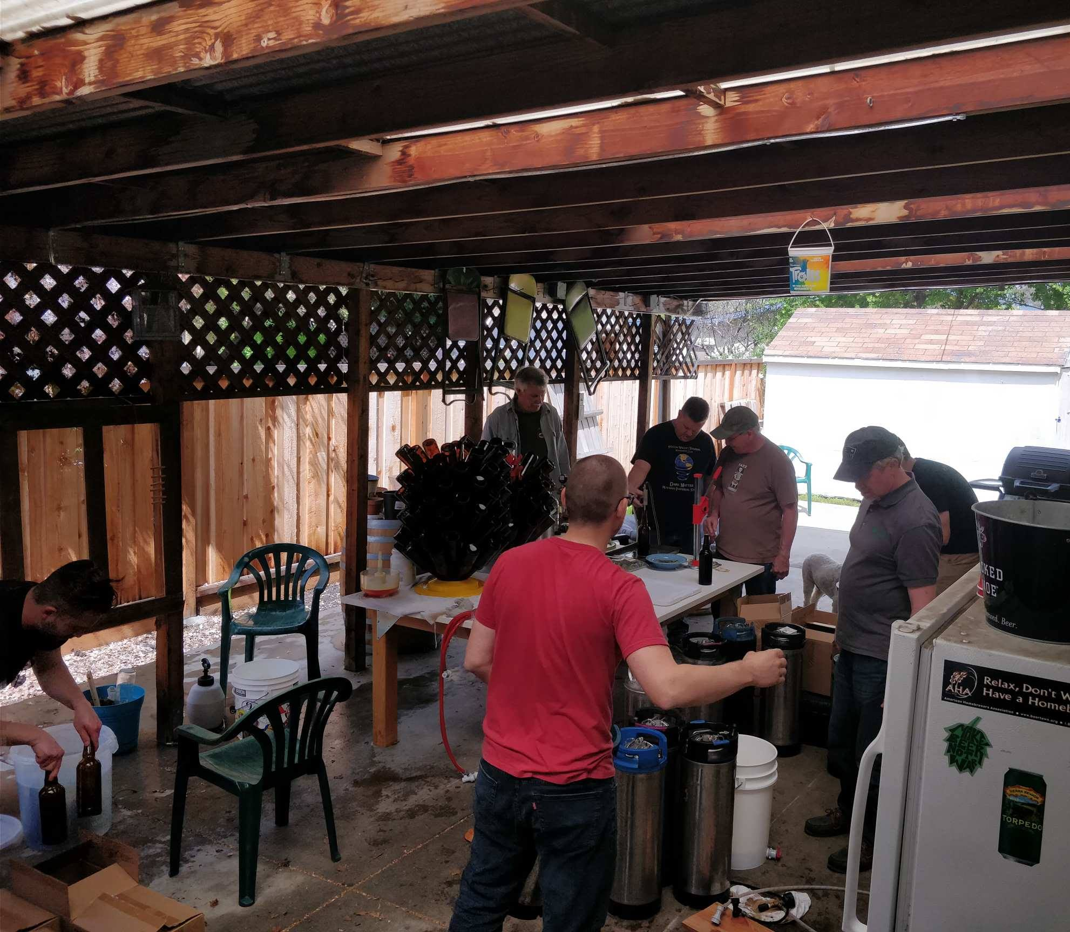

Slide 10
Final result

Slide 11
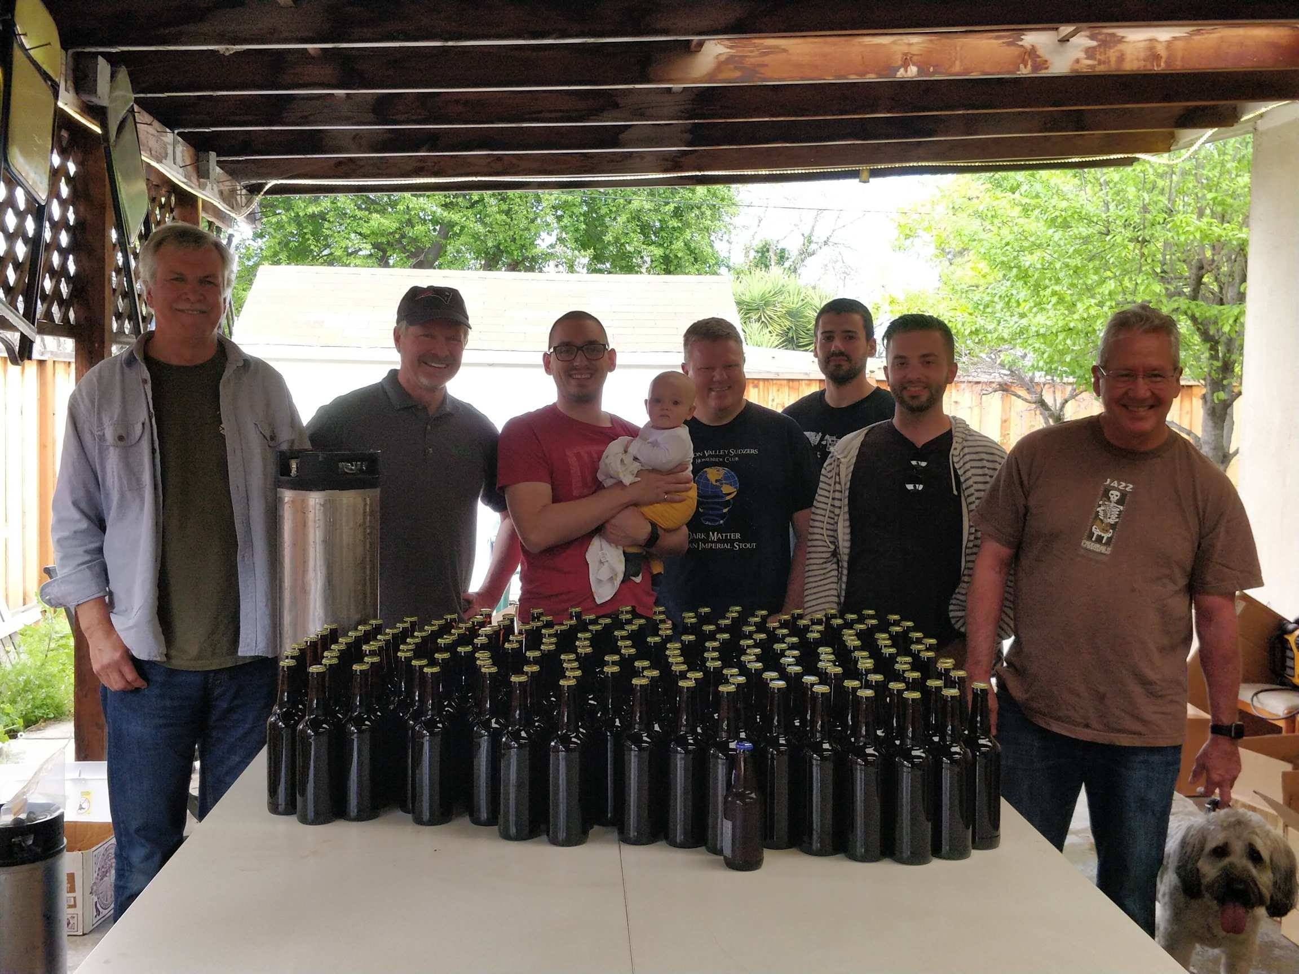
12oz bottle to scale

Slide 12
Blending NOtes

Slide 13
Blending notes

Slide 14
Blending notes

Slide 15
Blending notes

Slide 16
Blending notes

