Slide 1
Using a Tilt Hydrometer
because we’re in silicon valley

Slide 2
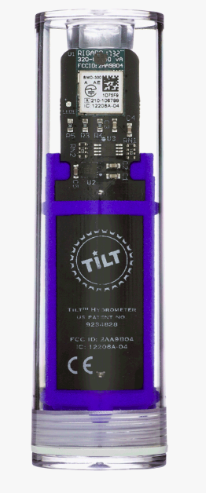
What is it?
An electronic hydrometer
Bluetooth connected
Measures density based on tilt
Higher density → greater buoyancy force

Slide 3
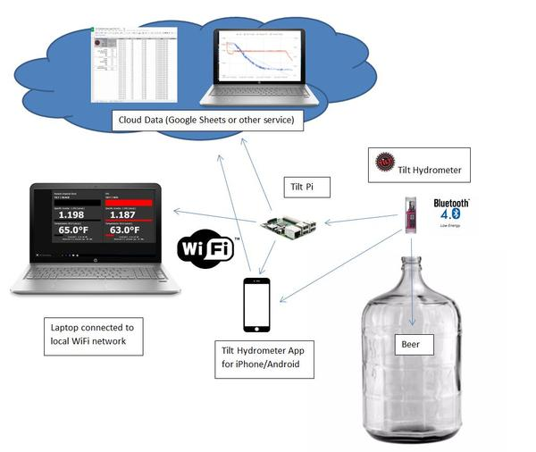
How to use it
Sanitize
Drop in fermenter
Track data
App
Raspberry Pi
https://tilthydrometer.com/blogs/news/introducing-tilt-pi-an-sd-card-image-download-for-your-raspberry-pi-3-or-zero-w
https://tilthydrometer.com/products/tilt-pi-raspberry-pi-disk-image-download

Slide 4
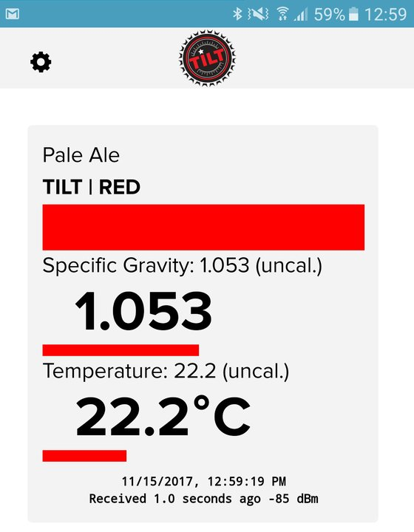
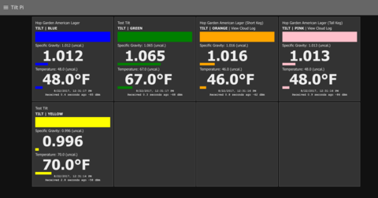
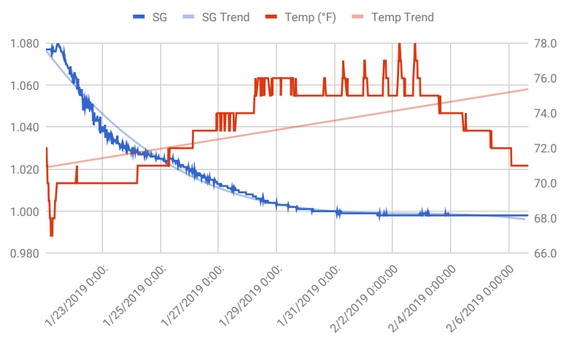
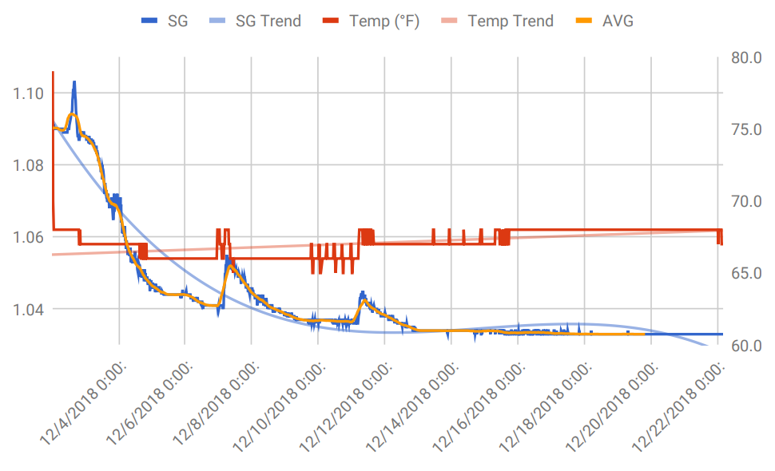
Why use it?
Live tracking
Yeast activity
Knowledge
Charts!

Slide 5
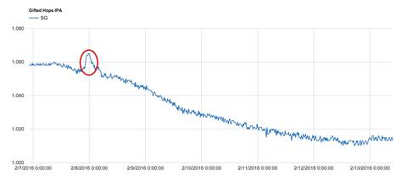
Some issues
Accuracy
High krausen/active fermentation alters readings
Battery life – No issue yet, but unknown
Expense
Recording data requires an extra device

