Slide 1
Spunding
The what, the why and the how
+
pros and cons

Slide 2
The what
Spunding is an old, but still relevant and widely used method of transferring beer with a small amount of residual sugars to a closed serving vessel to naturally carbonate. A spunding valve is attached to the vessel and is set to release CO2 at a certain PSI to avoid overcarbonation. For many breweries it is done as a matter of efficiency and economy.

Slide 3
The why
reduces cold side aeration and helps extend the shelf life of beer- It helps good beer stay good longer.
Uses active yeast to scavenge oxygen-active yeast is the most effective tool we have for this
Use less packaged co2
Makes beer taste different
New hoppy styles are very prone to oxidation and spunding can help if you are having shelf life issues

Slide 4
The how
When fermenting beer has approximately 4-6 gravity points left to ferment it is transferred (under gas) to a CO2 flushed Cornelius keg with a spunding valve attached to finish fermentation and naturally carbonate to your desired level, (Use co2 chart to determine how much carbonation you want, but typically between 20 and 30 PSI)

Slide 5
Since spunding is all about reducing the amount of oxygen in contact with your finished beer, your keg should be flushed with CO2 before beer goes in it. There 3 typical methods to do so
Flush with gas (not as effective as other methods, uses a lot of co2)
Fill keg up with sanitizer and push it out with co2, (effective, but uses a lot of time and co2)
Use co2 produced from fermentation to flush the keg (cheap, easy and effective- This is my favorite method.)

Slide 6
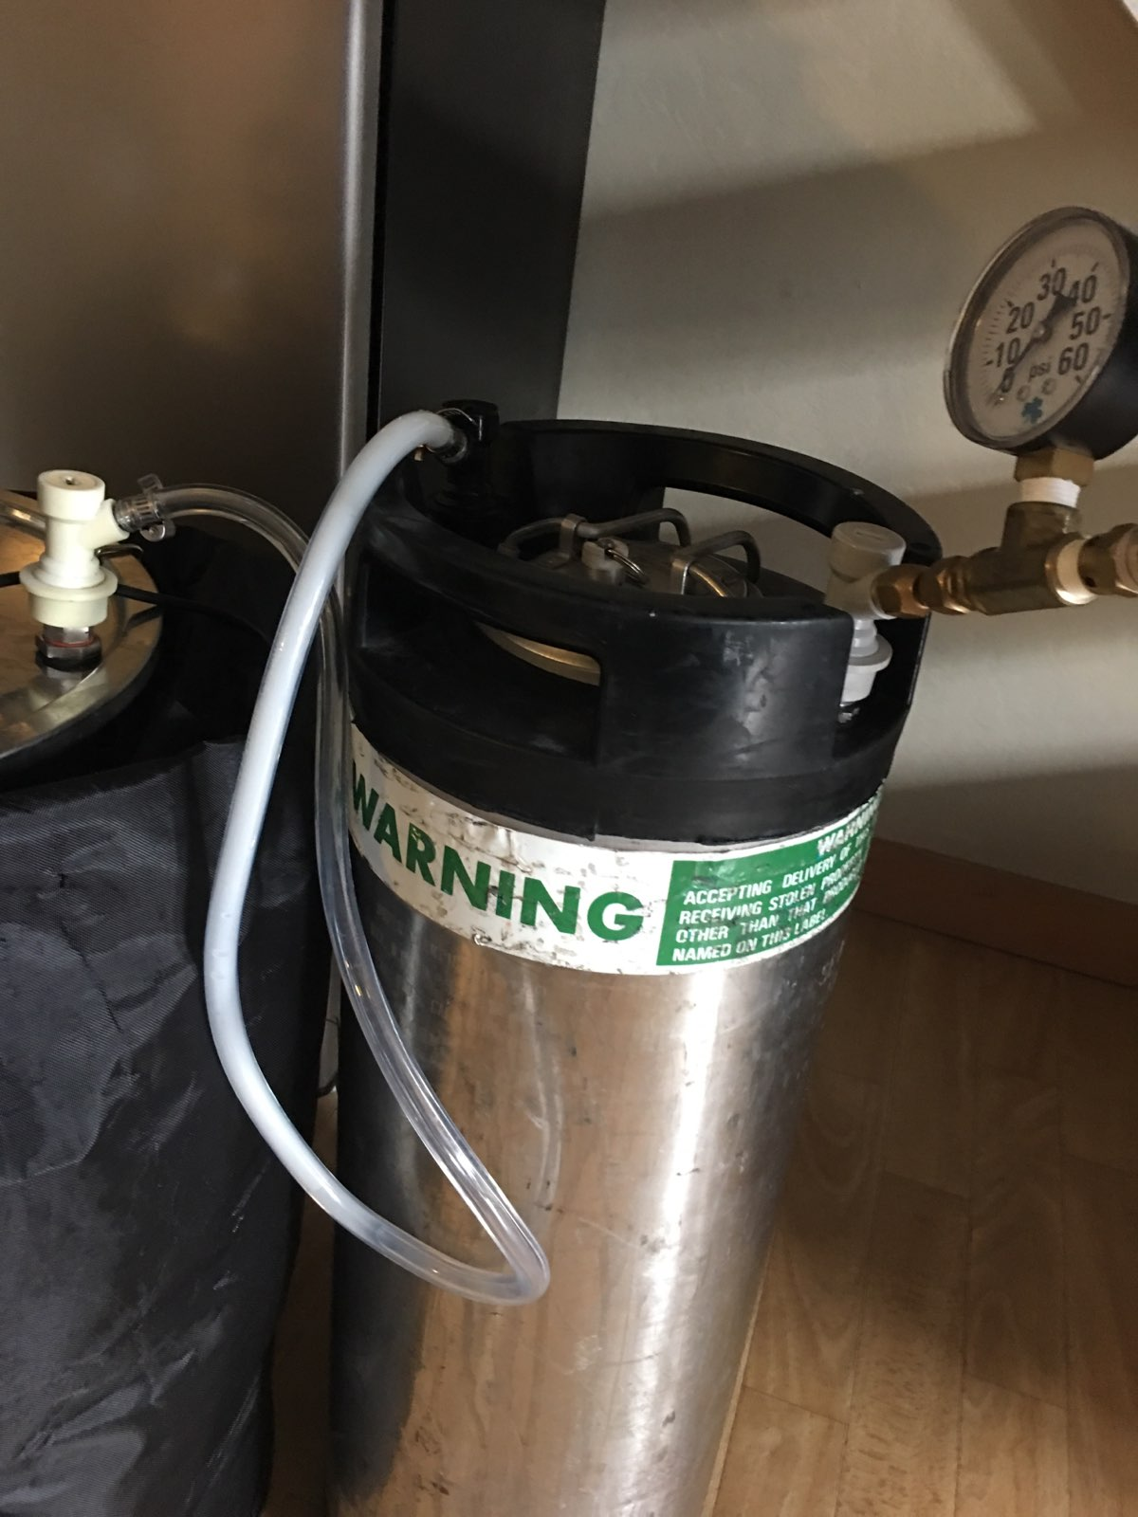
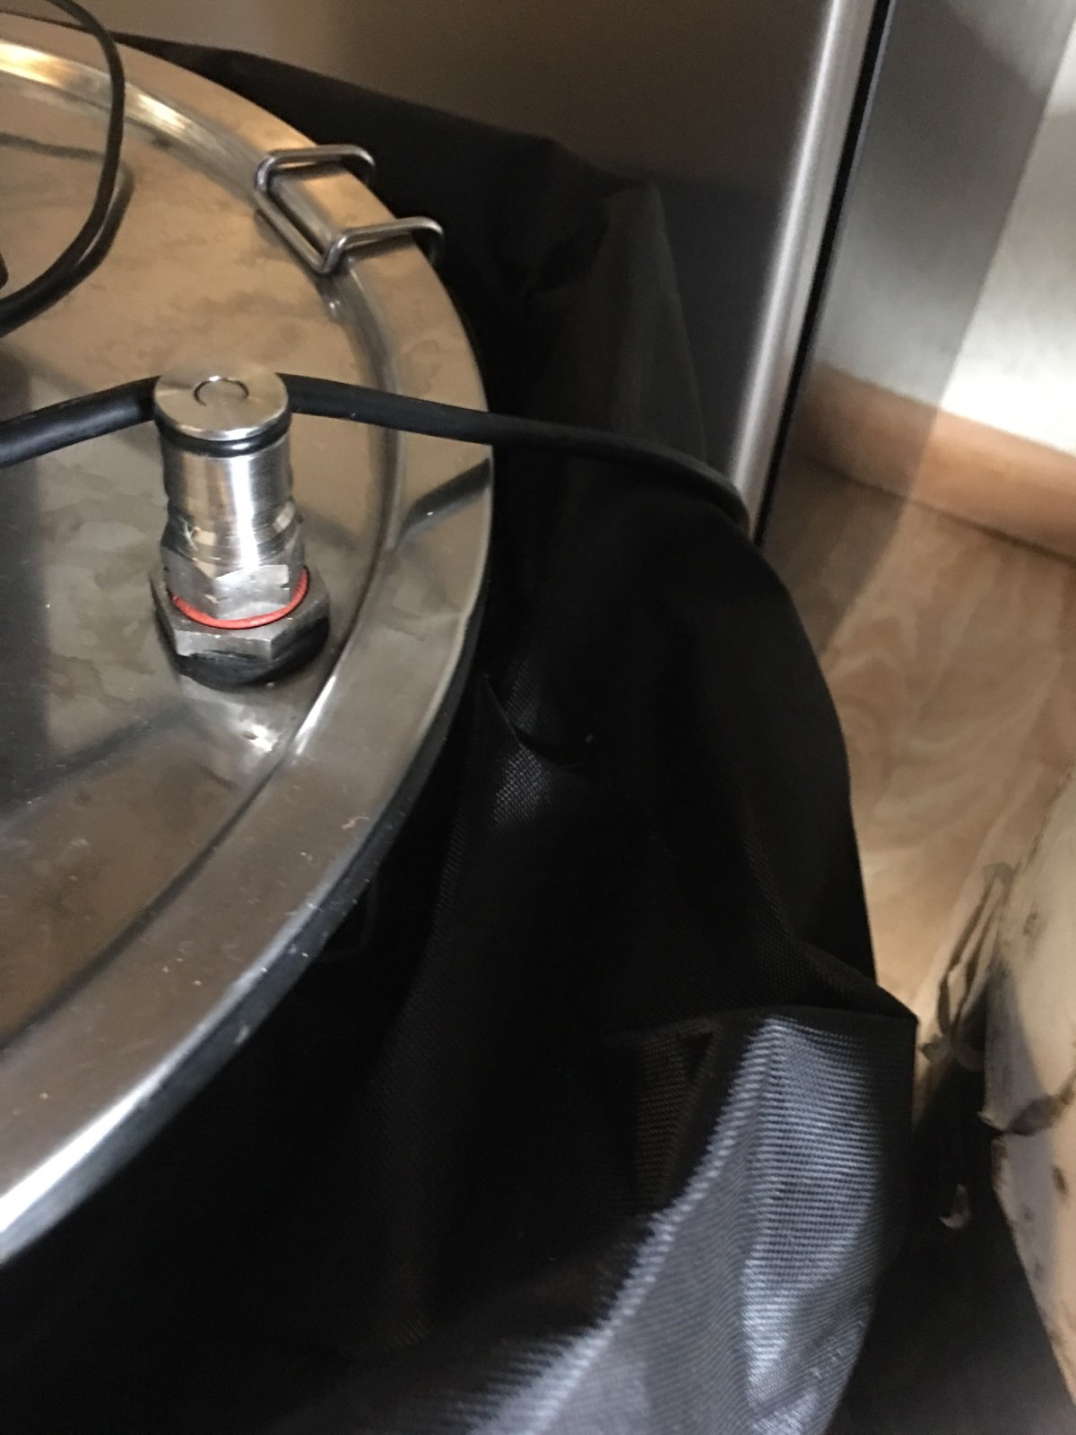
Using active fermentation to flush a keg

Slide 7
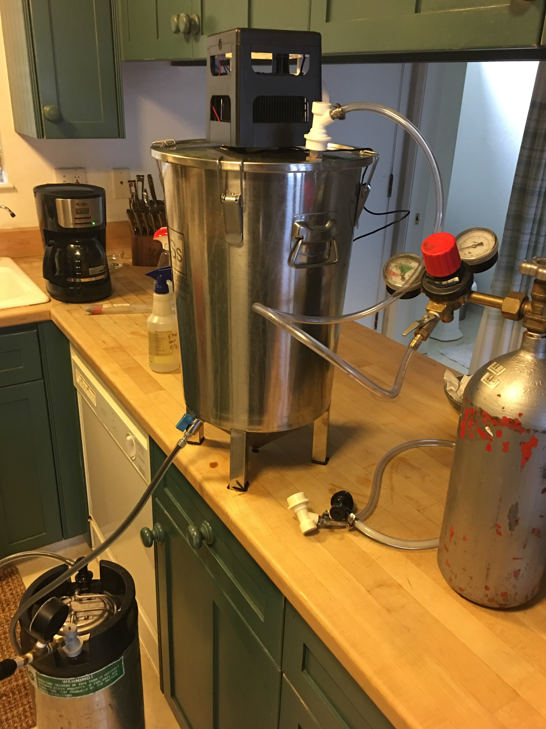

Slide 8
To know when your beer will have 4-6 gravity points left to ferment, perform a forced fermentation test (FFT) by taking about 150ml of wort and fermenting it on a stirplate with some yeast (from your starter). After 24 hours measure the gravity and add .001 and that should be the final gravity of your beer.

Slide 9
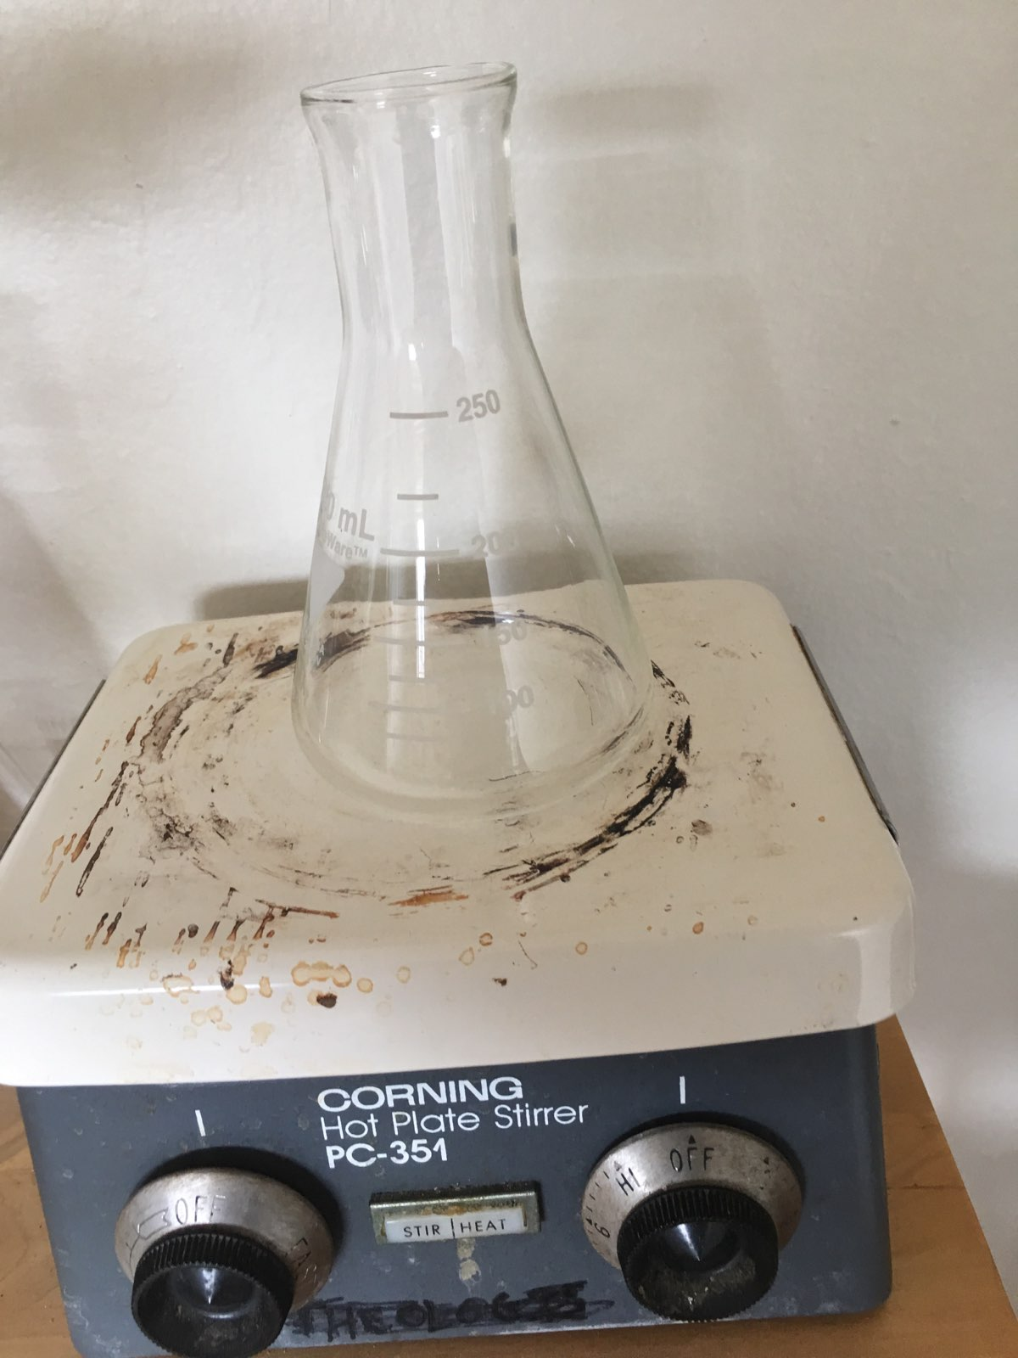
For example, if your FFT shows a final gravity of 1.008, then your estimated final gravity will be about 1.009 and your beer should be transferred from fermenter to keg to spund when it is at about 1.015

Slide 10
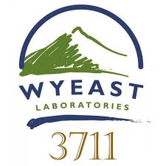
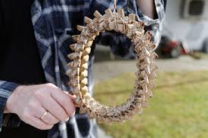
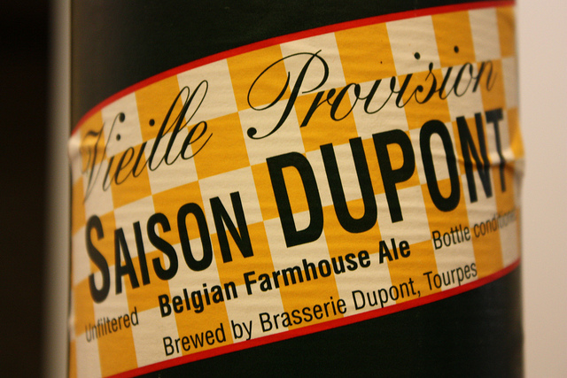
Note: Diastaticus yeasts do not perform accurately with the Forced fermentation test and kveik ferments too rapidly to work with spunding. I don’t really know what to do about this.

Slide 11
The pros
Excuse to buy more equipment
Prolonged shelf life
Longer lasting hop aromas
Crisper, cracker like malt flavor
More distinct character from roasted malts
More noticeable crystal/caramel malt character
Less honey, sticky sweet malt flavor
Don’t have to buy as much co2

Slide 12
The cons
More equipment
More work
Time sensitive
Increased trub loss
Can’t dry hop post fermentation
Doesn’t always work out (leaky keg)
Sulfur can take a long time to dissipate if it’s carried into the keg
Difficult to add finings
Cant get it to work with kveik and diastatic yeasts don’t work with the fft

Slide 13
steps from start to finish are:
On brewday take 150ml of your finished wort and perform a forced fermentation test(this step can be skipped when you know the beer/yeast).
Use fermentation to flush serving keg
When beer is within .004 to .006 gravity points of finishing, transfer to serving keg with spunding valve set to desired co2 level
Seal keg with a blast of co2
Condition for desired amount of time (usually between 3 days and 2 weeks

Slide 14
Things to remember when spunding
The spunding valve makes for a terrible blow tube, so don’t overfill your keg
Its not a magic bullet
Sulfury yeasts are a pain
Can reduce esters that you may want.
It’s a great method to increase the shelf life of your beer

