Slide 1
Kölsch

Slide 2
History of Kölsch
Kölsch as we know it < 100 years
Brewing in Köln or Cologne > 1000 years
Charlemagne (800) regulated breweries in each feudal estate (Aachen is < 40miles from Cologne)
Before, well, it was part of home cooking
Gruit with herbs until 1495, then later hops
(yes they were ahead of Reinheitsgeboot)

Slide 3
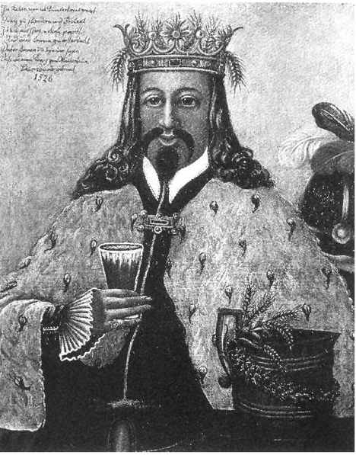
Gambrinus (not the malt)
Patron saint of brewers
Defeated Archbishop of Cologne
Battle of Worringen 1288
Power moved from church to guilds
Brewers guild formed in 1396

Slide 4
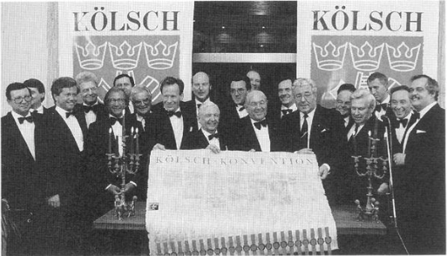
Kölsch only in Cologne
Kölsch Konvention
22 Breweries
Can only be brewed in Cologne (well big Cologne)
Signed in 1986

Slide 5
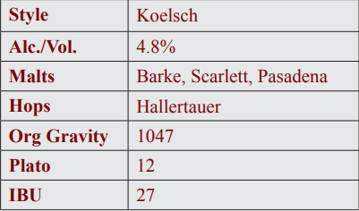
A look at Reißdorf

Slide 6
Malt
Barke from Weyermann
Scarlett barley malts supplied by Cargill Malt Division (Herent, Belgium)
Pasadena, Caltech???

Slide 7
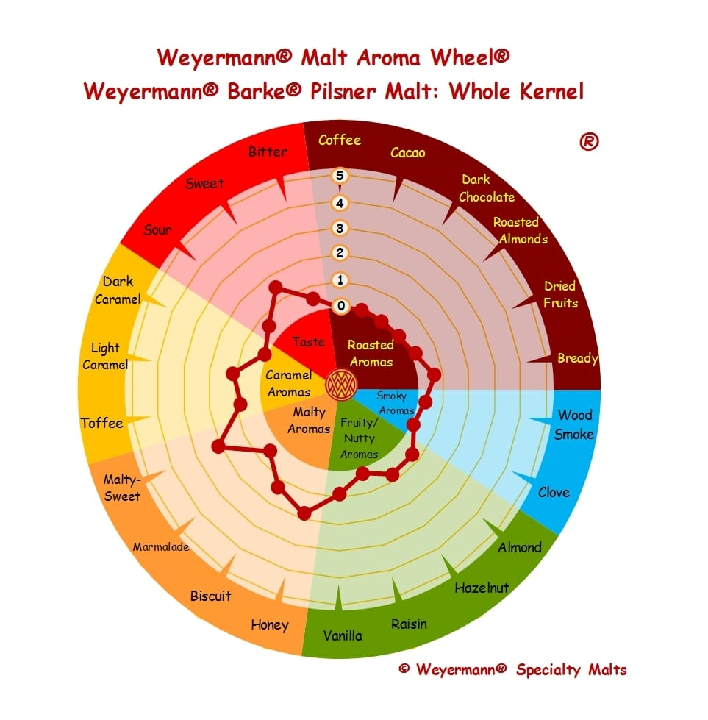
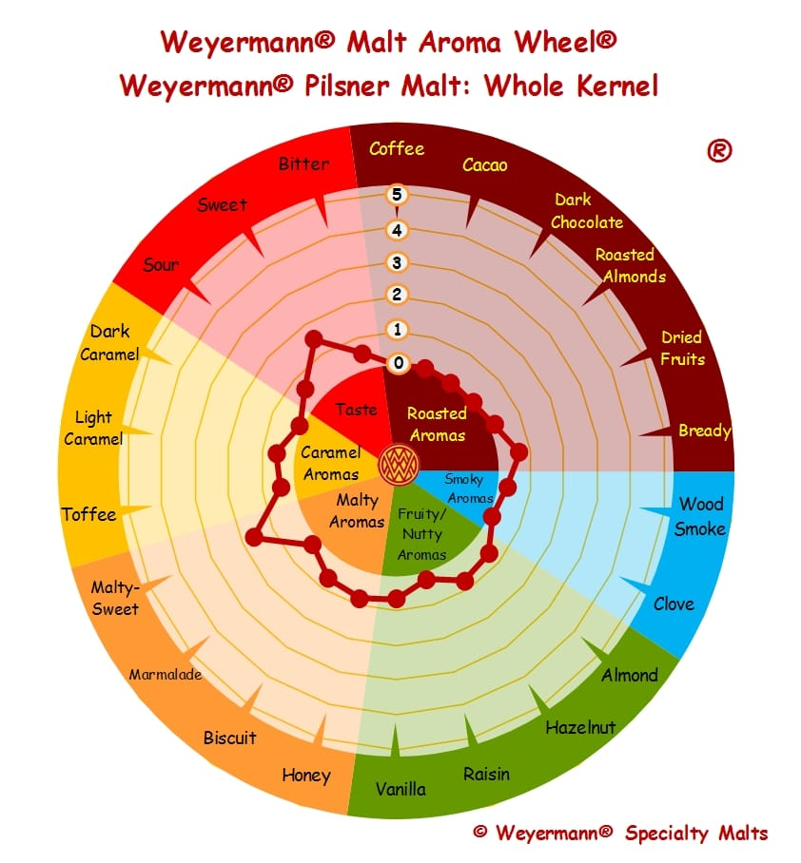
Malt
Reissdorf, Barke vs Weyermann Standard pilsner
More Honey and Biscuit

Slide 8
Hops
Hallertauer
Hops from Hallertau
Like San Franciscan
Hallertauer Mittelfrueh, often referred to as simply “Hallertau,”
Mittlefüh
mittelfrueh means “middle-early”
Hallertauer Mittlefrueh:
Early to mid season crop of hops from Hallertau
IBUs: 18 – 30

Slide 9
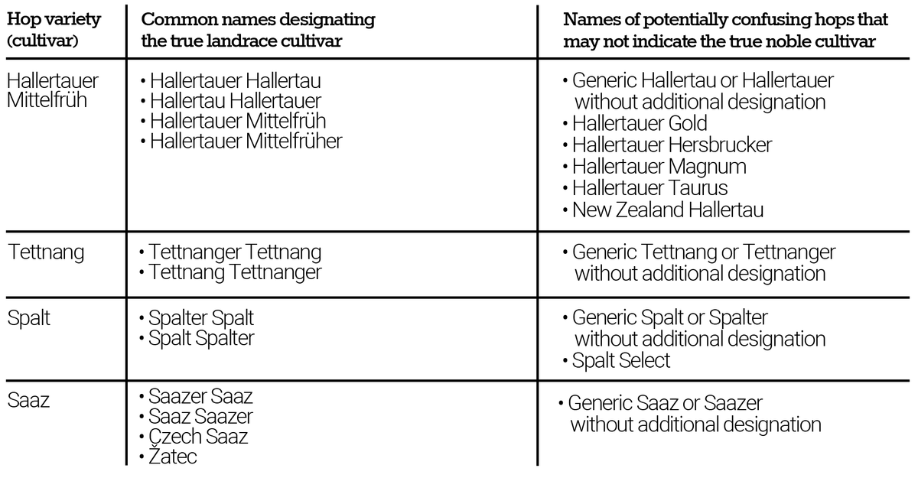
Traditional Hops

Slide 10
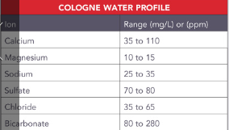
Water
Dry finish, more sulfate than chloride
Notice the sulphur notes

Slide 11
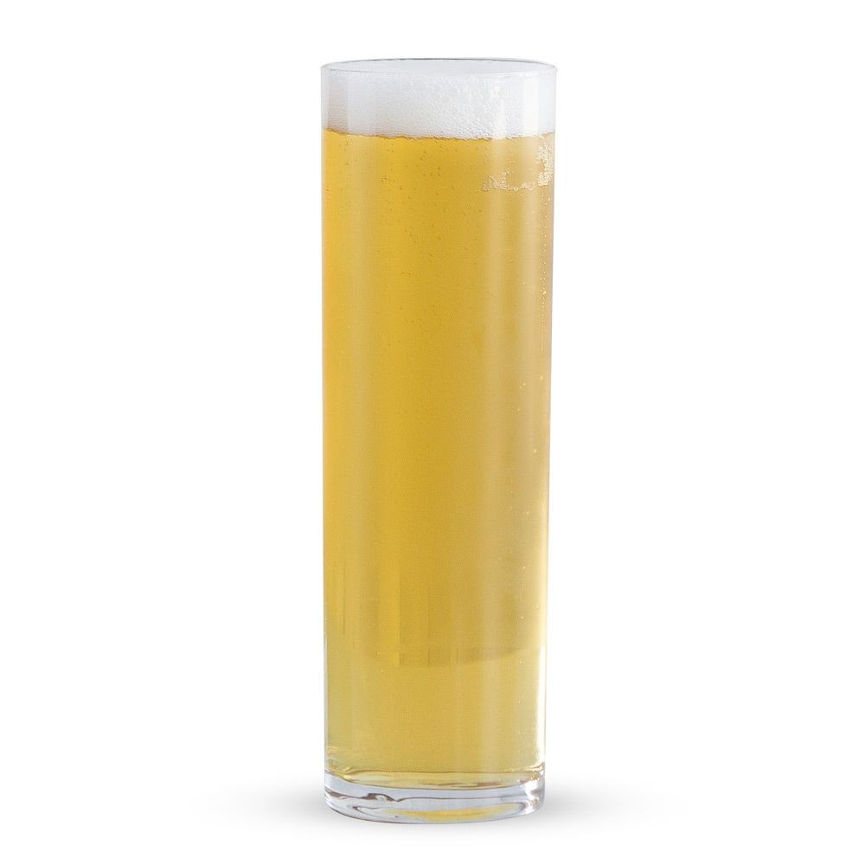
How to serve a Kölsch
Serving temp. 45–50°F (7–10°C)
Carbonation 2.2 to 2.4 volumes
Stange, small narrow glass (0.2l less than 1 cup)
But, keep them coming...

Slide 12
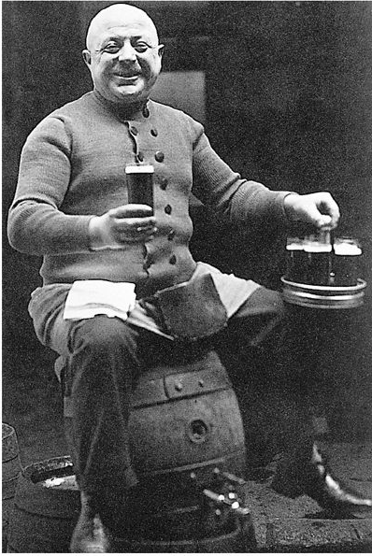
Enjoy a Kölsh!
Köbes

Slide 13
Thank You!

