Slide 1
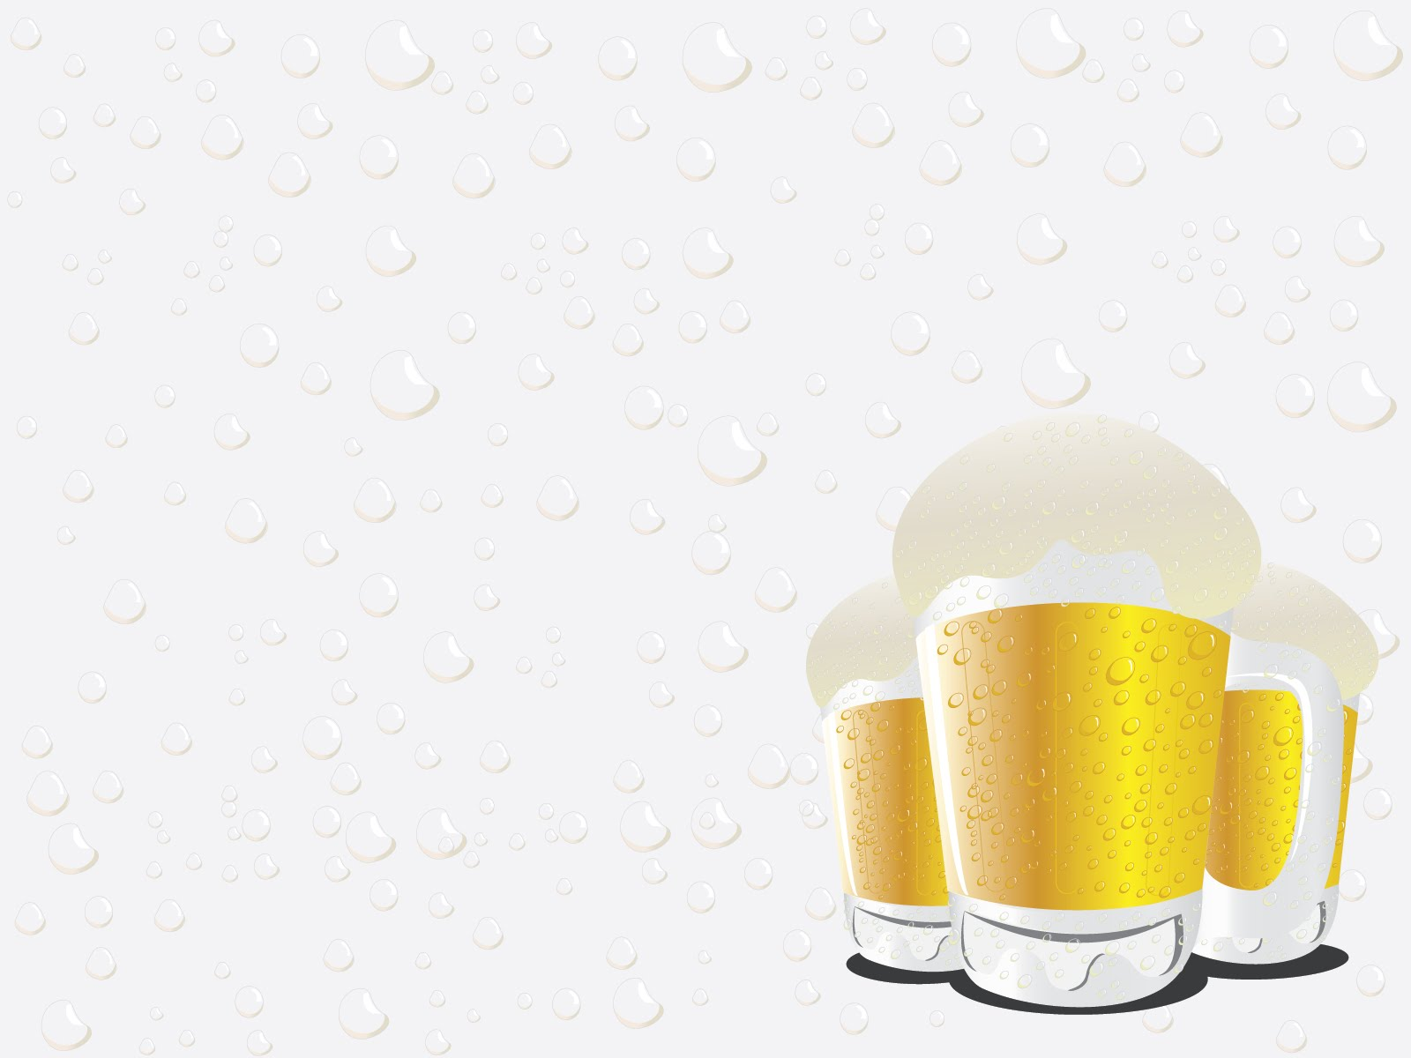
Oktoberfest (Mӓrzen)
& Festbier

Slide 2

Malt
Pilsner malt or two row, preferably European
Vienna and/or Munich for maltiness and color, between 10% for Festbier and up to 60% for Mӓrzen
Crystal/Caramel malt to add some fruity character and for head retention, 7-9%
Carapils or wheat to fatten a little 3-7%
Some other malts like Amber can be used to darken for Mӓrzen, ~4%
Festbier:
OG: 1.054 – 1.057
SRM: 4.0 – 7.0
Mӓrzen:
OG: 1.054 – 1.060
SRM: 8.0 – 17.0

Slide 3
Hops
Continental nobel hops
  Hallertau (bittering)
  Tettnanger
  Spalt
  Saaz
New World Hallertau hybrids like Liberty and Mt Hood are often used in homebrew comps
Stay away from citrusy/piney new world hops
IBUs: 18 – 25

Slide 4
Water
A water profile that will balance malt /hops is best, so a .9 to .79 range sulfate to chloride ratio
For 10 gallons of RO water
  1 gram Gypsum (as low as .25 grams to accent some maltiness)
  4 grams Epsom Salt
  5 grams Calcium Chloride
  2 grams Baking Soda

Slide 5
Yeast
Any Bavarian strain that produces malt accented beer.
Ferment in low temps like lager
WhiteLabs WLP820

Slide 6
Brewing
Low temp mash 149F
  You want it dry
Long boil
  90 min often suggested
  DMS is a concern
Watch the pH
Aerate well, pitch a healthy starter

Slide 7
Fermentation
Temperature control is key
Primary ferment at 50F no higher than 57F
Ramp up towards end of fermentation to 68F
  Make sure fermented out
  DMS but also Diacetyl
Better to lager but not required
  Cool to 33F to 38F
  A month is great, a week helps
FG: 1.007 – 1.011

Slide 8
Clarify
Any trick in your arsenal
  Vorlauf
  Kettle fine with Whirlflock or Irish Moss
  During fermentation use Clarity ferm (helps with cold haze)
  Post fermentation clarifier use Gelatine or Biofine
  Filtering helps but most home brewers don’t have the setup

Slide 9

Thank You!

