Slide 1
Oktoberfest
Festbier

Slide 2
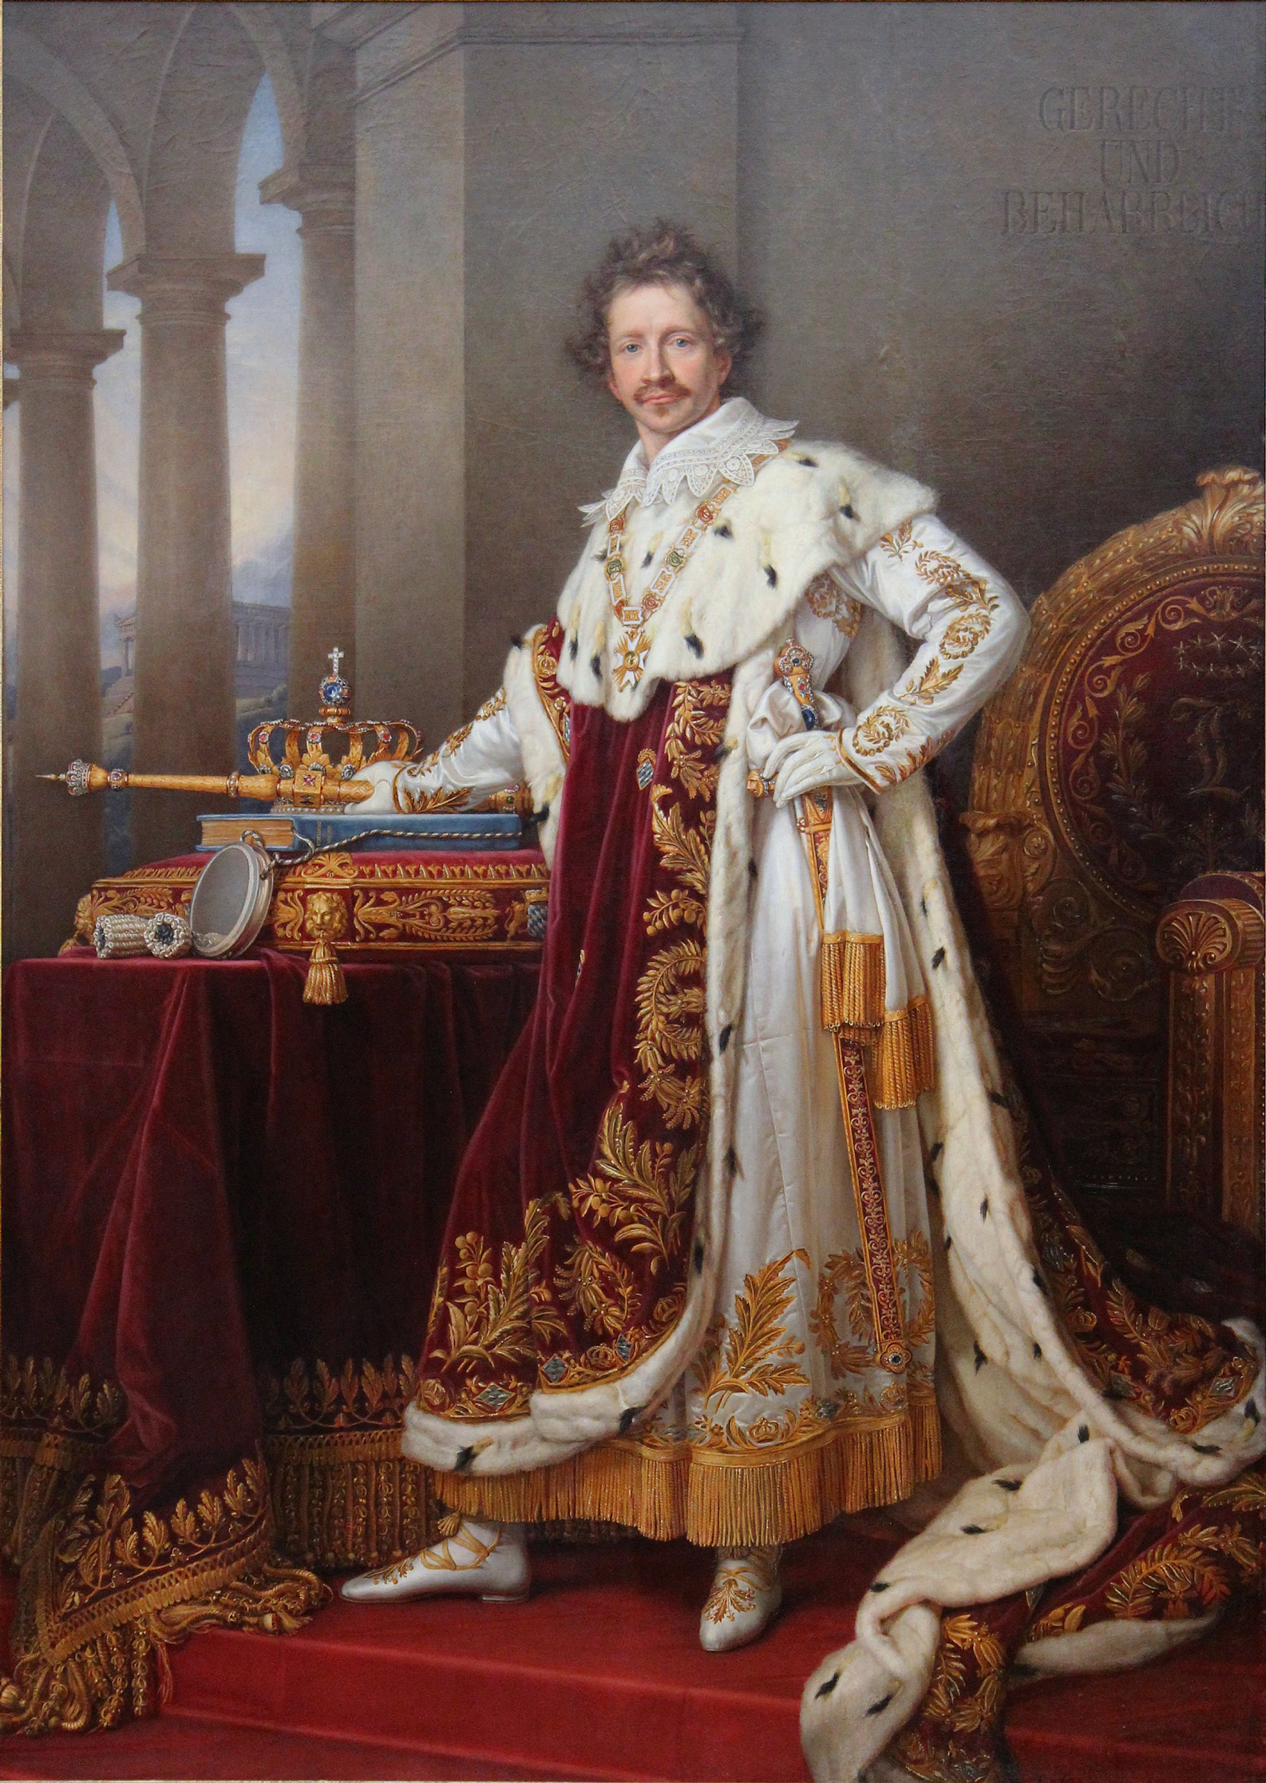
History of Oktoberfest
King Ludwig I of Bavaria
On October 12, 1810, Prince Ludwig married Princess Therese von Sachsen-Hildburghausen. They celebrated the wedding publicly in Munich and 40,000 people attended. Such a celebration of royalty with the public was previously unheard of and subsequently it became the annual tradition of Oktoberfest. The field where Oktoberfest takes place every year is named Theresienwiese (Therese’s field) in her memory.

Slide 3
Oktoberfestbier
Mӓrzen Origins
Origin is 100s of years before Oktoberfest
Brewed in March (Mӓrz) or end of Spring for consuming in the summer months when it was too hot to brew lager
More hops and higher alcohol to preserve through summer
Likely the stronger malt character is to balance the increased hops which also led to darker color
Originally much darker like a Munich Dunkel

Slide 4
Oktoberfestbier
Mӓrzen Changes
In 1872 Gabriel Sedlmayr, the head brewer at Franziskaner (now Spatenbräu), decided to lighten the beer to appeal to the greater European trend of lighter, pale lagers
Originally called Ur-Marzën, “original Marzën”
Other Munich breweries quickly followed suit due to popularity

Slide 5
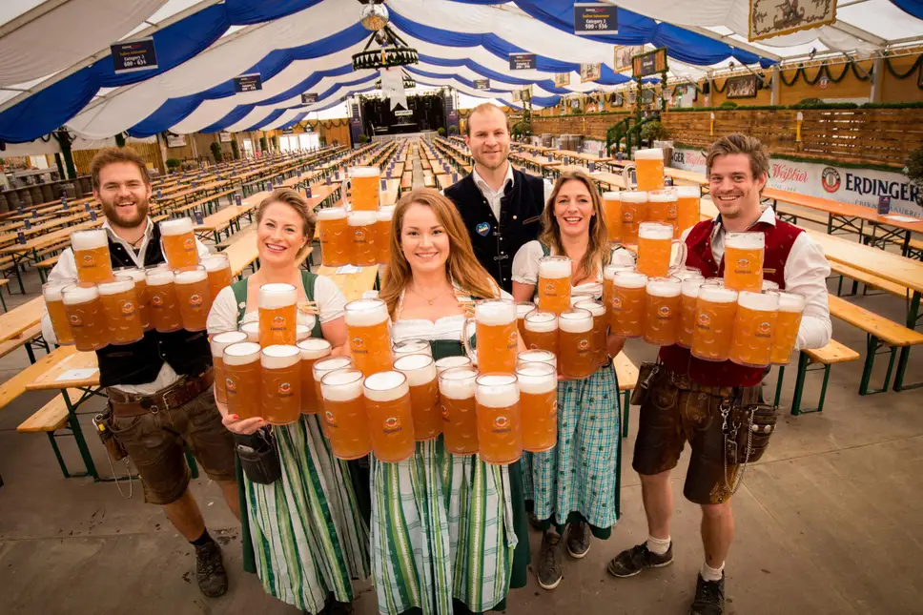
Oktoberfestbier
Only 5 Breweries legally brew for Oktoberfest
Augustiner-Bräu
Hacker-Pschorr-Bräu
Löwenbräu
Spatenbräu
Staatliches Hofbräu-München
Must follow Reinheitsgebot
Must be minimum of 13.5% Stammwürze (6% ABV)
Must be brewed within city limits of Munich
Served in 2 liter steins within festival halls

Slide 6
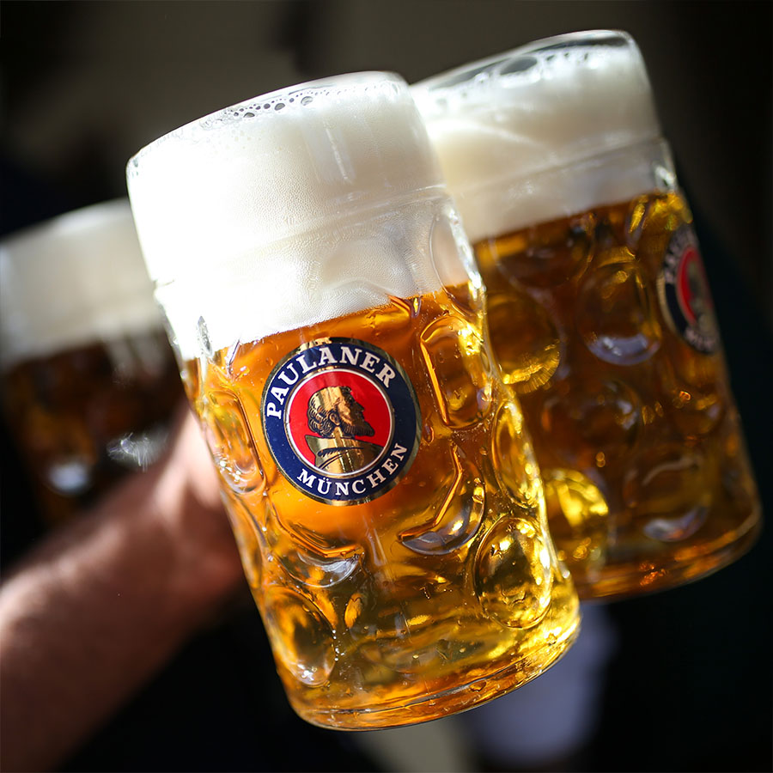
Festbier Further Changes
In 1970’s Paulaner felt the Mӓrzen style was too heavy and decided to make a lighter lower alcohol version
Alcohol is under 6% ABV
Lighter golden color with no amber hues
Now the standard for serving at festivals but Mӓrzen is still brewed by many brewers

Slide 7
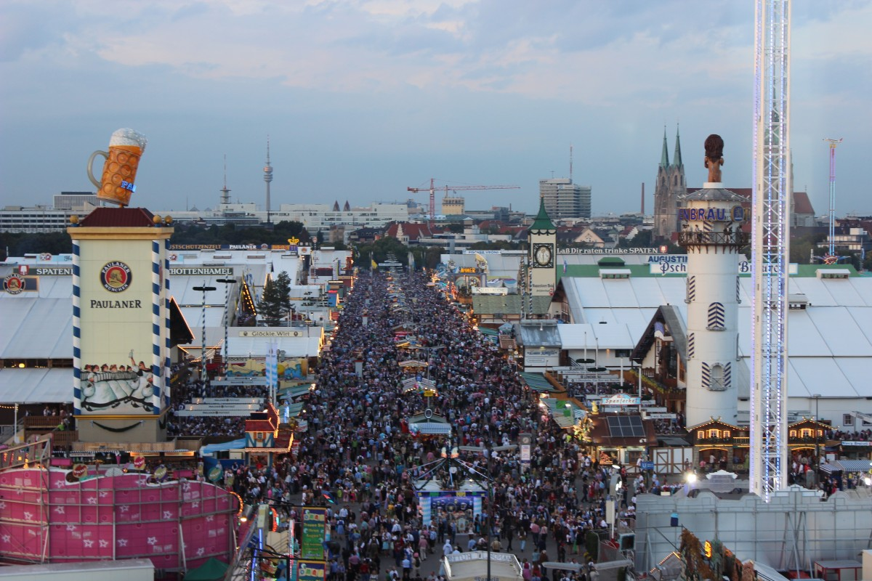
Interesting Facts
Oktoberfest attracts roughly 2 million visitors every year

Slide 8
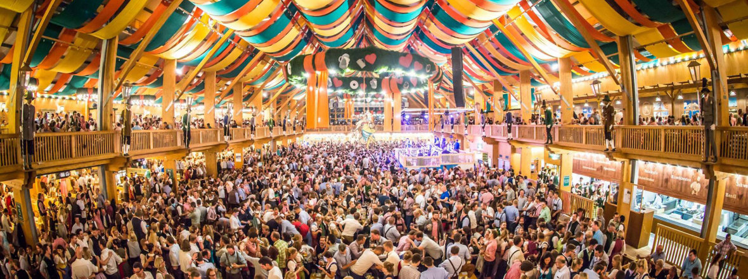
Interesting Facts
Locals call the festival die Wies'n in their local dialect

Slide 9
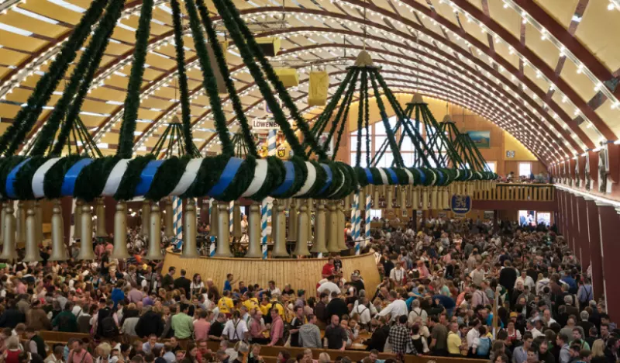
Interesting Facts
Many other beer festivals in Germany, including Volksfest in Stuttgart, the second largest

