Slide 1
Brewing Trappist Ales
David Wilson, Sudzers October 2019 Meeting

Slide 2
Terminology
Trappist vs. Abbey vs. Belgian
Trappist: Technically an appelation (Authentic Trappist Product) that is exclusive to a small number of Trappist abbeys. Trappist is a marketing term, not a style.
Achel
Chimay
Orval
Rochefort
Westmalle
Westvleteren

Slide 3
Terminology
Trappist vs. Abbey vs. Belgian
Abbey: Means a beer is associated with an abbey, often produced by commercial breweries licensing an Abbey’s name.
Leffe (AB InBev)
Affligem (Heineken)
St. Feuillien

Slide 4
Terminology
Trappist vs. Abbey vs. Belgian
Belgian: Term can be used by any brewer to describe beers brewed in the style of trappist or abbey ales. May also include styles falling outside of trappist production (i.e. belgian wit).
Russian River
Duvel Moortgat
Allagash

Slide 5
Terminology
Lower ABV Light Trappist Ales (SRM: 3-5, OG: 1.030-1.060)
Single, Patersbier, Enkel, Blond, Extra
Westmalle Extra, Westvleteren Blond, Achel Blond
Higher ABV Light Trappist Ales (SRM: 4-8, OG 1.060-1.085)
Tripel (Belgian Golden Strong, “Abbey”)
Westmalle Tripel, Chimay White, Tripel Karmeliet, Damnation

Slide 6
Terminology
Lower ABV Dark Ales (SRM: 10-17, OG: 1.062-1.075)
Dubbel
Rochefort 6, Westmalle Dubbel, Chimay Red
Higher ABV Dark Trappist Ales (SRM: 12-22, OG 1.075-1.110)
Belgian Dark Strong, Quadrupel (Quad)
Rochefort 10, Westvleteren 12, Chimay Grande Reserve

Slide 7
BJCP Recognized Trappist Ales
Single
Dubbel
Tripel
Belgian Dark Strong

Slide 8
Malt (Castle/Dingemans)
Belgian pilsner malt is the base malt for all styles
A good tripel can be made with just pilsner and sugar
Light and dark style character malts
Aromatic/Biscuit (15-30 L)
Munich/Vienna (3-15 L)
Additional dark style character malts
Caravienne (20-25 L)
Caramunich (40-60 L)
Special B (~150 L, controversial)
Roasted malts (300-500 L)*
*Generally I’m against roasted malts in belgian beers

Slide 9
Adjuncts
Sugar
Should account for 5-20% of your fermentables
Plain white table sugar is fine for light beers
Can use belgian “candi” syrups for darker beers
Avoid the “rock candy”. Belgian brewers use “caramel syrup” made from caramelized invert syrup
Wheat (malted or flaked)
Can be used in low amounts (~5%) for head retention or higher amounts (30%) for body and flavor

Slide 10
Hops
Use noble hops, aim for BU:GU ratio of 3:8. Higher for light beers, lower for darker beers
Hallertau, Tettnanger, Spalt, Saaz
“Hoppy” Belgian Pale Ales are also now in vogue
Allagash’s “Hoppy Table Beer” and The Bruery’s “Mischief”
Not traditional, but can be fun to play with

Slide 11
Water

Slide 12
Water
Target relatively soft water
2:1 Sulfate to Chloride for lighter beers
1:1 Sulfate to Chloride for darker beers
Adjust water with acid as needed to hit mash pH (5.2-5.5)

Slide 13
Brewing
Single infusion mash is sufficient, between 148-150 F. Avoid protein rest on modified malts.
Add sugar at end of boil for light beers, at start of boil for dark beers
Alternatively, add sugar to fermenter at high krausen to avoid stressing a low yeast pitch
Long boil
90 min often suggested
DMS is a concern
Aerate well, pitch a healthy starter

Slide 14
Yeast
Yeast is the soul of any good belgian beer
Historically all trappist ales were brewed with an Abbey’s house culture
Often times gifted from other Abbeys
Characterized by esters (solventy, bubblegum, tropical fruit, bannana) and phenolics (bandaid-plastic, clove). May also have a light sulfur finish

Slide 15
Yeast
Many Trappist strains are “commercially available”
White Labs | Wyeast | Origin
WLP500 | WY1214 | Chimay
WLP530 | WY3797 | Westmalle
WLP540 | WY1762 | Rochefort
WLP550 | WY3522 | Achouffe
WLP570 | WY1388 | Duvel
WLP510 | -- | Orval*
-- | WY3864 | Unibroue
*Add brett at packaging to simulate Orval

Slide 16
Yeast
Caveats
Most of these strains were isolated decades ago
Fermentation context matters (volume, geometry, temperature, pitch rate, etc.)
Results may vary

Slide 17
Fermentation
Pitch plenty of healthy, viable yeast and PITCH COLD
Pitch between 62-66 F
Hold at lower temperatures (66-68 F) for 1 day
Allow to freerise (68-80 F). Avoid chilling excessively at this point to avoid stalling yeast
Thoroughly aerate
Pull off airlock and shake yeast up at day 2
Can add sugar adjuncts at this point too
Rest at F.G. at room temperature for 3-5 days
Cold condition for 1-2 weeks

Slide 18
Fermentation
Achel
Pitch at 63-64 F, Freerise to 72-73 F
Westmalle
Pitch at 64 F, Freerise to 68 F
Westvleteren
Pitch at 68 F, Freerise to 84 F (open fermentation)

Slide 19
Style Specifics - Single
Fermentables
Pilsner malt (50-90%)
Munich/aromatic/biscuit (0-5%)
Wheat (0-25%)
Sugar (5-15%)
Hops
Noble (traditional) or American (“hoppy belgian”)
Spices (uncommon)

Slide 20
Style Specifics - Tripel
Fermentables
Pilsner malt (75-90%)
Munich/aromatic/biscuit (0-5%)
Wheat (0-5%)
Sugar (5-20%)
Hops
Noble

Slide 21
Style Specifics - Dubbel
Fermentables
Pilsner malt (60-85%)
Munich/aromatic/biscuit (0-15%)
Light crystals, 20-60 L (0-10%)
Special B (0-5%)
Roasted malts (0-5%)
Candi Syrup (5-15%)
Hops
Noble
Extras
Dried fruit (not traditional)

Slide 22
Style Specifics - BDS
Fermentables
Pilsner malt (50-85%)
Munich/aromatic/biscuit (0-20%)
Light crystals, 20-60 L (0-10%)
Special B (0-7%)
Roasted malts (0-5%)
Candi Syrup (5-15%)
Hops
Noble
Extras
Dried fruit (not traditional)
Barrel aging (not traditional)

Slide 23
Post Fermentation
Clarity should be good
Cold conditioning and finings agents should achieve this
Carbonation should be medium-high to high
Light ales: 2.5-3 volumes
Dark ales: 2-2.5 volumes
Bottle conditioning may require re-yeasting
Remember to use heavy walled bottles!

Slide 24
General Tips
Brew a dry beer
Mash low, use sugar, pitch enough yeast, avoid excessive chilling at end of fermentation
Limit use of crystal malts
Simpler is (usually) better
Pitch cold
Rest after hitting F.G. and allow for long cold conditioning
Play with different yeast strains, find your favorite
Orval: Bottle with brettonamyces

Slide 25
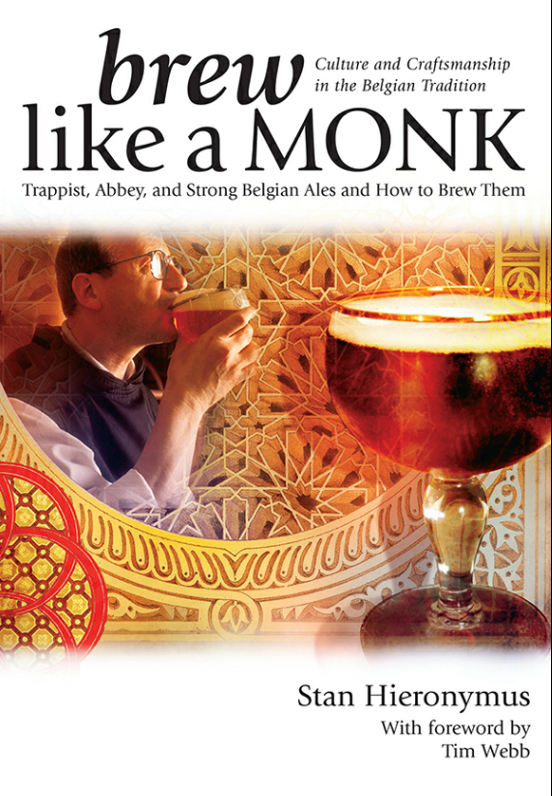
Questions?

