Slide 1
2019 Sudzers Financial Report
Derek Wolfgram, Sudzers CFO
January 12, 2020

Slide 2
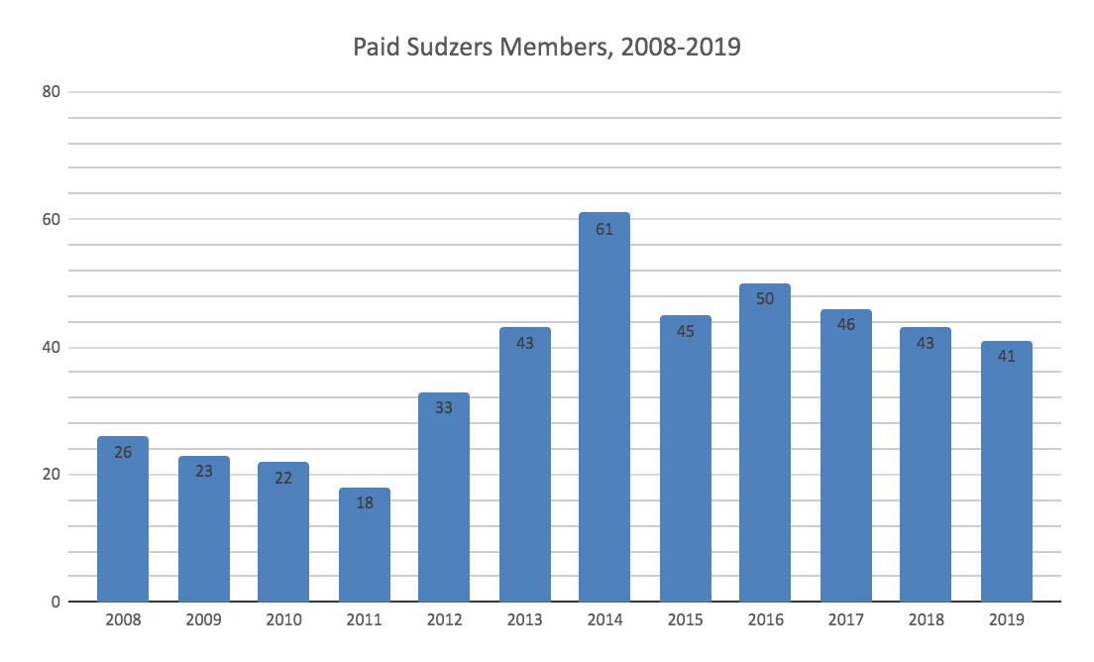
Membership
41 paid members in 2019
28 continuing members
13 new or returning members
17 departed members

Slide 3
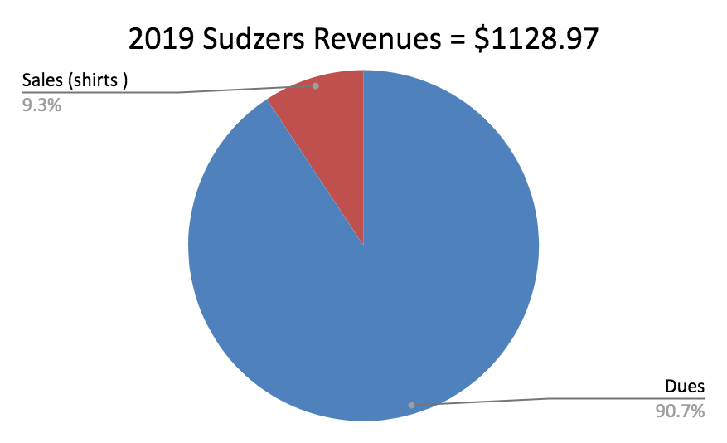
Financials - Revenues

Slide 4
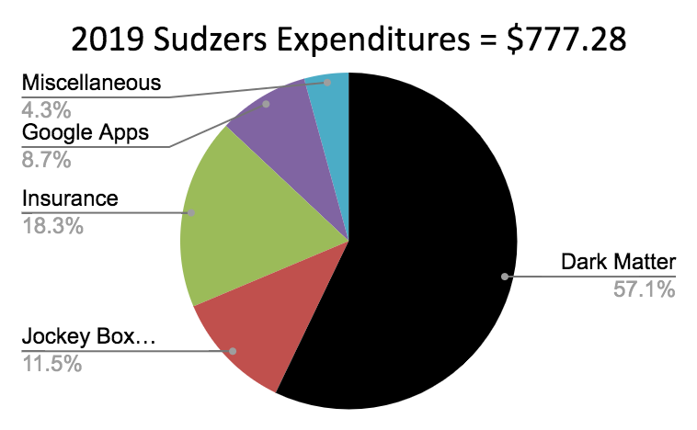
Financials - Expenditures

Slide 5
Financials - Summary
Revenues |  |  | Expenditures
Dues | $ 1,023.97 |  | Dark Matter | $ 444.18
Sales (shirts ) | $ 105.00 |  | Jockey Box supplies | $ 89.46
 |  |  | Insurance | $ 142.50
 |  |  | Google Apps | $ 67.96
 |  |  | Miscellaneous | $ 33.18
 | $ 1,128.97 |  |  | $ 777.28

Slide 6
Balance History
 | Beginning of Year balance | Revenues | Expenses | End of Year Balance
2015 | $ 451.41 | $ 1,405.00 | $ (863.33) | $ 993.08
2016 | $ 993.08 | $ 1,912.34 | $ (1,733.83) | $ 1,171.59
2017 | $ 1,171.59 | $ 1,560.00 | $ (1,862.18) | $ 869.41
2018 | $ 869.41 | $ 1,483.97 | $ (1,721.83) | $ 631.55
2019 | $ 631.55 | $ 1,128.97 | $ (777.28) | $ 983.24

Slide 7
Inventory
2019 | Qty | Each | Inv | Sales
Gen 5 T-Shirts, Dark Matter
Beginning on hand inventory | 1 | $ 5.00 | $ 5.00
Comp | 1
Ending on hand inventory | 0 | $ 5.00 | $ -
Gen 6 T-Shirts, Prohibition
Initial inventory | 2 | $ 5.00 | $ 10.00
Sales | 2 | $ 5.00 |  | $ 10.00
Ending on hand inventory | 0 | $ 5.00 | $ -
Gen 7 T-Shirts, Waffle
Initial inventory | 6 | $ 5.00 | $ 30.00
Sales | 5 | $ 5.00 |  | $ 25.00
Ending on hand inventory | 1 | $ 5.00 | $ 5.00
Gen 8 Shirts, Polo
Initial inventory | 8 | $ 10.00 | $ 80.00
Sales | 7 | $ 10.00 |  | $ 70.00
Ending on hand inventory for sales | 1 | $ 10.00 | $ 10.00
BOH Shirt Inventory | 17 |  | $ 100.00
EOH Shirt Inventory | 2 |  | $ 15.00
2019 Shirt Sales | 14 |  |  | $ 105.00
2019 Shirt Comps | 1

Slide 8
2019 Sudzers Financial Report
Derek Wolfgram, Sudzers CFO
January 12, 2020

