Slide 1
Trappist Ales History
David Wilson, Sudzers January 2020 Meeting

Slide 2
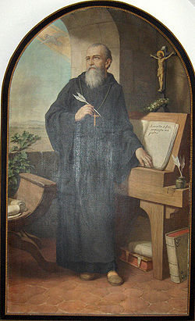
Rule of Saint Benedict
Written in 516 by Benedict of Nursia
Outlines the tenets of monastic living
Founded Order of Saint Benedict
Emphasizes ora et labora (prayer and labor)
“for then are they monks in truth, if they live by the work of their hands”
Manual labor, self sufficiency, solitude, simple living, hospitality to travelers (beer was safe to drink)
To support the abbey through manual labor, monks would produce beer, cheese, wine, honey, and many other goods.

Slide 3
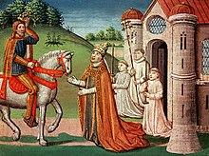
Monastic Brewing
Prior to commercialization in the 12th and 13th century, monasteries represented large scale facilities for brewing beer in continental europe.
Charlemagne is crowned the first emperor of the Holy Roman Empire in 800
Charlemagne was a big fan of monastic brewing, encouraged its spread

Slide 4
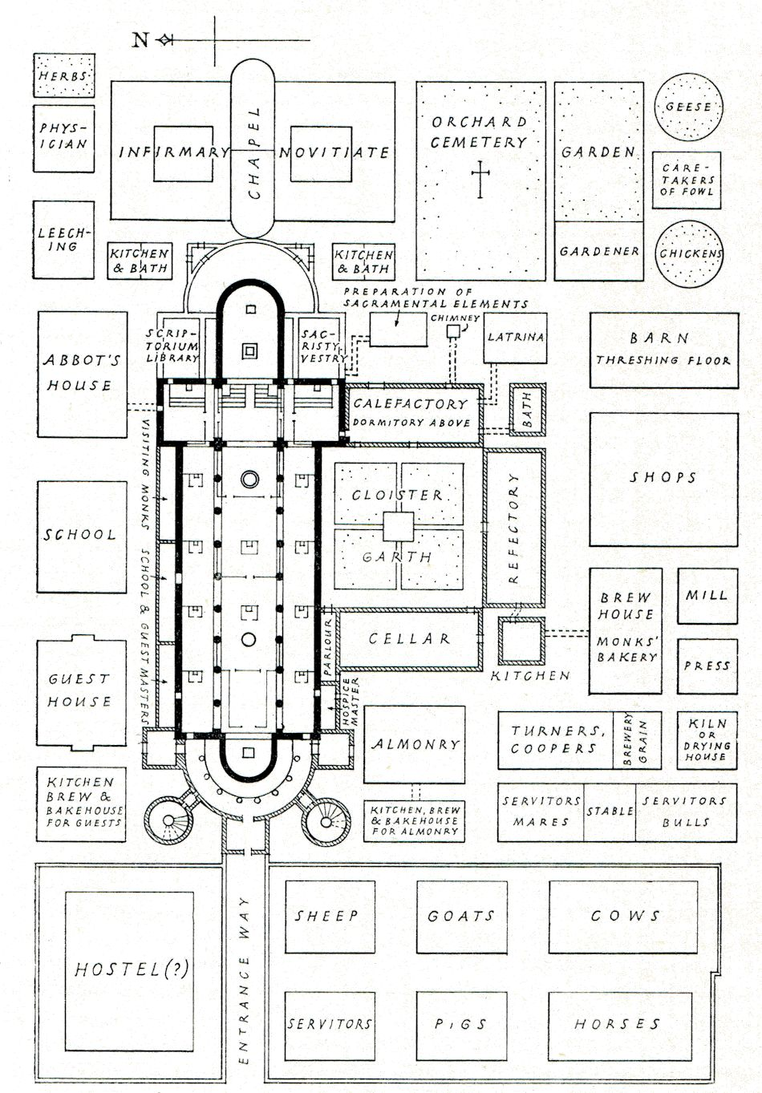
Saint Gall Monastery (802)

Slide 5
Trappiste Origins
In 1098, the Order of Cistercian branched off from the Benedictines in the south of France
They felt the Benedictines were getting too soft
In 1664 a small group of Cistercians at La Trappe branched off in Northern France
They felt the Cistercians were getting too soft
Re-emphasized the tenets of manual labor, silence, meagre diets, isolation.
Manual labor was meant to sustain the monestary, keep contact with the outside world to a minimum

Slide 6
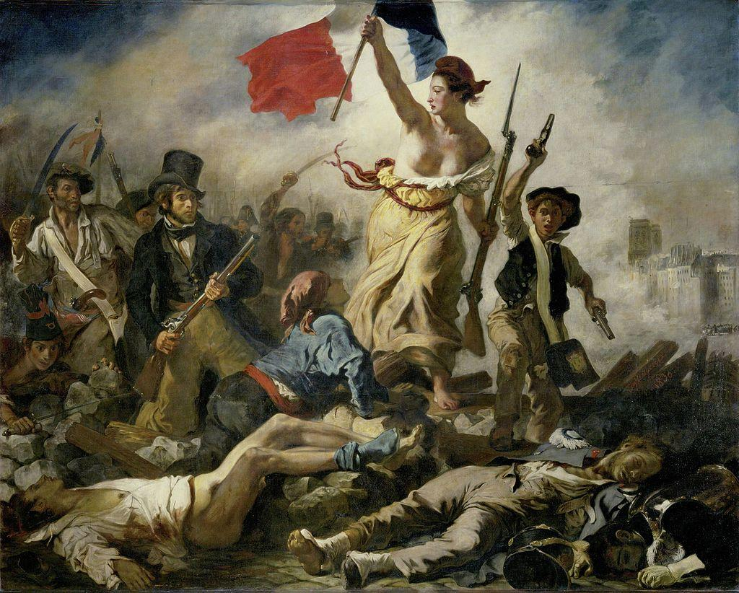
French Revolution
The French Revolution (1792-1802) was not a good time for Trappists, most monasteries were confiscated by the revolutionary government and many monks were executed
Monks fled France as far east as Russia and a Trappist monastery was founded at Westmalle (1802)

Slide 7
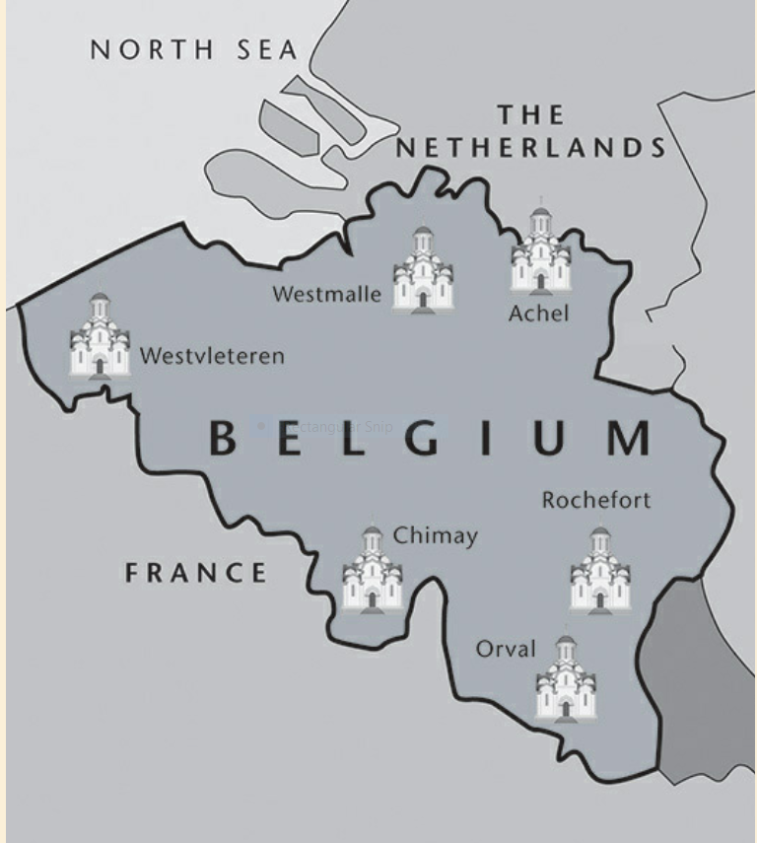
Trappist Brewery Timeline
1830 - Belgium declares independence
1834 - Westvleteren is founded
1836 - Brewing begins at Westmalle
1839 - Brewing begins at Westvleteren
1844 - Monks from Westmalle found Achel
1850 - Monks from Westvleteren found Chimay
1852 - Brewing begins at Achel
1862 - Brewing begins at Chimay
1887 - Monks from Achel re-establish Rochefort
1899 - Brewing begins at Rochefort
1926 - Orval is rebuilt and established as a Trappist monastery
1932 - Brewing begins at Orval

Slide 8
Trappist Brewery Timeline
1919 - Belgian government prohibits the sale of spirits in bars
Genever, the parent liquor of Gin, is very popular at the time
To fill the market segment voided by spirits, brewers begin increasing alcohol content significantly
1922 - Westmalle begins adding dark candi sugar to boost ABV
1934 - Westmalle builds a new production facility, begins selling the first Tripel
A response to both the 1919 law and the invasion of trendier light colored beers
1948 - Chimay yeast is isolated and Chimay Blue is brewed for the first time

Slide 9
Trappists in the 20th Century
The University of Leuven was, and still remains, an authority on brewing best practices and innovation
WWI and WWII cause disruption in brewing
Westvleteren modernized after WWI
Chimay rebuilds and expands after WWII
Breweries continued to boost ABV, realizing they could charge more for stronger beers
Trappists win court ordered brand protection in 1962
Employing laypeople in the brewery became increasingly common along with modern brewing equipment and QC practices (e.g. cylindroconical vessels, heat x chillers, VD tests, etc.)

Slide 10
Trappists in the 21st Century
Today there are ~170 trappist monasteries around the world, mainly in Belgium, France, Spain and America
Almost all of them produce some kind of local products
Officially 14 of them are recognized as Trappist beer producers
6 in Belgium
2 in the Netherlands
1 in America (Spencer Brewery, St. Joseph’s Abbey in Spencer, MA)
Founded in 1950, began brewing in 2010
1 each in Italy, France, Spain, England and Austria
Limited advertisement and distribution remains important (to varying degrees, i.e. Chimay vs Westvleteren)

Slide 11
David’s Pontification
While the practice of monastic brewing dates back centuries, the modern Trappist beers we enjoy today are a product of modern history. The monasteries themselves are largely a product of the Trappist diaspora initiated by the French revolution, and the character of the beers is in response to 20th century alcohol laws and consumer trends. Is the spirit of monastic brewing still intact? The sales of Trappist beer continue to support monasteries, charities and community organizations. But global distribution and the use of laypersons in the brewery stands in conflict with the Rule of Saint Benedict. Perhaps in the 21st century, a new understanding of ora et labora is required. The impact of Trappist brewing in American craft beer has also been significant, both helping to create the market and inspiring American brewers.

Slide 12
Questions?

