Slide 1
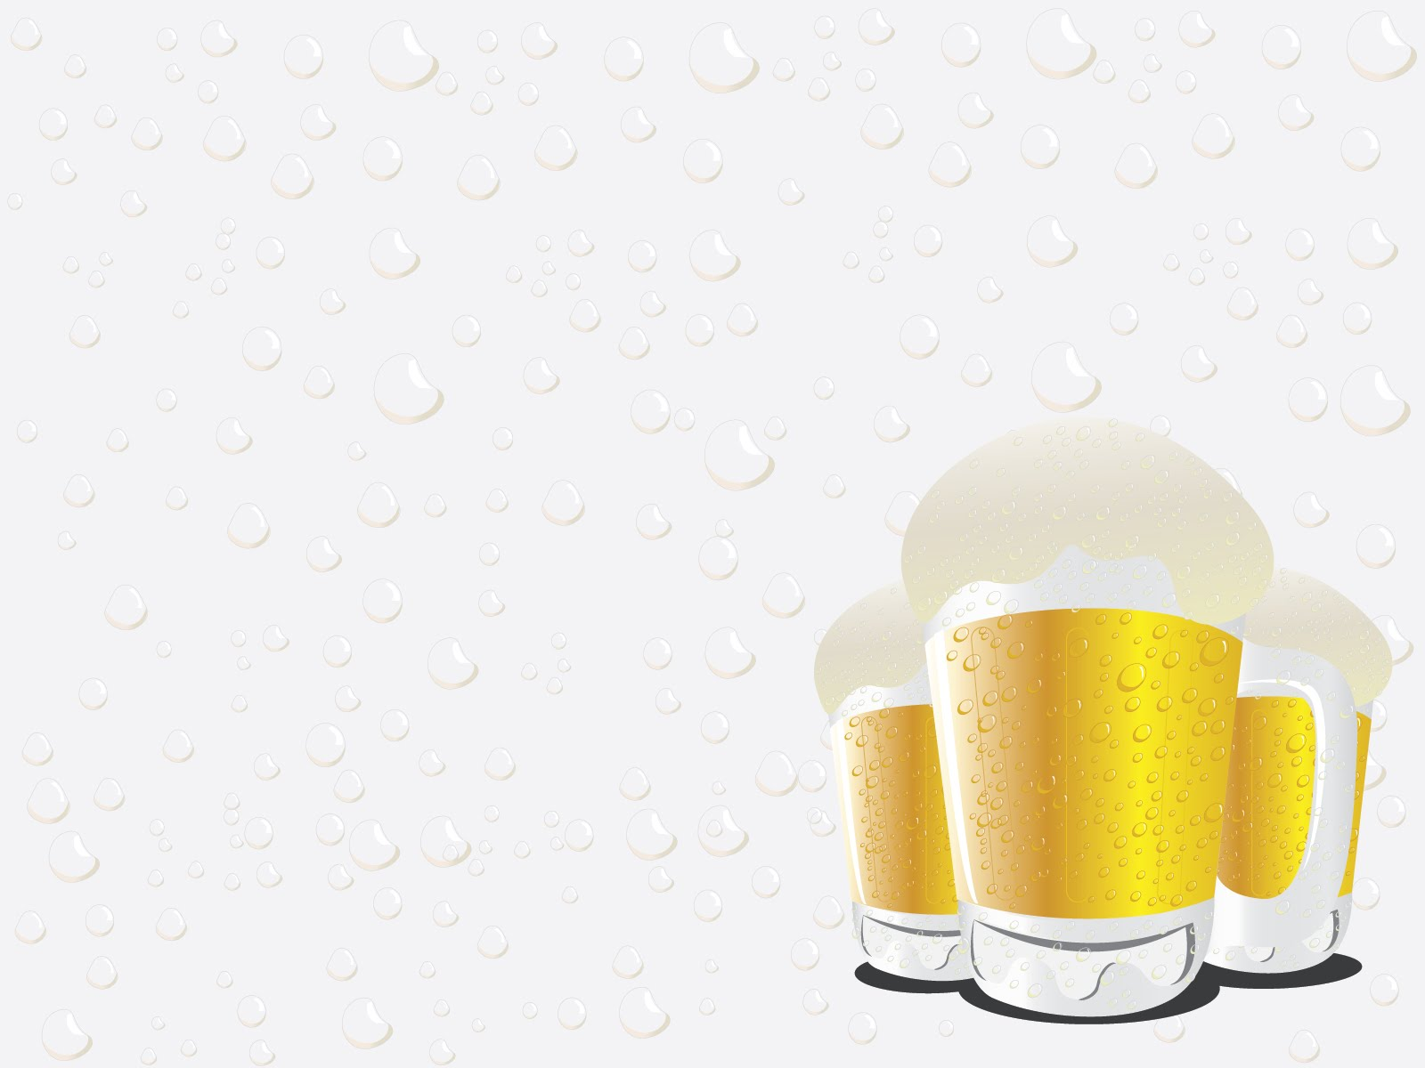
Stouts
Sudzers February 2020 meeting

Slide 2

Stouts vs. Porters
“Historically speaking, the first of the two styles was porter, born about 300 years ago from the English brown ales of the time. Stouts came after, as stronger, fuller-bodied versions of porters, aka ‘stout porters.’ When a pub offered both a stout and a porter, stout was always the stronger beer.”
“One similarity across stouts is they are more likely to contain roasted barley as opposed to most porters (though more robust porters may have some).”
https://www.allagash.com/blog/stout-vs-porter-whats-the-difference/

Slide 3
BJCP 2015 styles
Irish Beer
Style | OG | FG | ABV | IBUs | SRM
15B. Irish Stout | 1.036–1.044 | 1.007–1.011 | 4.0–4.5% | 25–45 | 25–40
15C. Irish Extra Stout | 1.052–1.062 | 1.010–1.014 | 5.5–6.5% | 35–50 | 25–40
16A. Sweet Stout | 1.044–1.060 | 1.012–1.024 | 4.0–6.0% | 20–40 | 30–40
16B. Oatmeal Stout. | 1.045–1.065 | 1.010–1.018 | 4.2–5.9% | 25–40 | 22–40
16C. Tropical Stout | 1.056–1.075 | 1.010–1.018 | 5.5–8.0% | 30–50 | 30–40
16D. Foreign Extra Stout | 1.056–1.075 | 1.010–1.018 | 6.3–8.0% | 50–70 | 30–40
20B. American Stout | 1.050–1.075 | 1.010–1.022 | 5.0–7.0% | 35–75 | 30–40
20C. Imperial Stout | 1.075–1.115 | 1.018–1.030 | 8.0–12.0% | 50–90 | 30–40
Dark British Beer
American Porter
And Stout
Notes:
Irish Stout-

Slide 4
BJCP 2015 styles
Style | Description
15B. Irish Stout | Roasty, coffee, bitter chocolate, similar to Irish Extra Stout but lower ABV
15C. Irish Extra Stout | Fuller bodied, bittersweet to bitter, between Irish Stout and Foreign Extra Stout
16A. Sweet Stout | Full body, slightly roasty, ‘coffee-and-cream’ or ‘sweetened espresso’, lactose
16B. Oatmeal Stout. | Full body, roasty, malty, sweet/bitter balance can vary; cross between 15C+16A
16C. Tropical Stout | Dark, sweet, fruity, smooth roast, no burnt harshness, warm fermented lager yeast, ‘like a scaled-up sweet stout with higher fruitiness’
16D. Foreign Extra Stout | Fairly dry, prominent roast flavors, not as bitter as American Stouts
20B. American Stout | Highly roasted, more aggressive American hop character and bitterness
20C. Imperial Stout | “Like a black barleywine”, “intensely-flavored”, roasty, burnt, warming
Notes:
Irish Stout-

Slide 5
https://homebrewsupply.com/learn/homebrew-malt-comparison-chart.html
Some roasted malts
Type | SRM | Description
Extra Special (Briess) | 130 | Coffee, Marshmallow, Prune
Roasted Barley | 300 | Roasty, Burnt, Coffee, Nutty
Carafa I | 337 | Espresso-likt, coffee, chocolate, mild but noticeable roasted aftertaste
Carafa II | 412 | The de-husked version of Carafa; less hash flavors & bitterness
Chocolate Malt | 350 | Dark flavors of roasted coffee and cocoa
Black Patent | 500 | Has a sharper flavor than other roasted grains, burnt, roasted
Midnight Wheat | 550 | No bitter, astringent, dry flavors or aftertaste
Notes:
Irish Stout-

Slide 6
https://byo.com/article/american-stout-style-profile/
Recipe (American Stout)
85% Great Western domestic pale malt 2 °L (or similar)
5% Briess black barley 500 °L (or similar)
5% Great Western crystal malt 40 °L (or similar)
5% Briess dark chocolate malt 420 °L (or similar)
Horizon hops (60min, ~1oz); Centennial (5min, ~1oz)
WLP001 (California Ale Yeast)
Water: baking soda/chalk can offset acidity from roasted malts
OG = 1.072 (17.5 °P)
FG = 1.017 (4.4 °P)
IBU = 73 SRM = 48 ABV = 7.2%

Slide 7
https://www.brewersfriend.com/homebrew/recipe/view/550024/tropical-stout
Recipe (Tropical Stout)
72.4% United Kingdom - Maris Otter Pale
5.4% United Kingdom - Roasted Barley
3.6% United Kingdom - Extra Dark Crystal 160L
3.6% German - Carafa II
1.8% United Kingdom - Chocolate
1.8% Belgian - Special B
0.5% American - Caramel / Crystal 60L
10.9% Turbinado Sugar
Galaxy hops (60min, 30min, .75oz, 5min 1.5oz)
White Labs - San Francisco Lager Yeast WLP810 (58-65 degrees)
OG = 1.074
FG = 1.019
IBU = 45 SRM = 40 ABV = 7.2%

Slide 8
Adjuncts
Vanilla
Coffee
Chocolate (cocao nibs, powdered coca, …)
Maple Syrup
Wood (barrel aged, wood chips/cubes)
Cinnamon
Peppers
Sugars (Lactose, brown sugar, turbinado, etc,)
Fruits (berries, citrus, …)
Marshmallows
...

