Slide 1
History of Stout
Sudzers March 2020 meeting

Slide 2
Starts with Porters
John Felthman, guidebook “The Picture of London”, published 1802, wrote that Ralph Harwood invented ported in 1722 in London
Porter replicated “Three Threads”: “blend of three separate beers, consisting of one third each beer, ale*, and strong beer”, mixed at bar at point of service
“Entire” or “Entire-butt” since the whole thing was served from one cask
“Workingman’s pint of choice”, which may be the reason for the name “porter”
*probably refers to a drink made without hops
https://www.anchorbrewing.com/blog/porter-the-entire-history/
http://zythophile.co.uk/false-ale-quotes/myth-one-ralph-harwood-invented-porter-as-a-substitute-for-three-threads/

Slide 3
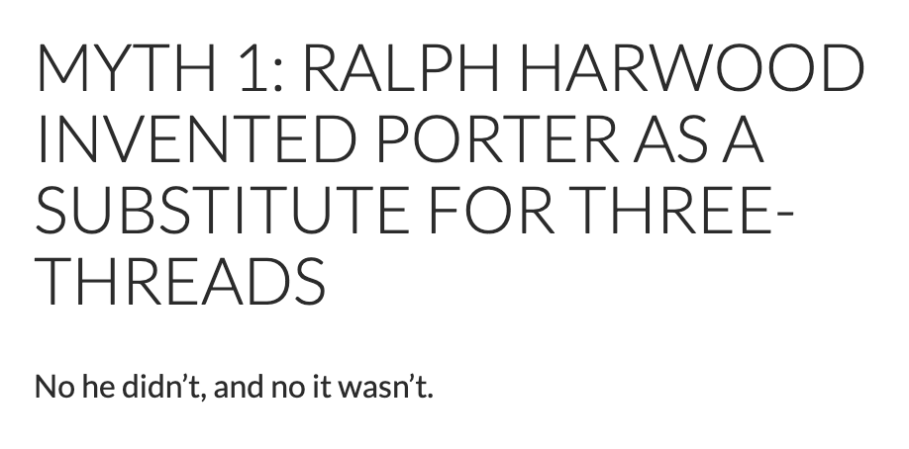
Or, maybe not...
http://zythophile.co.uk/false-ale-quotes/myth-one-ralph-harwood-invented-porter-as-a-substitute-for-three-threads/

Slide 4
Another story
“No previous writer in the 80-plus years since porter had first appeared had ever said the drink was an attempt to imitate another, mixed beer. Nor, apart from one brief attempt in 1788, almost 70 years after the event, had anyone before claimed Harwood of Shoreditch as the inventor of porter.”
John Tuck “Private Brewer’s Guide to the Art of Brewing Ale and Porter”, published 1822
“London’s brewers. who sold a “heavy and glutinous” brown beer, started to come under pressure from the brewers of paler beers which were popular with the country gentry now buying themselves houses in the capital.”
“About 1720., Tuck said, London’s brewers brought out an “improved” brown beer “started, well hopped, into butts, and … kept a considerable time to grow mellow.” “
http://zythophile.co.uk/false-ale-quotes/myth-one-ralph-harwood-invented-porter-as-a-substitute-for-three-threads/

Slide 5
Improved malts
“Wheeler’s invention of the malt roaster in 1817 made black malt available for the first time”
Previously, grains were floor malted; typically smoked due to the fuel source below the floor; inconsistent
Wheeler’s invention used a rotating metal drum; inspired by coffee makers
Allowed for more control over the time and temperature, and gave rise to many new malts
https://www.anchorbrewing.com/blog/porter-the-entire-history/
https://beerandbrewing.com/dictionary/QPuJzcZGJq/

Slide 6
Guinness
1759; Arthur Guinness signed a lease for the St. James’s Gate Brewery in Dublin for 9000 years at an annual rent of £45
1770’s started brewing porter, “Porter was different from ale because it was brewed using roasted barley, giving the beer a dark ruby colour and rich aroma.”
1799, porter was so popular that he stopped brewing ale altogether
“Arthur Guinness brewed different types of porter to suit different tastes, including a special export beer called ‘West India Porter’. This beer is still brewed today and is now known as GUINNESS Foreign Extra Stout.”
Interesting to note that the Guinness website credits Harwood with the creation of porter
https://www.guinness-storehouse.com/content/pdf/archive-factsheets/general-history/company-history.pdf

Slide 7
Porters and stouts
“I [Bob Brewer, Anchor] asked for a simple clarification of the stylistic difference because I considered it to be one of the more confused and ill-defined. Michael [Jackson]’s reply was that it was actually the MOST confused and ill-defined. He furthermore stated that even the best-researched and well-intended writings on the subject were “as unambiguous as a horoscope.””
https://www.anchorbrewing.com/blog/porter-the-entire-history/

Slide 8
Porters and stouts
“Historically speaking, the first of the two styles was porter, born about 300 years ago from the English brown ales of the time. Stouts came after, as stronger, fuller-bodied versions of porters, aka ‘stout porters.’ When a pub offered both a stout and a porter, stout was always the stronger beer.”
https://www.allagash.com/blog/stout-vs-porter-whats-the-difference/

Slide 9
BJCP 2015 styles
Style | Description
15B. Irish Stout | Roasty, coffee, bitter chocolate, similar to Irish Extra Stout but lower ABV
15C. Irish Extra Stout | Fuller bodied, bittersweet to bitter, between Irish Stout and Foreign Extra Stout
16A. Sweet Stout | Full body, slightly roasty, ‘coffee-and-cream’ or ‘sweetened espresso’, lactose
16B. Oatmeal Stout. | Full body, roasty, malty, sweet/bitter balance can vary; cross between 15C+16A
16C. Tropical Stout | Dark, sweet, fruity, smooth roast, no burnt harshness, warm fermented lager yeast, ‘like a scaled-up sweet stout with higher fruitiness’
16D. Foreign Extra Stout | Fairly dry, prominent roast flavors, not as bitter as American Stouts
20B. American Stout | Highly roasted, more aggressive American hop character and bitterness
20C. Imperial Stout | “Like a black barleywine”, “intensely-flavored”, roasty, burnt, warming
Notes:
Irish Stout-

Slide 10
Russian Imperial Stout
18th&19th century, British breweries exporting dark beer to Baltic ports, and from that, we got the RIS and Baltic Porters, both much higher ABV versions of the original porters and stouts
“Though the history of imperial stout is somewhat murky, it was indeed a London brewery that is credited with popularizing the style as a strong, exported stout. Around 1781, Barclay Perkins began exporting its stout to assorted ports in the Baltic region. Purposely brewed to be a formidable beer, it would easily withstand the voyage. “
“When Empress Catherine II discovered it, its place in Russian legend was cemented. The commercial viability of the brew ensured that the style endured.”
Today, under the name of Courage, the same imperial stout is still brewed in London.
http://allaboutbeer.com/article/imperial-stout-4/

Slide 11
Tropical Stout
A style born in the West Indies (mostly the Caribbean) and West Africa
Before 2015 BJCP guidelines, it was a subcategory of Foreign Extra Stout
The style originated from the British exporting Porter to the English colonies in the Indies
“by 1801 Guinness was brewing their “West Indies Porter” and it was being exported into Barbados, Trinidad and the rest of the Caribbean.” (probably a ‘stout’ porter)
Local brewers in the Caribbean, and then Africa, started making their own
“A tropical stout makes use of indigenous grain and adjunct sugars where possible and, because most of these “hot clime” breweries are heavily committed to lager brewing, this style often uses lager yeast, instead of the usual ale yeast. “
Less hops were used in local versions
https://learn.kegerator.com/tropical-stouts/

