Slide 1
2020 Sudzers Financial Report
Derek Wolfgram, Sudzers CFO
January 10, 2021

Slide 2
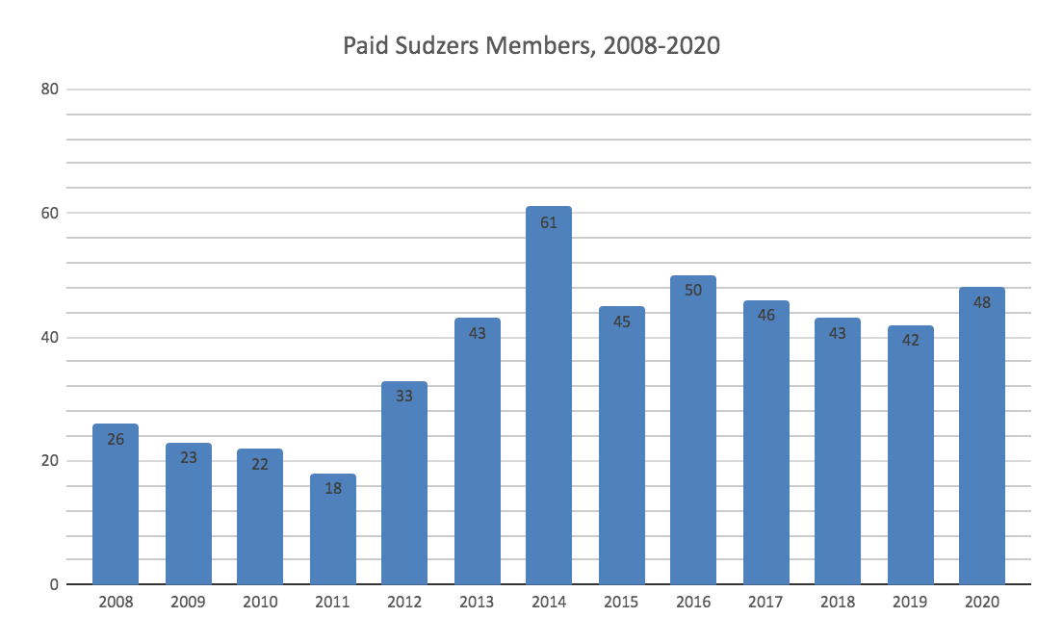
Membership
48 paid members in 2020
34 renewing members
14 new or returning members
8 departed members (fewest since 2012)

Slide 3
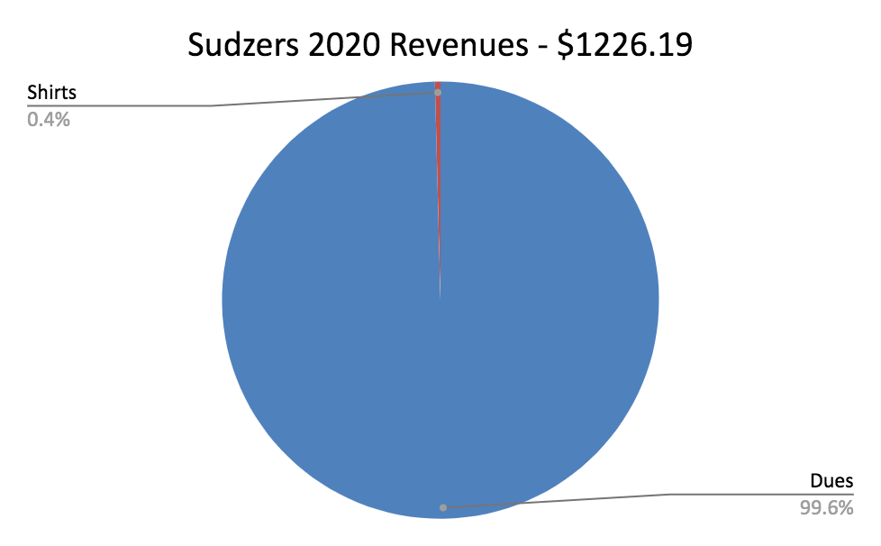
Financials - Revenues

Slide 4
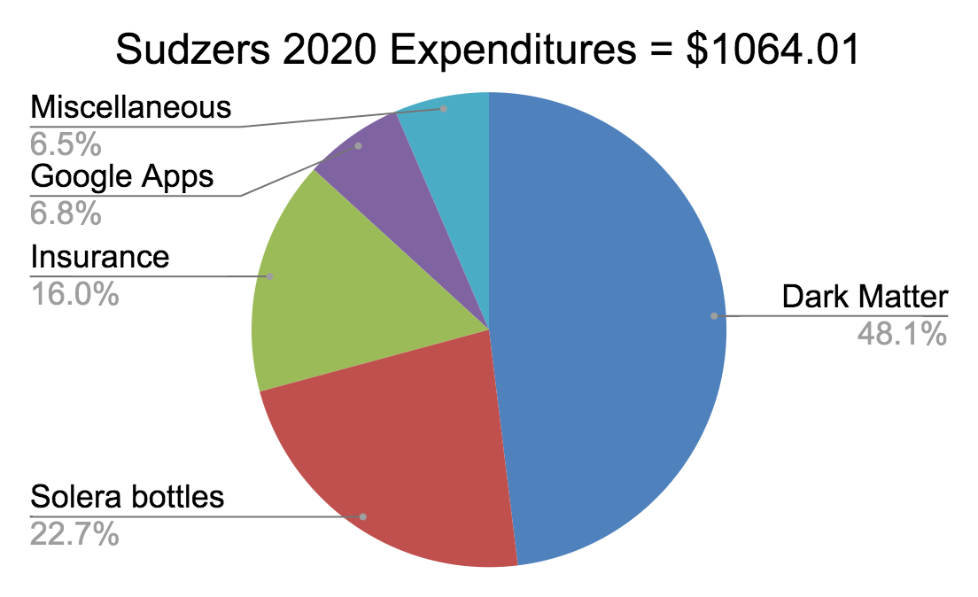
Financials - Expenditures

Slide 5
Financials - Summary
Revenues |  |  | Expenditures
Dues | $ 1,221.19 |  | Dark Matter | $511.35
Shirt Sales | $ 5.00 |  | Solera bottles | $242.00
 |  |  | Insurance | $170.00
 |  |  | Google Apps | $72.00
 |  |  | Miscellaneous | $68.66
Total | $ 1,226.19 |  | Total | $1,064.01

Slide 6
Balance History
 | Beginning of Year balance | Revenues | Expenses | End of Year Balance
2015 | $ 451.41 | $ 1,405.00 | $ (863.33) | $ 993.08
2016 | $ 993.08 | $ 1,912.34 | $ (1,733.83) | $ 1,171.59
2017 | $ 1,171.59 | $ 1,560.00 | $ (1,862.18) | $ 869.41
2018 | $ 869.41 | $ 1,483.97 | $ (1,721.83) | $ 631.55
2019 | $ 631.55 | $ 1,128.97 | $ (777.28) | $ 983.24
2020 | $ 983.24 | $ 1,226.19 | $ (1,064.01) | $ 1,145.42

Slide 7
Inventory
2020 | Qty | Each | Inv | Sales
Gen 7 T-Shirts, Waffle
Initial inventory | 1 | $ 5.00 | $ 5.00
Sales | 1 | $ 5.00 |  | $ 5.00
Ending on hand inventory | 0 | $ 5.00 | $ -
Gen 8 Shirts, Polo
Initial inventory | 1 | $ 10.00 | $ 10.00
Sales | 0 | $ 10.00 |  | $ -
Ending on hand inventory for sales | 1 | $ 10.00 | $ 10.00
BOH Shirt Inventory | 2 |  | $ 10.00
EOH Shirt Inventory | 1 |  | $ 10.00
2020 Shirt Sales | 1 |  |  | $ 5.00

Slide 8
2020 Sudzers Financial Report
Derek Wolfgram, Sudzers CFO
January 10, 2021

