Slide 1
Important Home Brewer practices that really aren’t
One homebrewer’s journey
Mike Conant, Silicon Valley Sudzers
October 14, 2018

Slide 2
It ain’t what you don’t know that gets you into trouble. It’s what you know for sure that just ain’t so.
- Quote that is falsely attributed to Mark Twain

Slide 3
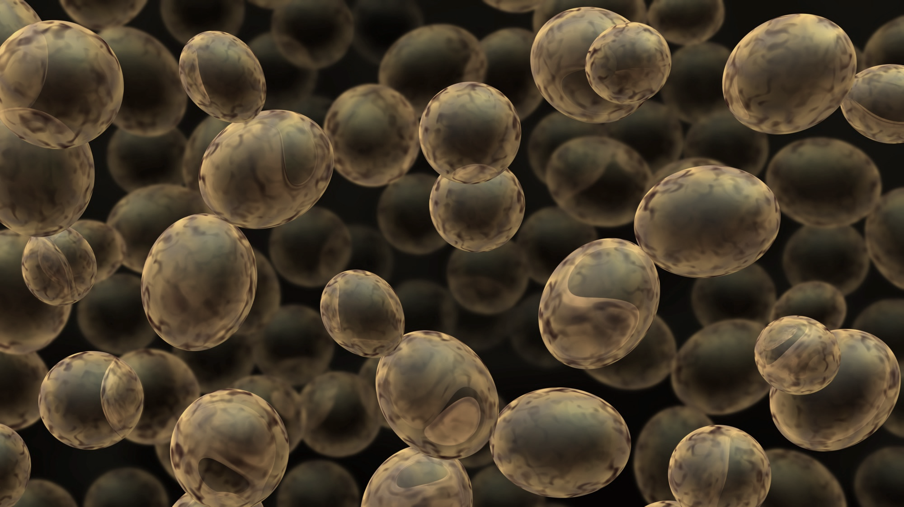
1. “Keeping beer on yeast longer than 2-3 weeks is bad”
Homebrewers are more often guilty of taking beer off yeast too soon!
Yeast cleans up diacetyl and acetaldehyde
Autolysis should not be a problem – for months even!
Sudzer suggestion: 1) focus on keeping light and oxygen away!
2) Keep temperature in control appropriate for your style
3) MINIMIZING transfers minimizes O2 and contamination

Slide 4
2. “Good tasting water makes good beer”
Yeah, BUT …
Your water profile may work for some styles, and not for others! And chloramines kill all good beer
It matters even for extract brewing
For mash brewing, it matters even more (for mash enzyme activity)
Sudzer suggestion: 1) Pay attention to water salts as part of your recipe
2) Use Campden tablets to clean up chloramines!
3) If all-grain brewing, use a pH meter to get acidity right

Slide 5
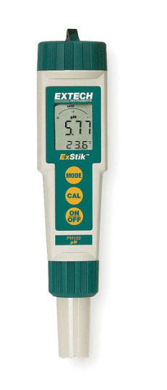
pH meter
Extech EXSTIK ~$70 (shown)
Make sure it is accurate enough (+/- 0.1 pH really doesn’t cut it)
Measure at room temp…temperature compensating pH meters DO NOT account for the organic chemistry of the mash

Slide 6
3. “Chill wort immediately after turning off flame to get a good cold break”
More important for light styles when you want clarity and minimal DMS
The whirlpool is a GREAT time for extracting hop floral characteristics
Sudzer suggestion: 1) Rapid chill for light beer styles
2) Whirlpool hops…but minimize contamination with a cover

Slide 7
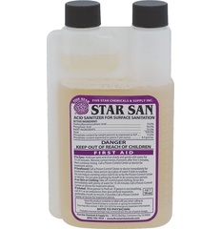
4. Rinsing off the STAR SAN bubbles
“Don’t fear the foam!”
No need to rinse
Phosphoric acid will not impact beer flavor
Sudzer suggestion: 1) Use the minimum 1 minute contact time
2) Is it still good? Measure pH should be <3

Slide 8
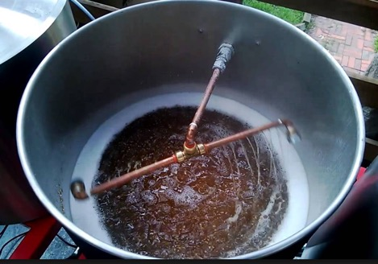
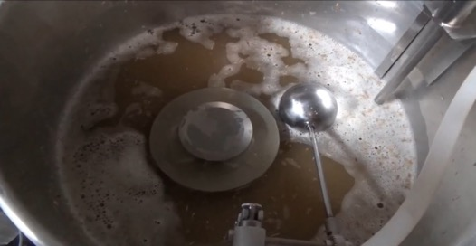
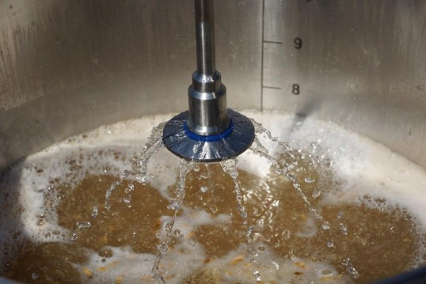
5. FLY SPARGING
Those are pretty cool fly sparging setups!
Just not needed for 5-10 gallon batches
Sudzer suggestion: 1) Batch sparging works, no-sparge is better
2) Incremental batch sparges can help
3) IF you have the time – go for it!

Slide 9
And finally, those things that ARE important
Water profile that matches the beer style
Temperature control during the mash
Temperature control during fermentation
Pitching rate -- for your style
Oxygen-free environment is best for grain and beer freshness.* Oxygen is ONLY your friend when pitching yeast
HAVING FUN!
*https://www.winning-homebrew.com/low-oxygen-brewing.html

